Slide 1
Supply Chain Standards
Cybersecurity and Digitalization:
Supply Chain Risks in the Electricity Sector
Frances Cleveland
Gian Luigi Pugni

Slide 2
Agenda: Supply Chain Standards for Electric Power Utilities
Focus on Electric Power Utility supply chain issues in the operational environment
Cover internationally accepted standards and guidelines relevant to identifying and managing cybersecurity risks associated with the supply chain risk from third-parties / suppliers and will provide a survey of these documents (e.g., the U.S. National Institute of Standards and Technology [NIST] Cybersecurity Framework, NIST SP800-161, ISO/IEC 27036-1:2021, NISTIR 8276).
Address different approaches and considerations that utilities should take into account based on their context (e.g., generation, transmission, distribution, DER aggregators).

Slide 3
Overview of Cyber Security Standards and Guidelines
The key IEC, ISO, IEEE, NIST, NERC, and IETF cyber security standards and best practices are shown in the diagram, organized by type (What, How, Process towards Compliance) and by Focus Area (High general level, High energy-specific level, Detailed technical level).

Slide 4
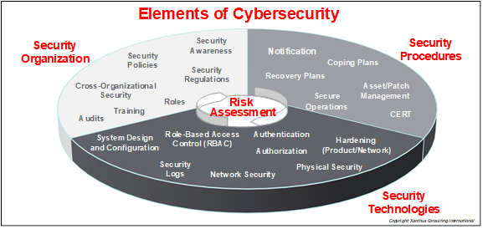
Elements of Cybersecurity: Organization, Procedures, and Technologies, based on Risk Assessment

Slide 5
What is Unique about Supply Chain Standards?
Most cybersecurity standards focus on what a single organization needs to do to secure their own people, systems, and operations.
Supply Chain security issues, by definition, involve multiple organizations
  Procurement of products from other organizations.
  Utilization of external communication networks and services, such as markets and cloud services.
  Interactions with personnel from other organizations: vendors, plant operators, aggregators, and customers.
  Incorporation of equipment from other organizations into power system operations, such as generating plants and distributed energy resources.

Slide 6
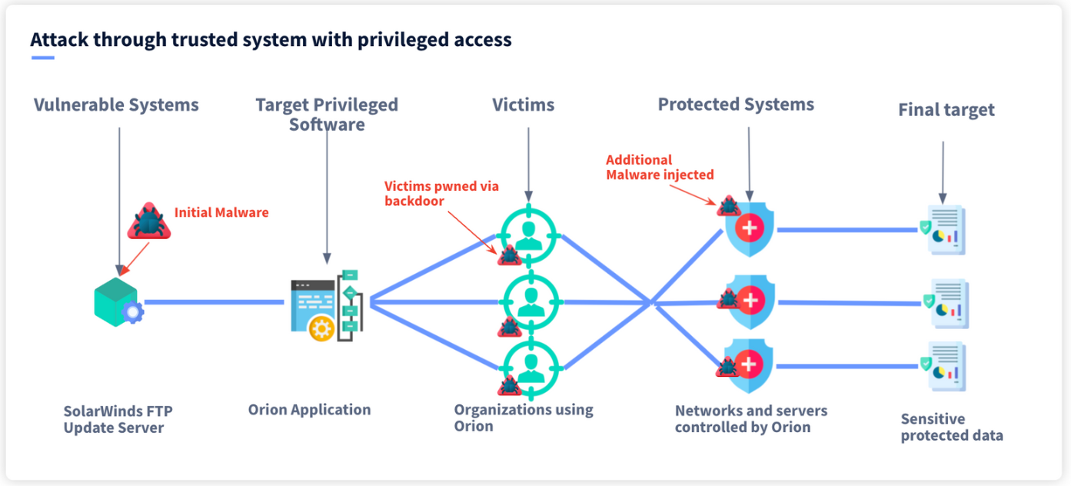
What are the Supply Chain Risks?
Utility purchases energy management products from vendors who have deliberately or accidentally incorporated malicious code into their systems.
Utility interfaces to 3rd party products which contain malicious code.
Utility develops software using code from compromised sources.
Utility installs 2 software/firmware patches with malicious code that is undetected: only detectable with both patches applied.
3rd parties connect to utility operations without adequate access control, authentication, or authorization.
Supplier cannot provide products to utility in a timely manner due to their supply chain problems.
Supplier provides lower quality or even counterfeit products due to their supply chain problems.
Natural disasters physically disrupt the development and/or delivery of products.
Regulatory changes affect delivery of systems – timing and/or quality.
Cloud services experience cyber attacks, impacting sensitive data and power system operations.
Malicious code impacts:
  Allows sensitive information to be stolen.
  Affects power system operations, causing power outages, frequency or voltage problems, equipment failures, or even safety issues.
  Affects power markets so that subtle changes allow one market participant to gain more than the rules permit.
  Affects customer’s appliances, causing utility loss of reputation even if they pay for damaged appliances.

Slide 7
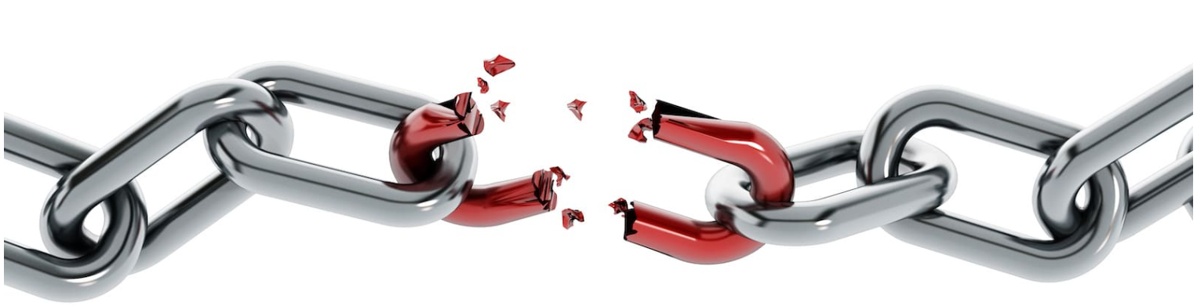
What are the Supply Chain Vulnerabilities?
Utility fails to have comprehensive Security Policies for their OT systems (ISO/IEC 27019, IEC 62443, NIST CSF, NERC CIPs, etc.)
Utility fails to have a supply chain policy for their procurements
Utility fails to check on their vendors’ supply chain policies
Utility fails to test vendor products for common malware
Utility fails to request the vendor to validate software systems and patches
Utility fails to test the cybersecurity of vendor products including interfaces with utility equipment
Utility fails to have multiple vendors able to supply similar products
Utility fails to use multifactor authentication for access to critical systems
Utility fails to require 3rd party owners and operators of generating plants and distributed energy resources (DER) to implement cybersecurity before connecting to the power system
Utility fails to have cybersecurity contractual agreements on responsibilities and actions with 3rd party aggregators and DER owner/operators
Utility fails to have plans for operations during natural disasters and recovering after such events

Slide 8
What are Some Key Actions to Address these Supply Chain Vulnerabilities?
Risk Assessment (see later slides)
Use of power system monitoring to detect and log possible cyber attacks
Cybersecurity requirements and testing certification for all interconnecting systems and personnel
Cross-organizational contractual agreements on responsibilities and actions of all parties
Role-Based Access Control (IEC 62351-8) for all external parties
Gateways with strong security (next slide)
Example: Role-Based Access Control

Slide 9
What are Some Key Actions to Address these Supply Chain Vulnerabilities?
Example DER architecture with gateways

Slide 10
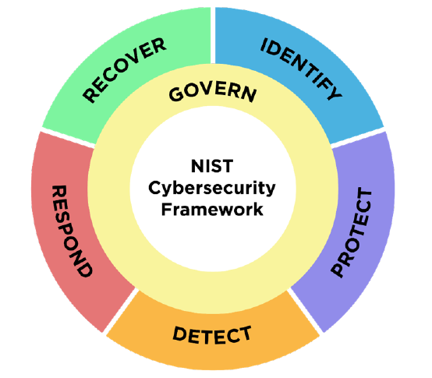
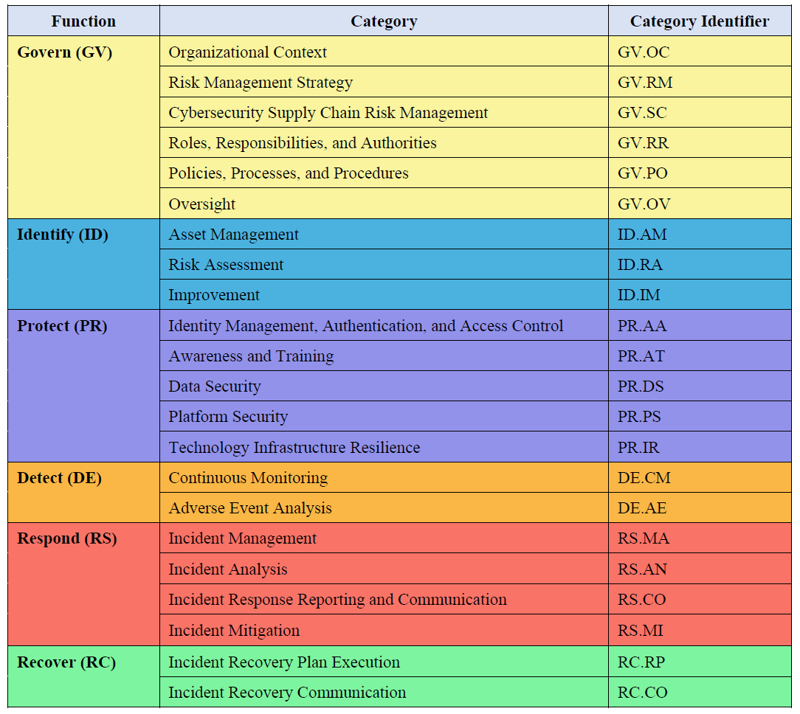
NIST Cybersecurity Framework 2.0 (draft)
GOVERN (GV) – Establish and monitor the organization’s cybersecurity risk management strategy, expectations, and policy.
IDENTIFY (ID) – Help determine the current cybersecurity risk to the organization.
PROTECT (PR) – Use safeguards to prevent or reduce cybersecurity risk.
DETECT (DE) – Find and analyze possible cybersecurity attacks and compromises.
RESPOND (RS) – Take action regarding a detected cybersecurity incident.
RECOVER (RC) – Restore assets and operations that were impacted by a cybersecurity incident.

Slide 11
Standards on Third-Party Risk Management and Cyber Risk Assessment Methodologies
Gian Luigi Pugni

Slide 12



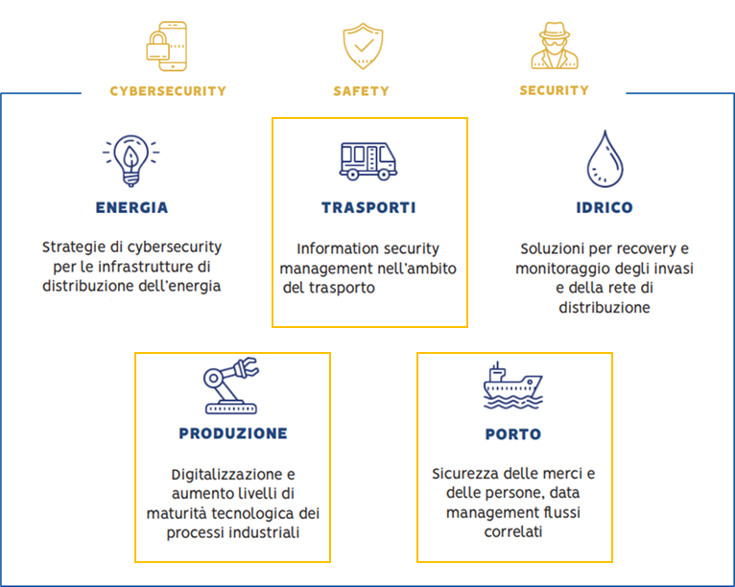
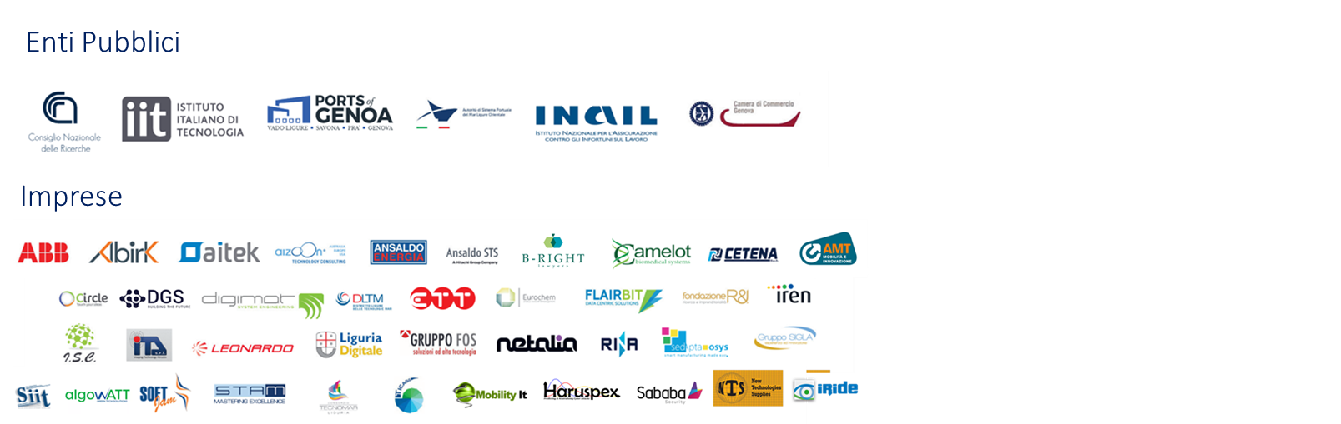
Competence Center START 4.0
www.start4-0.it
www.start4-0.it
Notes:
Già prima, ma ancor più a seguito delle innovazioni introdotte dalla cosiddetta quarta rivoluzione industriale, il settore delle costruzioni si è riconfermato come uno degli elementi propulsori dello sviluppo economico intrinsecamente interconnesso con diverse soluzioni dell’industria 4.0. L’Associazione START 4.0 ha nel proprio DNA, in qualità di centro di competenza promosso dal MISE nel Piano Nazionale I4.0, la mission di supportare le imprese e le PA nel trarre vantaggio da questa quarta rivoluzione industriale più che esserne spettatori. Come lo facciamo? Aggregando l’expertise tecnologica di una rete di soggetti pubblici e oltre 40 tra grandi imprese e PMI, per abilitare e trasferire l’innovazione su cinque domini applicativi
Domini in cui, come dappertutto, è pervasiva la presenza di asset costruiti e dove la transizione digitale ed ecologica pone imprese ed enti di settore di fronte a obiettivi particolarmente sfidanti, oltre che a grandi opportunità

Slide 13
Topics
Risk assessment for Energy Systems with the goal of Business Continuity
Adoption of company policy and guidelines in Supply Chain management: Cybersecurity Supply Chain Risk Management (C-SCRM)

Slide 14
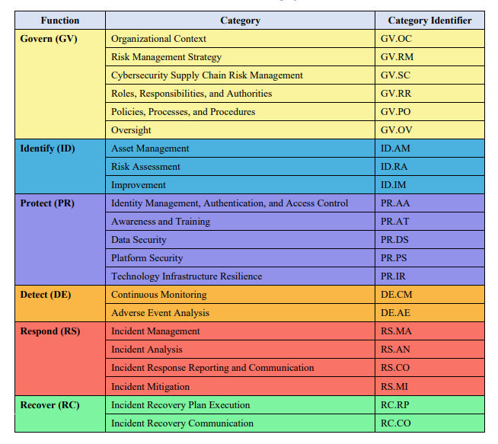
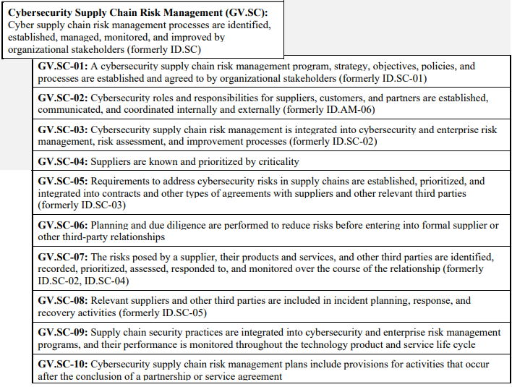
NIST 2.0 Framework draft perspective
Source: Public Draft: The NIST Cybersecurity Framework 2.0 – NIST -August 8, 2023 https://csrc.nist.gov/pubs/cswp/29/the-nist-cybersecurity-framework-20/ipd

Slide 15
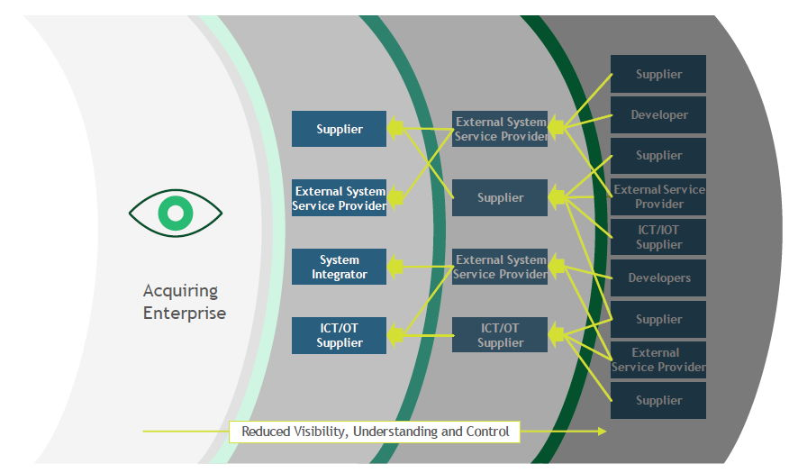
Enterprise supply chain
Source: NIST SP 800-161r1

Slide 16
Enterprise supply chain
The Supply Chain is a set of complex, globally distributed and interconnected resources and processes.
Cyber ​​SCRM is the set of activities necessary to manage the Cyber ​​Security risk associated with external parties.
This is needed to:
Determine Cyber ​​Security Requirements for Suppliers
Implement requirements through formal agreements (e.g. contracts)
Communicate to suppliers how these requirements will be verified and validated
Verify that cybersecurity requirements are met through a variety of assessment methodologies
Maintain and improve continuously this process as part of cyber security process
Source: NIST SP 800-161r1

Slide 17
Governance Risk & Compliance management
Supply Chain Risk management
NIST SP 800-161r1
Regulatory requirements
(NERC CIP, NIS2, …)
NIST Framework
Requirement Standards
(IEC 62443, ISO 27K, …)
Roles and Responsabilities
Policy and Guidelines
Risk management
ISO/IEC 31010
Technical Standards
(IEC 62351, …)
Asset Management process
Governance Risk & Compliance
Risk Assessment & management process
Dashboards
Evolution planning
Compliance report
Compliance
Business Continuity
Conformance

Slide 18
Policy and Guidelines – concept and examples
Global Policy
Identity and Access Management
Role Based Access Control
Physical Security
Network Security
Asset management
Security Monitoring
Business Continuity requirements
Data Classification
Specifications on
context requirements
Authentication requirements
Data protection and encryption
Physical monitoring for Substations
PKI Systems requirements
Monitoring of OT networks
OT/IoT Cyber Security requirements
Network Segregation in OT environments
IaaS cloud security requirements
Specific context technical specifications & guidelines
AD architecture structure and procedures
IEC 62351 implementation guide
Monitoring of OT networks
Firewall configuration profiles
Certification Authority CP and CPS
Monitoring of OT networks
IaaS Security zones configuration and management

Slide 19
Policy and Guidelines – concept and examples
It must be defined and well communicated Who is responsible of issuing, maintenance and deployment
Context requirements and technical specifications will feed the afterward supply chain processes and can incorporate controls from requirement standards (e.g., IEC 62443) or technical standard (e.g., IEC 62351).
Each control responsibility should be clearly assigned to specific actors of the supply chain (client, integrator, manufacturer, service provider)
Global Policy
Identity and Access Management
Role Based Access Control
Physical Security
Network Security
These are “the rules of the game” that must be valid for the whole supply chain (both for suppliers or clients)
Asset management
Security Monitoring
Business Continuity requirements
Data Classification
Policy and guidelines are guided by:
Regulatory requirements
Standard and best practices
yet must reflect the company reality
Specifications on
context requirements
Authentication requirements
Data protection and encryption
Physical monitoring for Substations
PKI Systems requirements
Monitoring of OT networks
OT/IoT Cyber Security requirements
Network Segregation in OT environments
IaaS cloud security requirements
Must be shared, agreed and adopted in the product/service procurement phase
and in internal solution development
Specific context technical specifications & guidelines
AD architecture structure and procedures
IEC 62351 implementation guide
Monitoring of OT networks
Firewall configuration profiles
Certification Authority CP and CPS
Monitoring of OT networks
IaaS Security zones configuration and management
Represent the basis for certification and Audit processes

Slide 20
C-SCRM Lifecycle – Agree with suppliers on…
Manufacturer/provider
Qualification
Purchase (tender) for product/service
Development and deployment of the solution
Maintenance
Decommissioning
Certifications
Competences and contribution on Cybersecurity standards and best practices
Better to share at this stage policy and guidelines
Share the expected standard compliance (e.g. IEC 62443, ISO 27K)
Risk assessment
Technical standard periodical Audit clause
HR requirement
Vulnerability and event notification
Lifecycle clauses (patching, maintenance, decommissioning)
SLA with attention to Business Continuity
Info sharing agreement
Security by design, standard based development or integration
Vulnerability Assessment on development and pre deployment
At this stage Policy, and technical specification based on standard (e.g IEC 62351) must be commonly adopted
Business Continuity process regular testing
Patching / maintenance process
Regular Audit on product / systems and services
Monitoring of events -> incident detection
Asset management
CERT/CSIRT process with asset responsibility
Secure Information back transfer
Cleanup of devices and supplier data base

Slide 21
Risk management ISO 31000 process and supply chain
Scope, context and criteria
Enterprise Policies must consider Business process relationship with supplier, customers and all stakeholders
Since vendor qualification stage the context will enrich
For every new product, system, service the contex will change
New Business processes will change the scope
At this stage the reference contacts for afterwards steps must be agreed
Risk Assessment
Risk identification
Risk Analysis
Communication ad consultation
Monitoring and review
Risk Evaluattion
Risk Treatment
Residual Risk acceptance

Slide 22
Risk management ISO 31000 process and supply chain
Scope, context and criteria
ISO 31010 provides several example metodologies for Risk Identification, Analysis and Evaluation. NIST SP 800-161r1 provides specific practices for C-SCRM
Questionaire, interviews but also statistical information. Best should be using common and standard tools. Perceived Risk is normaly unreliable.
Data from monitoring and Review subprocess are essential, but also a tools and metodologies to collect them (inside company and from supplier).
Information Sharing with all sector stakeholders, and authorities is important
Risk Assessment
Risk identification
Risk Analysis
Communication ad consultation
Monitoring and review
Risk Evaluattion
Risk Treatment
Residual Risk acceptance
Source: ISO IEC 31010 and ISO 27005

Slide 23
Risk management ISO 31000 process and supply chain
Scope, context and criteria
Risk Assessments results may require to be: Avoid, Transfer, Mitigate or Accept every specific Risk.
In a multilevel SC Risk Transfer is needed and must me specified in the contract agreement: Policy and Technical specification must be clear in defining roles between parties (e.g. CERT relationships).
Requirement and Technical standard are fundamental to build Company technical specifications
Product, maintenance and Service supply require quite different approach.
Risk Assessment
Risk identification
Risk Analysis
Communication ad consultation
Monitoring and review
Risk Evaluattion
Risk Treatment
Residual Risk acceptance
Source: ISO IEC 31010 and ISO 27005

Slide 24
C-SCRM additional elements
Regulatory compliance requirements:
NERC-CIP
NIS, NIS2
GDPR
RED directive
EC Cyber Resilience Act (upcoming)
…
Strict requirements for services and products:
Notification timing for discovered vulnerabilities and incidens
Product/service 3party certification
Lifecycle duration for maintenance
…
Difficult to comply and be aware to everything expecially for small companies. To overcome this problem is possible :
adopt collaborative model based on Competence Centers
enter Information Sharing groups like EE-ISAC
OT environment specific complexity:
extended solution lifecycle (15-20y) compared with IT systems
Very distributed environment
Relationship
Open source based solutions, responsibilities, and compliance to upcoming regulations.
Information Sharing

Slide 25
References and contacts
NIST SP 800-161r1, Cybersecurity Supply Chain Risk Management Practices for Systems and Organizations, May 2023, https://nvlpubs.nist.gov/nistpubs/SpecialPublications/NIST.SP.800-161r1.pdf
NIST CSF v2.0, https://www.nist.gov/system/files/documents/2023/01/19/CSF_2.0_Concept_Paper_01-18-23.pdf, https://www.nist.gov/news-events/events/2023/09/journey-nist-cybersecurity-framework-csf-20-workshop-3
EE-ISAC, European Energy Information Sharing & Analysis Centre: https://www.ee-isac.eu/

Slide 26
Thank You
Frances Cleveland, Xanthus Consulting International
fcleve@xanthus-consulting.com
Gian Luigi Pugni, Competence Center START 4.0
glpugni@gmail.com

