Slide 1
Cyber-Informed Engineering
Cybersecurity and Digitalization:
Supply Chain Risks in the Electricity Sector

Slide 2
What is Cyber-Informed Engineering?
Water Booster Pump Station

Slide 3
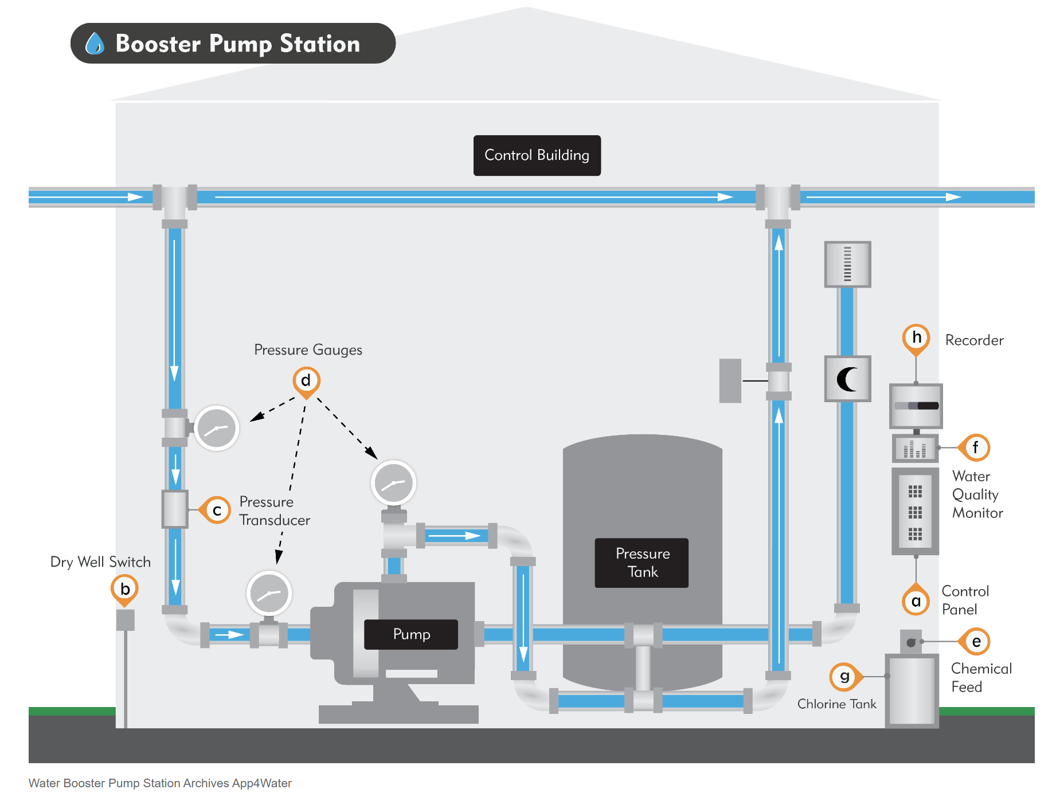
Water Booster Pump Station
https://bmxlovesk.xyz/product_details/13200675.html

Slide 4
Water Booster Pump Station
Cloud-based monitoring and control
https://bmxlovesk.xyz/product_details/13200675.html

Slide 5
Water Booster Pump Station
Cloud-based monitoring and control
https://bmxlovesk.xyz/product_details/13200675.html
Mechanical Time Delay Relay

Slide 6


Cyber-Informed Engineering (CIE)
CIE uses design decisions and engineering controls to eliminate or mitigate avenues for cyber-enabled attack.
CIE offers the opportunity to use engineering to eliminate specific harmful consequences throughout the design and operation lifecycle, rather than add cybersecurity controls after the fact.
Focused on engineers and technicians, CIE provides a framework for cyber education, awareness, and accountability.
CIE aims to align the culture of security with the existing industry safety culture.

Slide 7
How is it being applied?

Slide 8
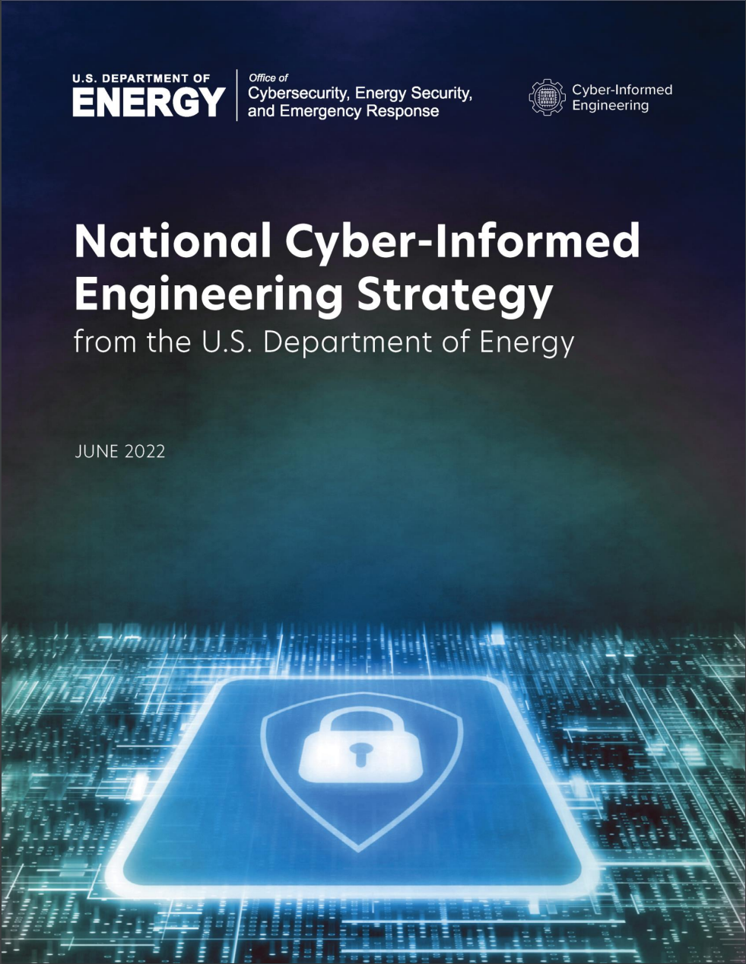
National CIE Strategy
Directed by the U.S. Congress in the Fiscal Year 2020 National Defense Authorization Act
Outlines core CIE concepts
  Defined by a set of design, operational, and organizational principles
  Placed cybersecurity considerations at the foundation of control systems design and engineering
Five integrated pillars offer recommendations to incorporate CIE as a common practice for control systems engineers
  Intended to drive action across the industrial base stakeholders—government, owners and operators, manufacturers, researchers, academia, and training and standards organizations
DOE issued the National CIE Strategy June 15, 2022
CIE has been named in the National Cyber Strategy and the National Cyber Strategy Implementation Plan and in the report on cyber-physical systems by the President’s Council of Advisors on Science and Technology
https://www.energy.gov/sites/default/files/2022-06/FINAL%20DOE%20National%20CIE%20Strategy%20-%20June%202022_0.pdf

Slide 9
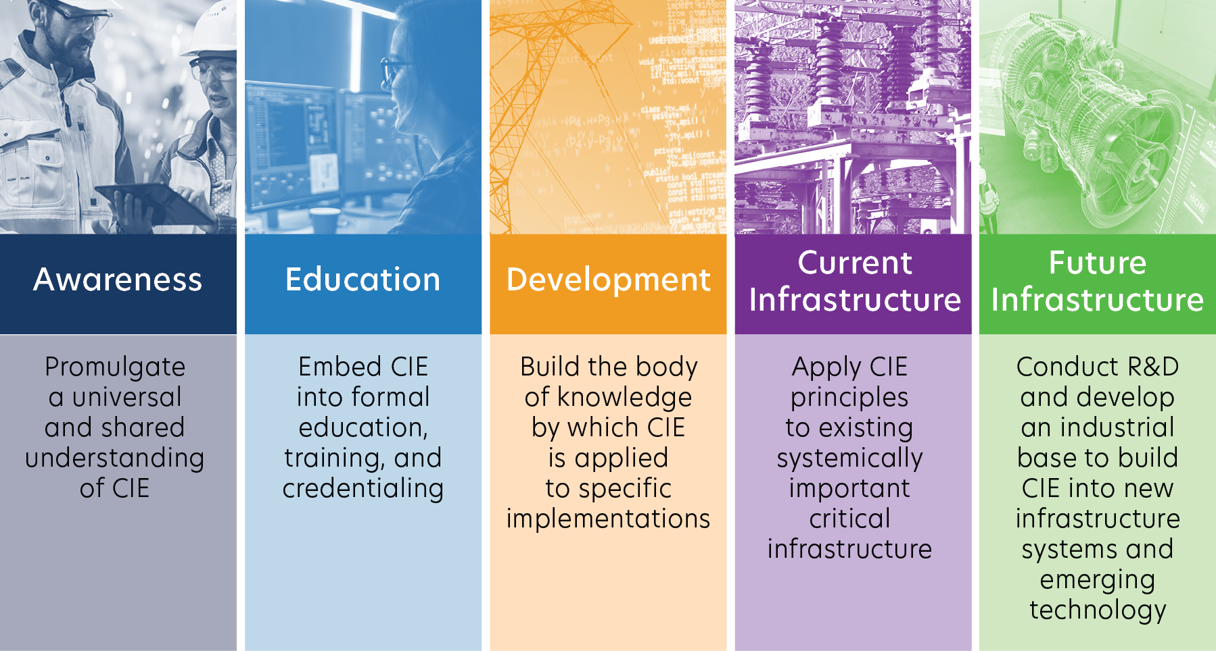
Pillars of the National CIE Strategy

Slide 10
CIE Principles
Principle | Key Question
Consequence-Focused Design | How do I understand what critical functions my system must ensure and the undesired consequences it must prevent?
Engineered Controls | How do I implement controls to reduce avenues for attack or the damage which could result?
Secure Information Architecture | How do I prevent undesired manipulation of important data?
Design Simplification | How do I determine what features of my system are not absolutely necessary?
Layered Defenses | How do I create the best compilation of system defenses?
Active Defense | How do I proactively prepare to defend my system from any threat?
Interdependency Evaluation | How do I understand where my system can impact others or be impacted by others?
Digital Asset Awareness | How do I understand where digital assets are used, what functions they are capable of, and our assumptions about how they work?
Cyber-Secure Supply Chain Controls | How do I ensure my providers deliver the security we need?
Planned Resilience | How do I turn “what ifs” into “even ifs”?
Engineering Information Control | How do I manage knowledge about my system? How do I keep it out of the wrong hands?
Cybersecurity Culture | How do I ensure that everyone performs their role aligned with our security goals?

Slide 11
CIE COP and Working Group Purpose
Cyber-Informed Engineering COP
Quarterly
11 AM ET on the 2nd Wednesday of January, April, July, and October
CIE Standards WG
Monthly
1st Wednesday, 9 AM MT / 11 AM ET
CIE Education WG
Monthly
3rd Wednesday, 9 AM MT / 11 AM ET
CIE Implementation WG
Monthly
4th Wednesday, 9 AM MT / 11 AM ET
Support integration of CIE into engineering and cybersecurity standards
Develop curricula and materials that integrate CIE principles into engineering degree programs
Multi-stakeholder team to aid the translation of CIE into technical requirements that can inform guidance, practices, and standards development
Develop CIE implementation guidance and an open-source library of resources
Notes:
In 2023, CESER through the national labs initiated a CIE community of practice and multiple working groups in response to the strategic recommendations to 1) lead a CIE awareness campaign to support a shift in the culture of energy infrastructure engineering and operations, and 2) Develop policy initiative and build partnerships to incentivize the broad adoption of CIE in the energy industry. The COP’s aid CESER and the labs to understand the needs of universities, standards organizations, asset owners, engineering design organizations and vendors and tool providers for the energy sector.

Slide 12
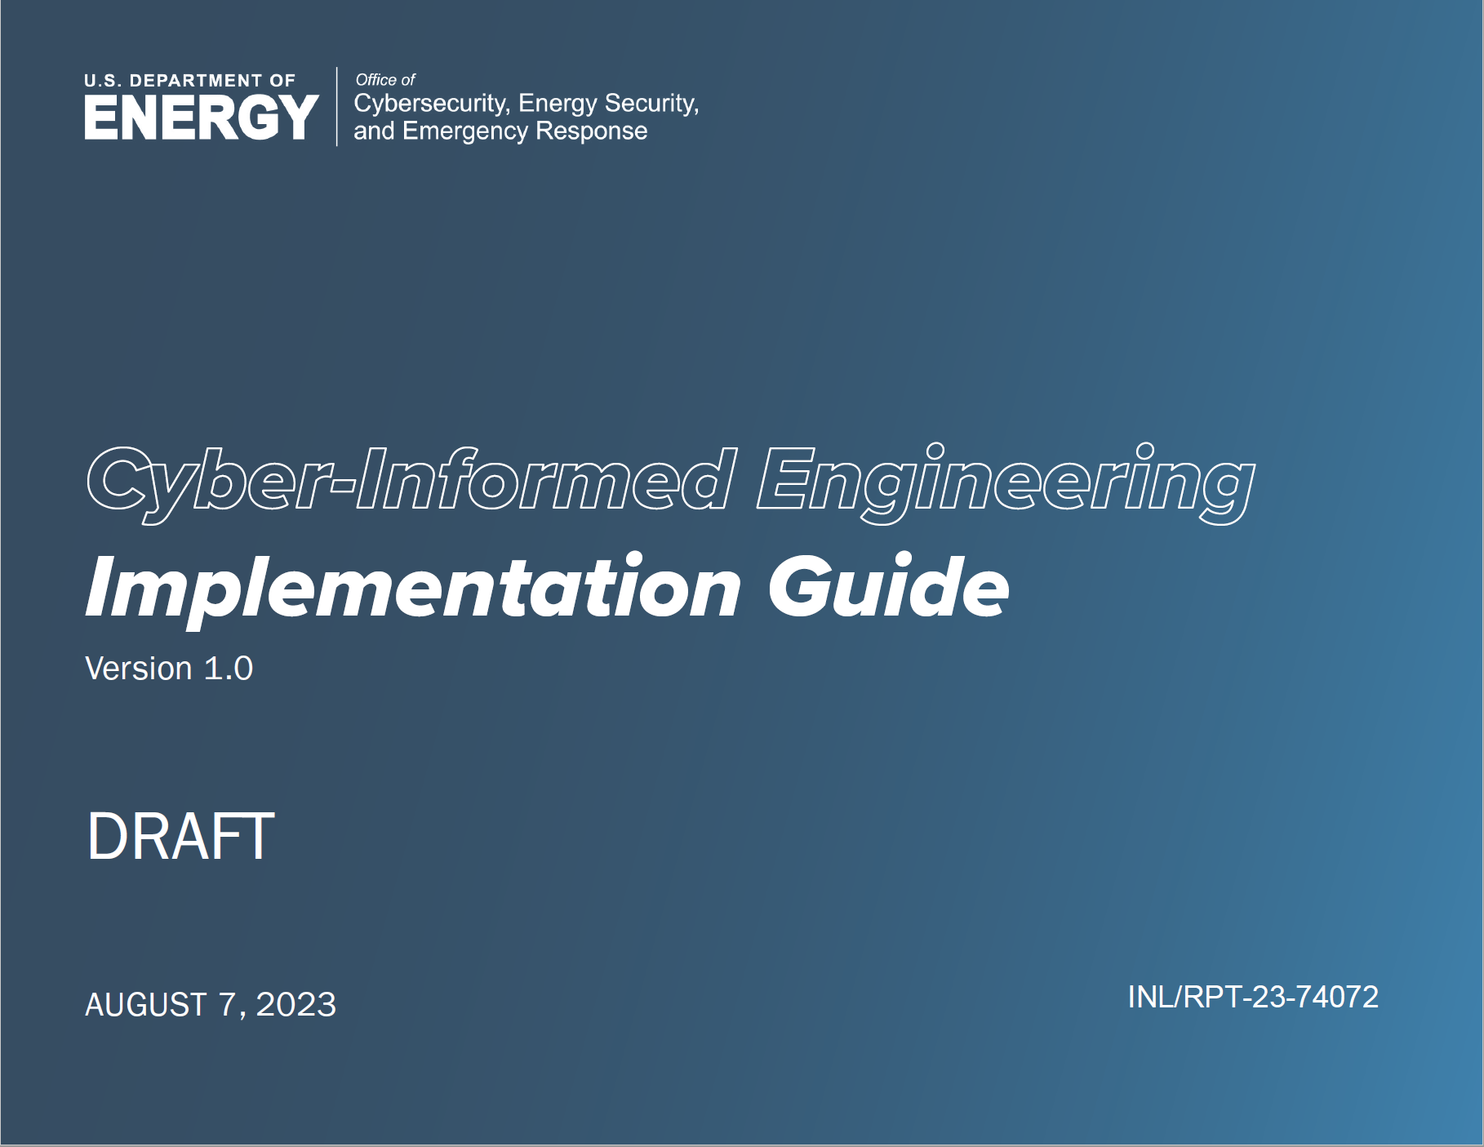
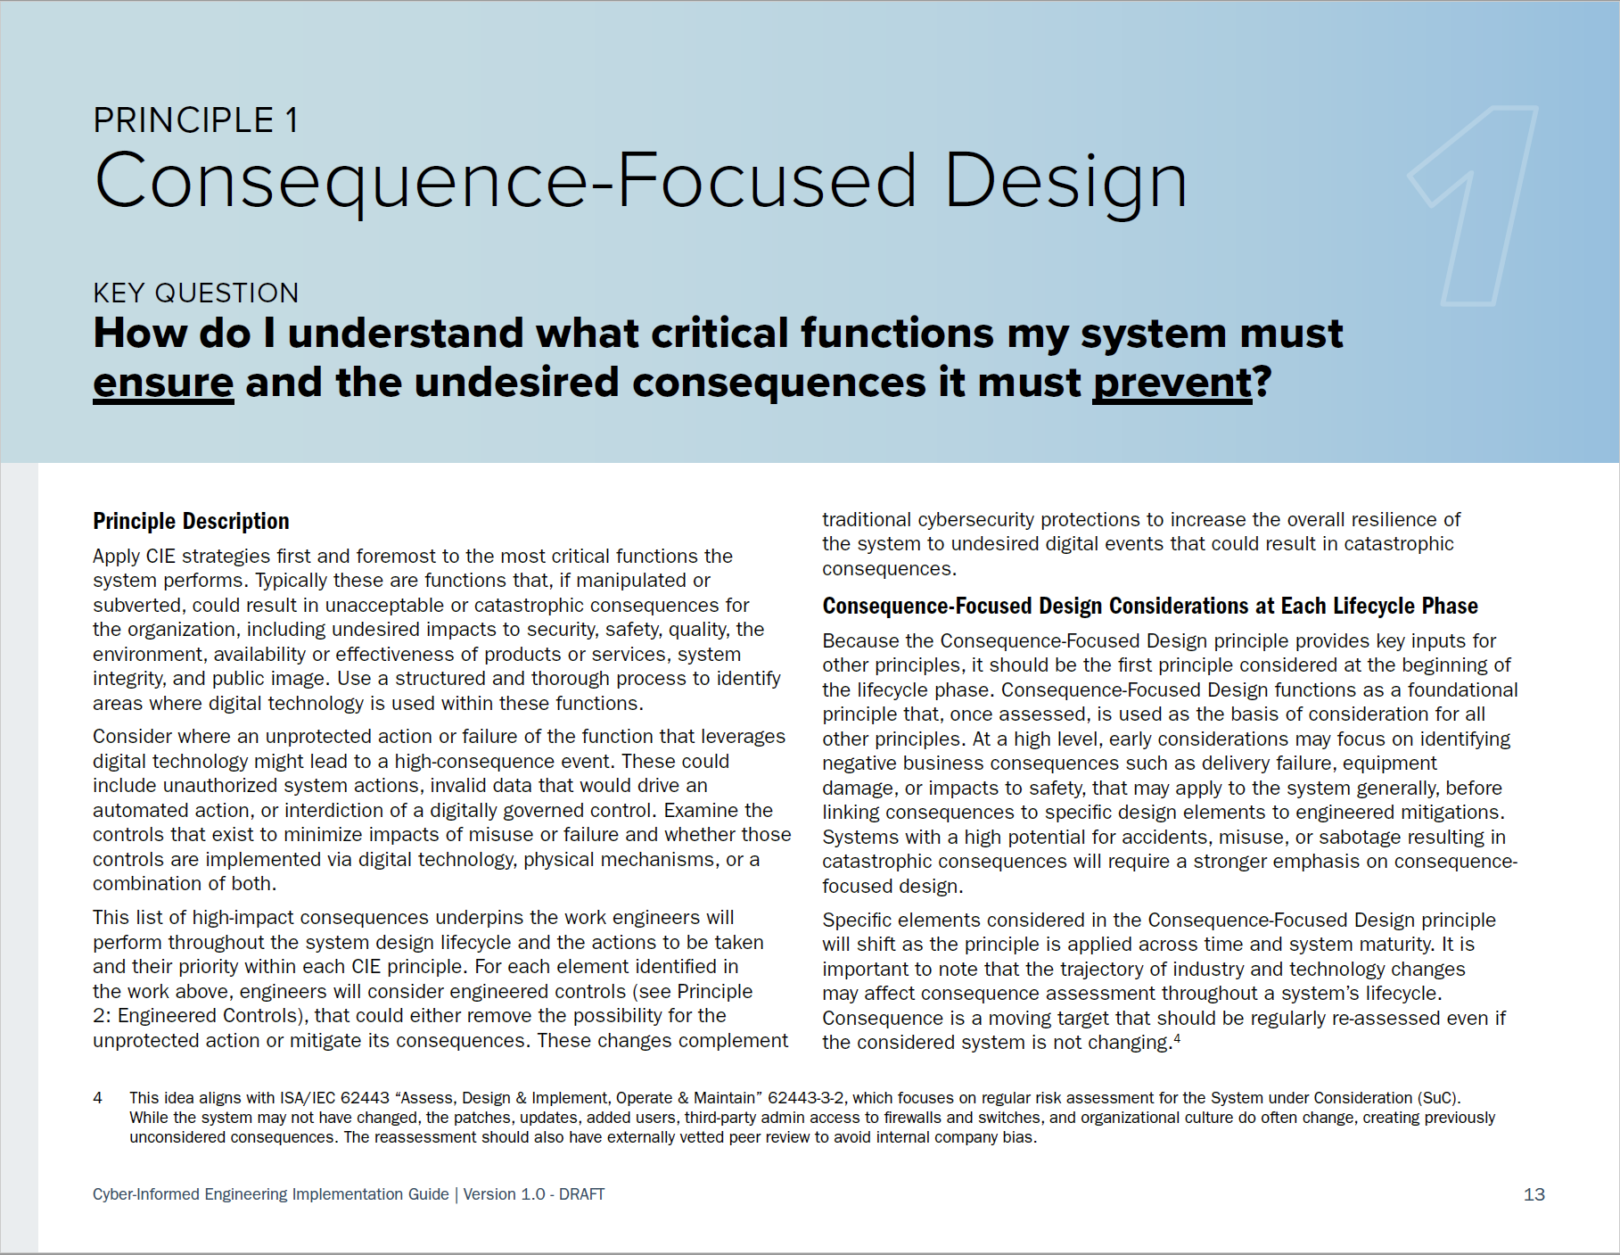
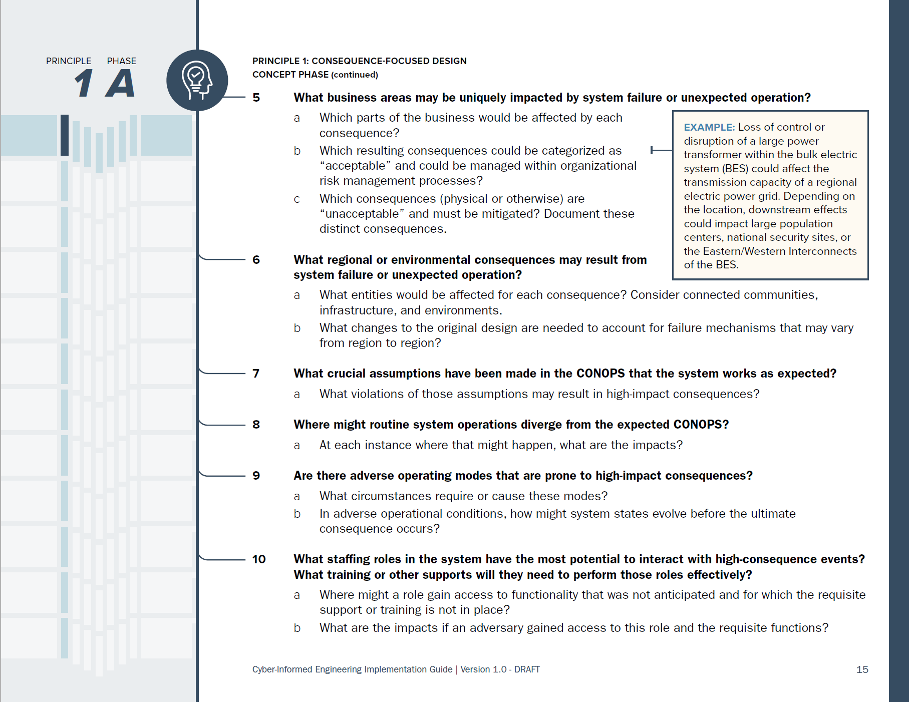
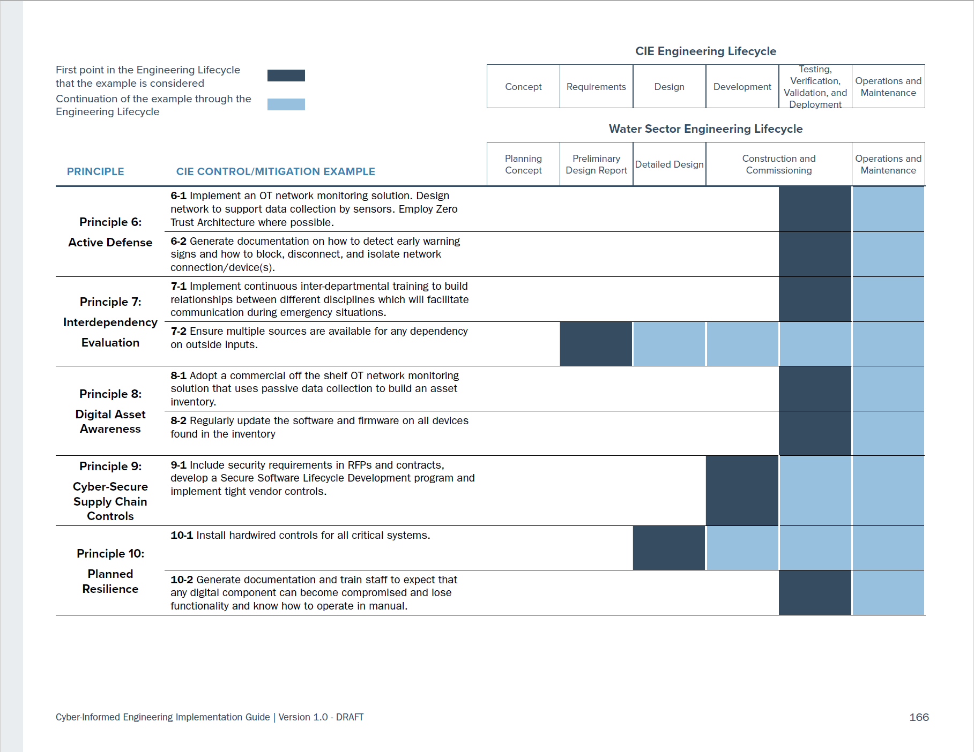
CIE Implementation Guide
https://www.osti.gov/servlets/purl/1995796
Notes:
In the appendix of the implementation guide is an example of CIE applied to a water-sector project. In that case study, a specific system is examined, with specific system consequences and the engineered solutions to mitigate them that the team creates. This example allows teams to explore what implementation of CIE on their systems engineering projects might look like.

Slide 13
Recent CIE Publications
Websites
DOE CESER CIE Website -- https://www.energy.gov/ceser/cyber-informed-engineering
INL CIE Website - https://inl.gov/cie/
NREL CIE Website - https://www.nrel.gov/security-resilience/cyber-informed-engineering.html
Publications
CIE Implementation Guide: Cyber-Informed Engineering Implementation Guide (Program Document) | OSTI.GOV
CIE Workbook (Distribution, ADMS): https://www.osti.gov/biblio/1986517
CIE Workbook (Microgrids): https://www.osti.gov/biblio/2315001
Articles and Briefings
SANS ICS Concepts Video: https://youtu.be/o_vIxW6UTeg
Industrial Cyber: CIE and CCE Methodologies Can Deliver Engineered Industrial Systems for Holistic System Cybersecurity (June 11, 2023) with interviews from INL, 1898, and West Yost
Harvard Business Review: Engineering Cybersecurity into U.S. Critical Infrastructure (April 17, 2023) by Ginger Wright, Andrew Ohrt, and Andy Bochman
Shift Left video podcast on GrammaTech blog: Shifting Left for Energy Security (April 4, 2023) with Ginger Wright, Idaho National Lab and Marc Sachs, Auburn University
For more CIE articles and publications, visit: inl.gov/cie

Slide 14
Thank you!
To Join our Communities of Practice or ask questions about CIE, please email: CIE@INL.gov

Slide 15
Current Activities
Working with Standards Bodies
  IEEE PES, and others
  ISA99 – 62443
Working with Universities
  Developing curriculum guidance
  Incorporating CIE into engineering education
Working with Asset Owners
  Incorporate CIE into ongoing efforts
  Refine products
  Templates for cyber-informed designs
Notes:
Working with Standards Bodies to link Cyber-Informed Engineering with existing Standards

Slide 16
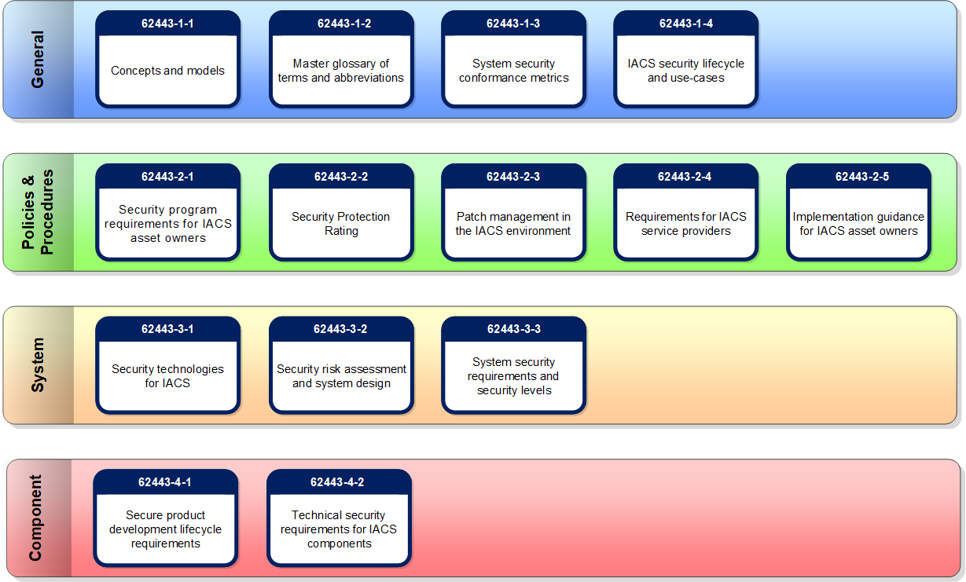
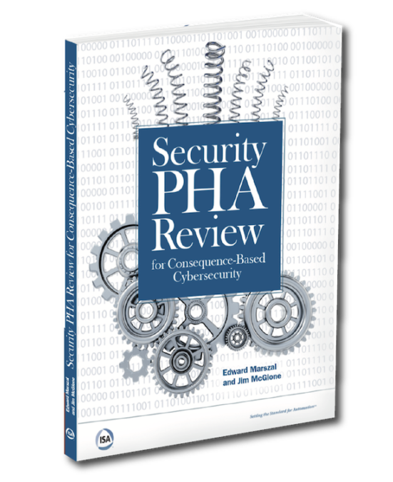
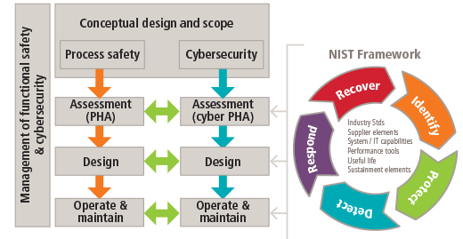
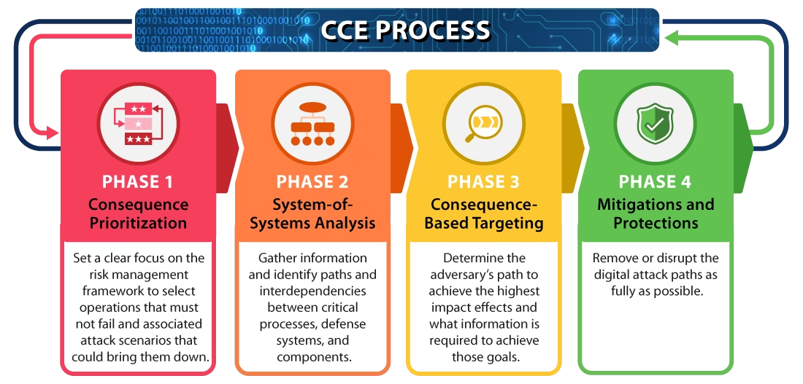
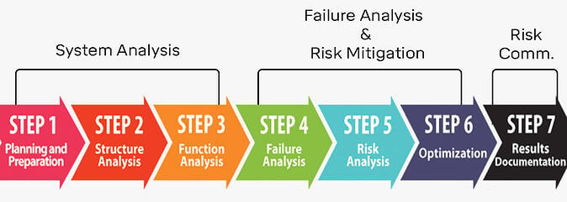
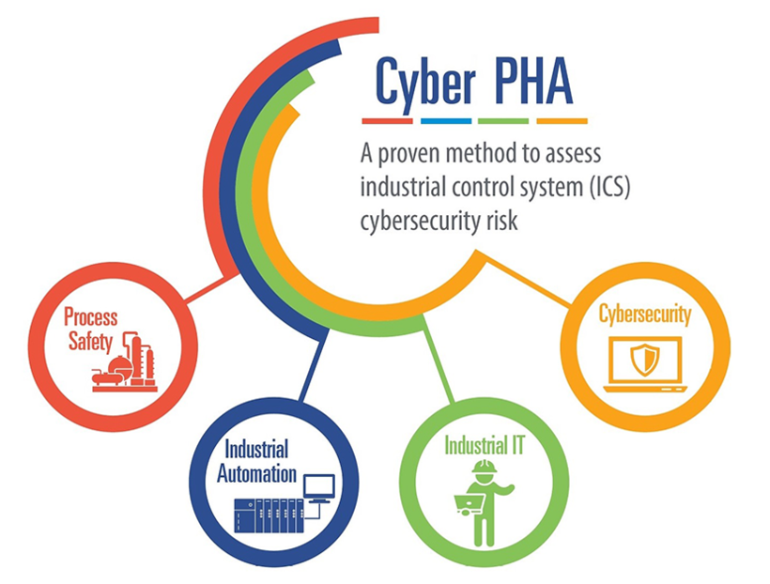
OK, But How Do You CIE?

