Slide 1
Cybersecurity Incident Response Plan Development
Incidence Response through Supply Chain Preparedness: The GRIDCo Case Study

Slide 2
Table of Contents
Intro & Background – GRIDCo
Considerations for OT Security
GRIDCo’s OT Incident Management
SCADA Upgrade Case Study
Q&A

Slide 3
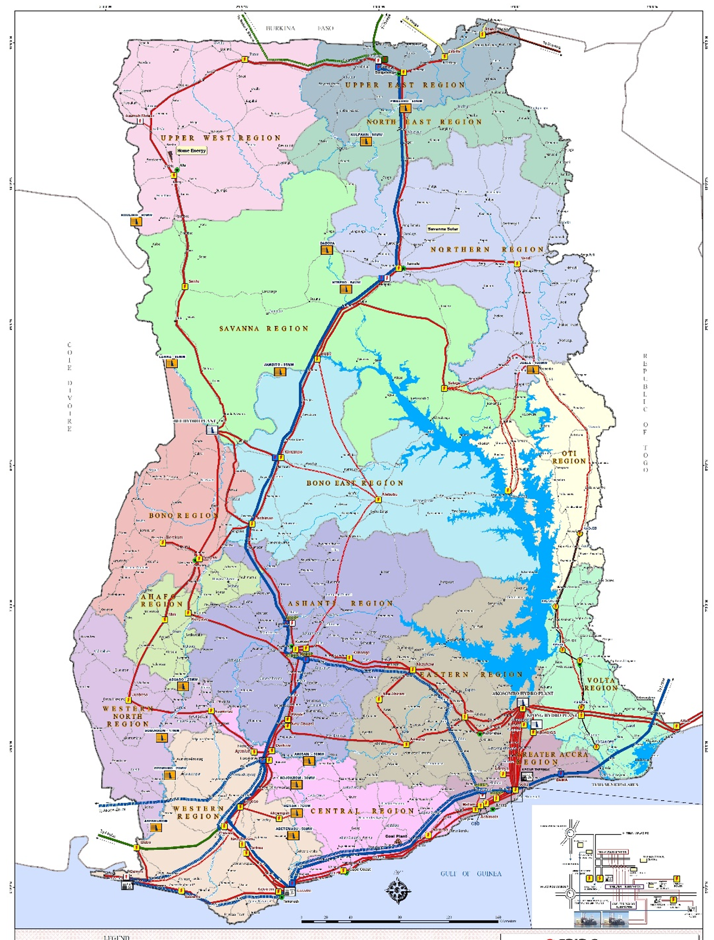
Introduction: The Power System
32 Bulk Customers
10 Generating Companies (incl. IPPs)
5,231 MW installed generation capacity (3 Hydro, 13 Thermal & 2 Solar Plants)
6,472.23 Circuit-km of transmission lines (69 kV, 161kV, 225kV & 330 kV) with about 70% fiber-optically equipped
Peak Demand – 3,618 MW in December 2023

Slide 4
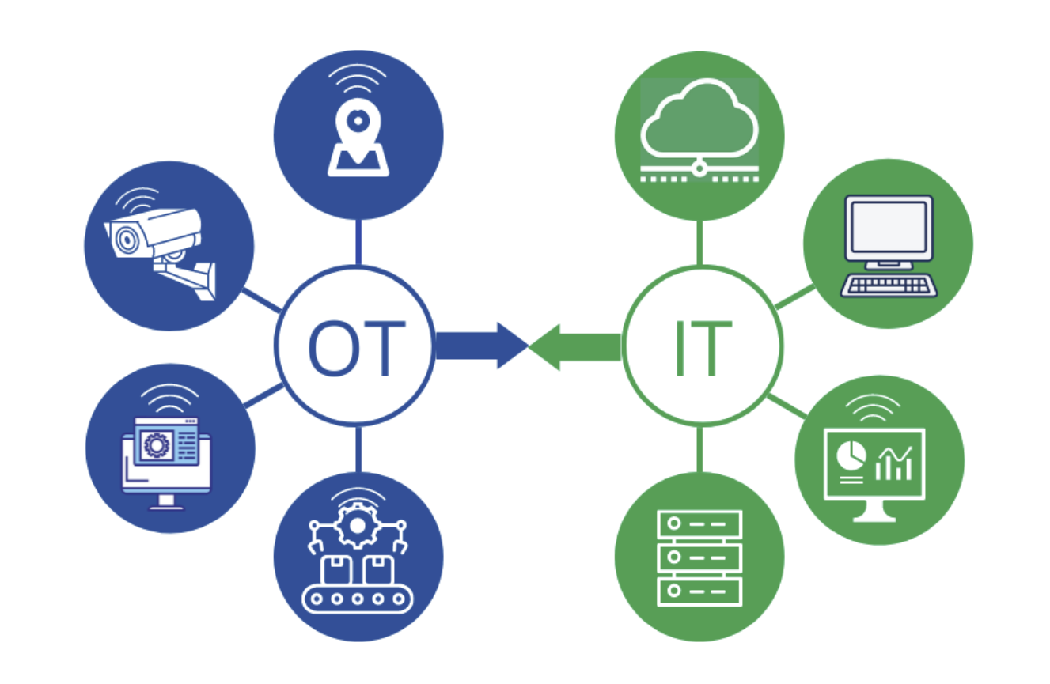
Introduction: Background Information
GRIDCo Operates both IT and OT Infrastructure
GRIDCo is Interconnected with Cote D’Ivoire, Burkina Faso, Togo, Benin
Potential Impact of Outages
Financial Loss of Millions of USD daily
Negative impact on GDP as ~80% of National production depends on Electricity
Sub-regional security stability

Slide 5
Considerations for OT Security and Incident Management [to establish basis for IRP]
Threat actors can introduce compromised components into a system, unintentionally or by design, at any point in the system's lifecycle.
Attackers set sights on Industrial control systems (ICS) and third parties
Need to understand Supplier's maturity and security processes and products for connected products and services

Slide 6
Considerations for OT Security and Incident Management [OT/ICS cannot be handled the same way as IT]
OT Focus Area
Direct Control of Devices and processes
Reliability and Continuity of Operations
System response times are critical
OT Devices
Customised OS devices running OEM apps, proprietary embedded devices, custom production systems
Refresh cycle sometimes over 20 years
Usually many legacy units
IT Focus Area
Information Management and Security
Digital Technologies
Internet and Connectivity
IT Devices
Commonly connected Windows servers, PCs, mobile devices running OS and Apps
Refresh cycle is 3-5 years

Slide 7
Considerations for OT Security and Incident Management [OT/ICS cannot be handled the same way as IT]
OT Threat Identification
Challenges in identifying domain-specific threats.
Higher exposure to zero-day vulnerabilities, especially in embedded devices
OT Remediation
Complex threat remediation
High operational risk; incorrect actions can halt production for extended periods
IT Threat Identification
Extensive public database for vulnerability identification
Lower zero-day vulnerability exposure
IT Remediation
Simple and more available threat remediation with minimal impact
Lower operational risk

Slide 8
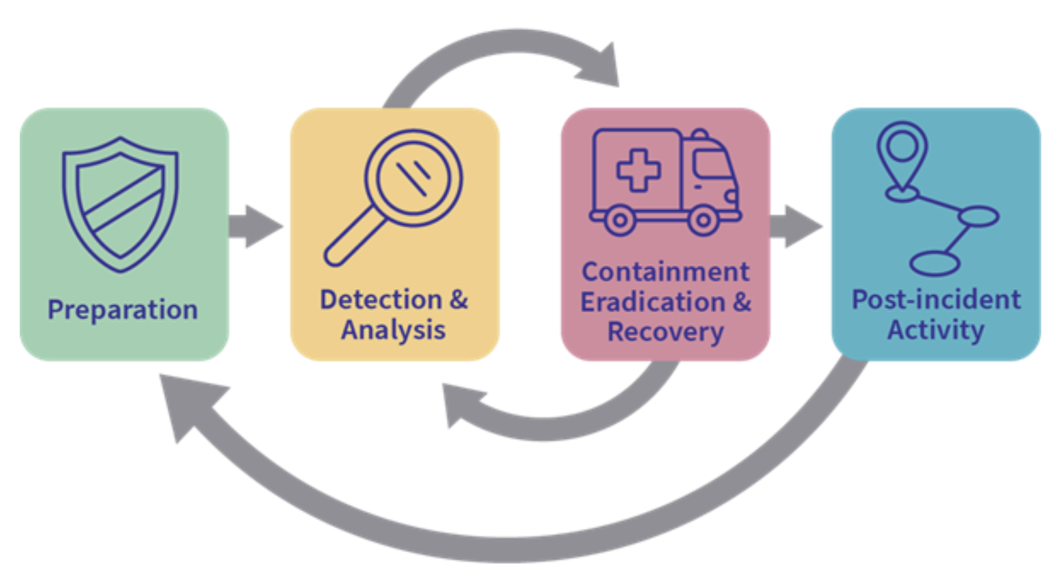
GRIDCo’s OT Incident Management Plan (IMP) – Based on NIST Guide to OT Security (800-82 Rev. 3)
GRIDCo has adopted and follows the NIST Guide to OT Security (800-82 Rev. 3) for incident management.
NIST 800-82r3 builds on the NIST Framework (Identify, Protect, Detect, Respond, Recover)
It’s IMP includes four main stages:
preparation and prevention;
detection and analysis;
containment, eradication, and recovery;
post-incident activity.

Slide 9
GRIDCo’s OT Incident Management
Step 1: Preparation and Prevention.
Preparation is key to an effective response.
Calculate business impacts
Use existing risk analysis.
Identify supporting systems/assets
Triage the Assets [meet 80/48 KPI] – Know and Prioritise Systems that are critical – Control 80% of our operations
95% Certainty of the priority of these Assets

Slide 10
GRIDCo’s OT Incident Management: Calculate business impact, using existing risk analysis
Risk Assessment – critical part of our USAID-sponsored BIP Program.
Engage Relevant Teams (Finance, Procurement, Engineering) to determine estimated value of potential operational losses and restoration costs.
Assess all probabilities and apply them to calculate Business impact, raw impact, and raw Risk Rating
Assess Treatment Cost (and status) and Calculate Target Risk and compare with current risk rating for decision making

Slide 11
GRIDCo’s OT Incident Management
Step 2: Detection and analysis.
Take steps to put security safeguards in place.
Ensure to deploy relevant systems
Vendors must meet GRIDCo’s criteria to qualify Vendor [where we are unsure, vendor makes written commitment]
Implemented Security by Design – Cybersecurity Assessment done with Vendors and Factory Acceptance Testing (FAT) before implementation
Site Acceptance Testing (SAT) not limited to only system functionality, but also CS compliance
CS Awareness programs and simulations

Slide 12
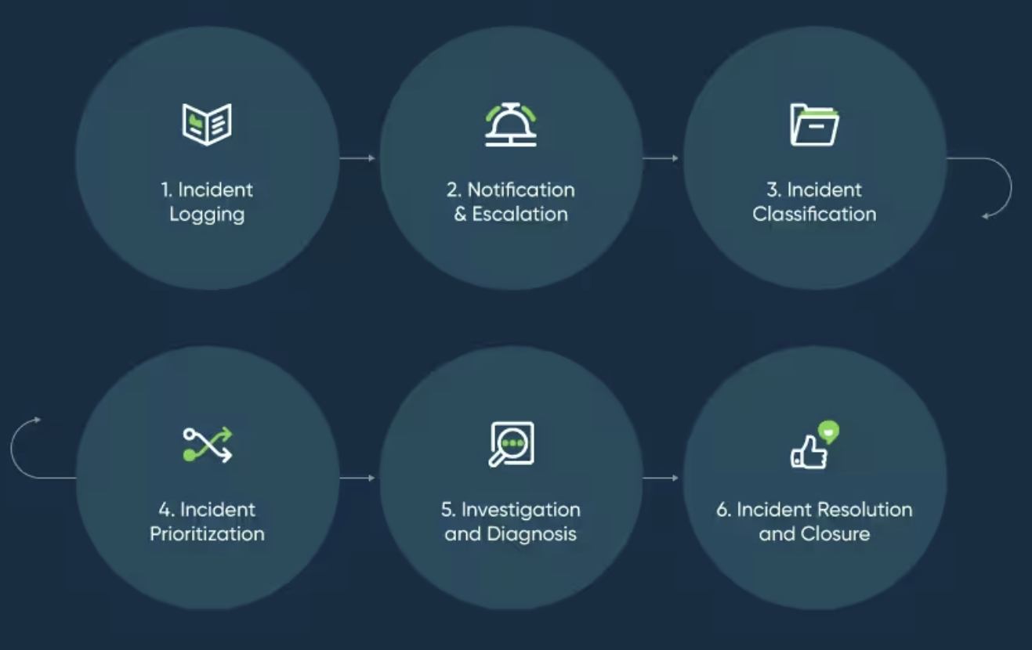
GRIDCo’s OT Incident Management
Step 3: Containment, eradication, and recovery.
Incident Response process is triggered immediately when an issue / suspected issue is picked up.
Incident Reporting process is triggered with the least positive information obtained.
Communicate to Management first. Then industry stakeholders must be informed on a need-to-know basis.

Slide 13
GRIDCo’s OT Incident Management
Step 4: Post-incident Activity.
Test your plan.
Documented Simulations driven by Business Continuity and Compliance teams
Simulations in OT carried out. Results recorded and compared with expected outcomes.
Lessons Learnt log is kept.
Plan is reviewed annually.

Slide 14
GRIDCo’s OT Incident Management Process Improvement
We used Lean Six Sigma Approach we learnt through the USAID-sponsored Business Innovation Project to improve our incident management processes.
The Process has been incorporated into our IRP
Know your Suppliers and Third Parties:
Have categorized database of all Suppliers, Vendors, and Contractors, and engage them through that database.
Undertake periodic assessment of their cybersecurity compliance status
Vendors legally accept responsibility for their undeclared vulnerabilities
Pre-tender cybersecurity assessment – for specific activities

Slide 15
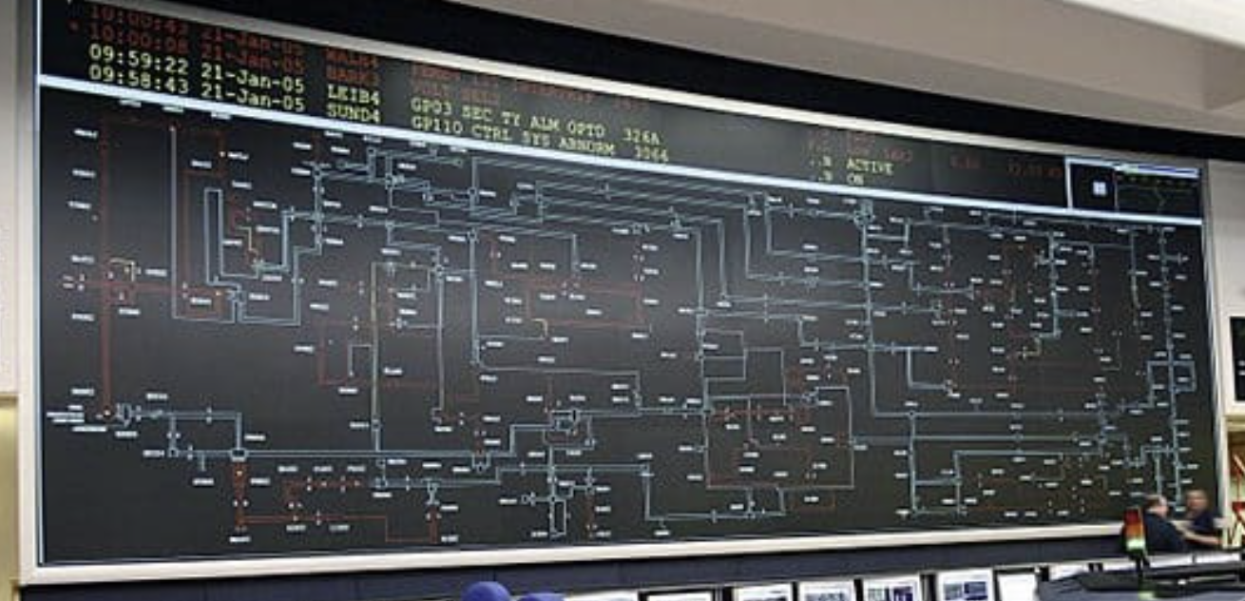
A Case Study: SCADA Upgrade Project
Scope: Upgrade of the SCADA System including deployment of DR Site Control Centre.
Ensured Security-by-design during scoping and Requirements gathering.
Pre-qualification (Cybersecurity) of Tenderers
Tenderer accepts responsibility for undeclared vulnerabilities
FAT at Vendor’s Factory: OILs are documented for resolution
Site Acceptance Testing – before project sign-off, includes CS Reviews and regression testing. Firewall config & Setup, HW and OS hardening, AD systems security and in Redundancy, Firewall Configs reviews.
Actual Red-Team attack-attempts, both internally and remotely – staged breach.

Slide 16
Conclusion
The Energy sector OT Cybersecurity threat landscape is rapidly evolving and expanding.
Attacks are now many and more frequent: Power sector is one of the most targeted.
Actors are increasingly getting, and using, sophisticated Malware tools.
Interruptions / Disruptions have dire consequences (financial, security, social, political...)
Supply chain has become one of the most challenging vulnerabilities to address.
Unfortunately, cyber-supply chain accountability are usually not well-defined, and CISOs have little or no control over their supply chain.
No matter how challenging, companies can start by identifying and mapping critical assets using a maturity framework (like NIST) to assess their maturing level, and take steps to treat critical gaps.
Incident management / response is as important as incident prevention.

Slide 17
Tony Assan
Chief Information Security Officer

