Slide 1
HOW TO DEVELOP AN INCIDENT RESPONSE PLAN
Michael Martin
Chelan County Public Utility District

Slide 2
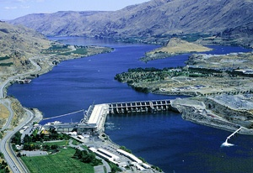
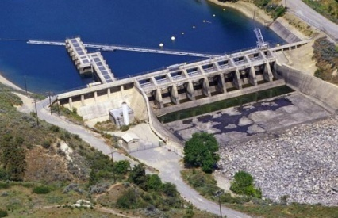
CHELAN COUNTY PUBLIC UTILITY DISTRICT
ROCKY REACH DAM
5 MILLION megawatt hours generated in 2023
11 generators
2022 production cost $13.4/MWh
ROCK ISLAND DAM
2.1 MILLION megawatt hours generated in 2023
2 powerhouses – 19 generators
2022 production cost $34.4/MWh
LAKE CHELAN DAM
0.3 MILLION megawatt hours generated in 2023
2 generators
2022 production cost $19.5/MWh

Slide 3
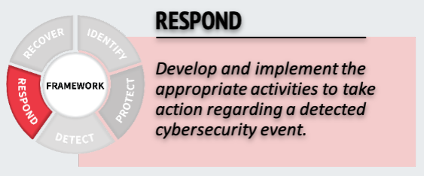
NIST Cybersecurity Framework: RESPOND
Identify
Protect
Detect
Respond
Recover
Example Outcomes:
Ensuring response planning processes are executed during and after an incident
Managing communications during and after an event
Analyzing effectiveness of response activities

Slide 4
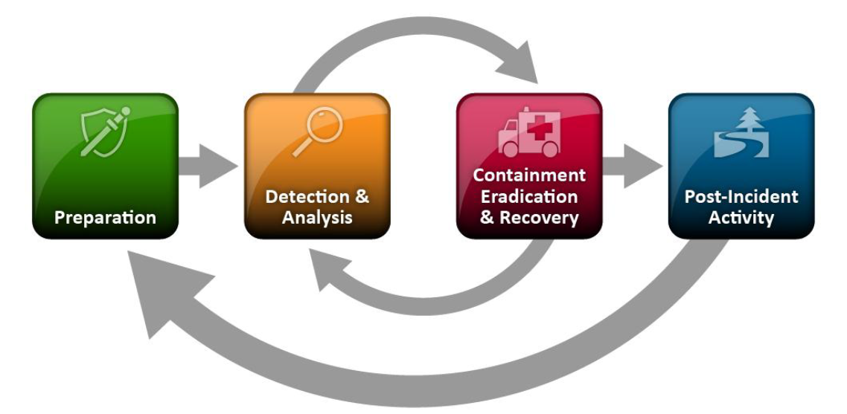
OUR INCIDENT RESPONSE PLAN JOURNEY
Overhauled incident response plan in 2016 to comply with U.S. North American Electric Reliability Corp. (NERC) Critical Infrastructure Protection (CIP) version 5 regulations
Adopted the NIST Model
Referenced documents to develop plan:
Computer Security Incident Handling Guide, NIST Special Publication 800-61 Revision 2 (2012)
Developing an Industrial Control Systems Cyber Security Incident Response Capability, Department of Homeland Security (2009)
Source: U.S. National Institute of Standards and Technology (NIST)

Slide 5
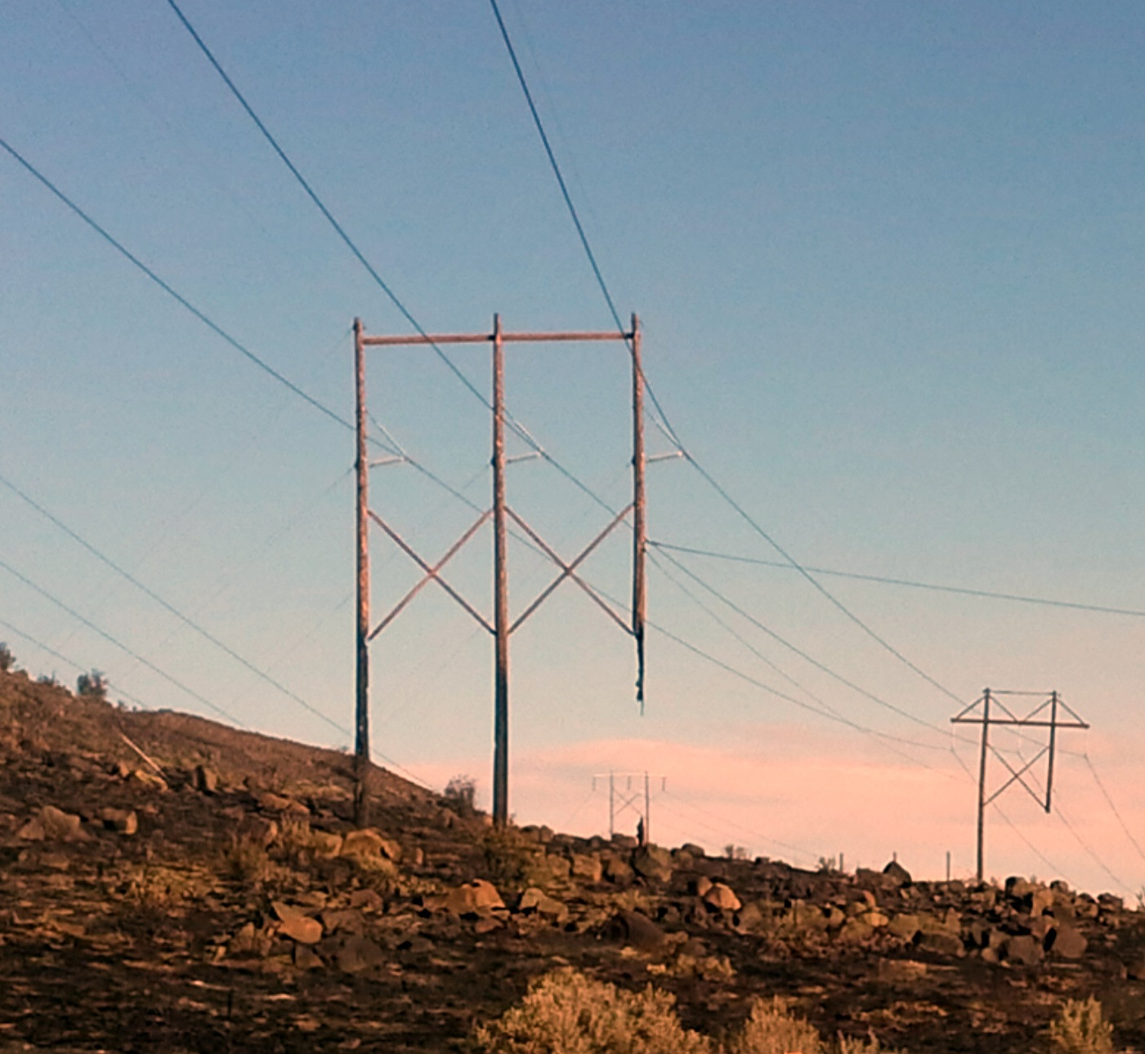
PREPARATION: Identifying Critical Utility Assets
All U.S. power utilities apply NERC Critical Infrastructure Protection (CIP) industry-standard classification criteria to identify critical and supporting systems with high, medium, low, or no impact to the greater interconnected power grid
Based on their impact, systems are protected by physical and cybersecurity controls to mitigate their risks
Chelan uses business impact risk assessment to identify additional mitigations for these systems (such as insurance, support agreements, spare inventory, preventative maintenance, etc.)

Slide 6
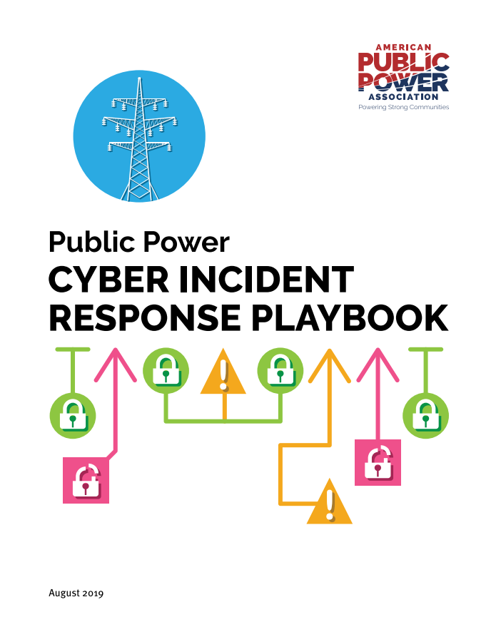
WRITING YOUR INCIDENT RESPONSE PLAN
Follow the Public Power Cyber Incident Response Playbook (2019) and its “Top 10 Steps to Develop a Cyber Incident Response Plan”
Helped our IT department develop its incident response plan
“Right size” your plan to your organization’s size and resources
Put together a plan
It won't be perfect and doesn’t need to be

Slide 7
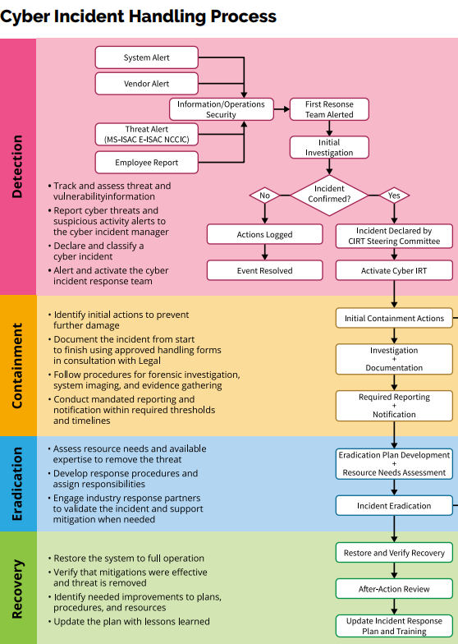
Cybersecurity Incident Response Plan KEY ELEMENTS
Roles and responsibilities – who does what
Detection – distinguish incident from normal events
NERC: “malicious act or suspicious event”
Operators: NERC Cyber Intrusion Guide for System Operators
System Admins: NIST Guide to Industrial Control Systems (ICS) Security
Source: Public Power Cyber Incident Response Playbook

Slide 8
Cybersecurity Incident Response Plan KEY ELEMENTS
Containment – prevent further damage
Document potential containment actions for common incident types that might be overlooked during the frenzy of an incident
Eradication – remove the threat
Recovery – restore the system to full operation
Spare hardware for computers, HMIs, PLCs, RTUs, switches, etc. (in case of supply chain delays)
Practice operational recoveries of different system types (HMI, firewall, switch, etc.)
Source: Public Power Cyber Incident Response Playbook

Slide 9
Cybersecurity Incident Response Plan KEY ELEMENTS
Communication plans
Methods – cell phones, Slack, Teams, WhatsApp, Zoom, etc.
Technical response teams
Communication between groups or departments
External communications – law enforcement, public, partners, neighboring utilities

Slide 10
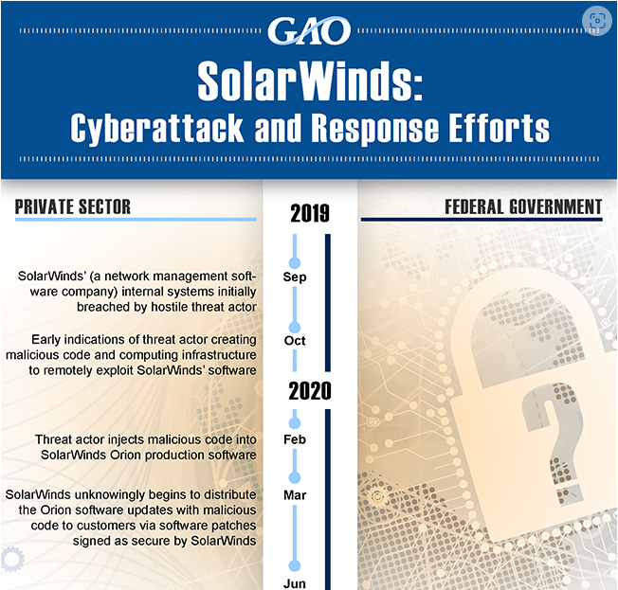
EXERCISE YOUR INCIDENT RESPONSE PLAN
Practice the plan with a tabletop drill
Once a year seems reasonable
Consider testing recent scenarios in the news
Supply chain watering hole attack
Insider threat: Stolen two-factor fob and USB key logger enables unauthorized computer use
Ransomware
USE the plan during the exercise
Train responders
Source: U.S. Government Accountability Office

Slide 11
Cybersecurity Incident Response Plan LESSONS LEARNED MEETING
After testing your plan, hold a lessons learned meeting to improve the process and be better prepared for future incidents.
How well did we perform?
What information was needed sooner?
What should we do differently next time?
How could information sharing be improved?
Can corrective actions be implemented?
Did any steps inhibit recovery?
Are additional tools or resources needed?
Could this incident have been prevented?

Slide 12
Cybersecurity Incident Response Plan LESSONS LEARNED FEEDBACK
Plan was too long
Users wanted shorter plan or decision tree/checklist
Communication plan didn’t reflect reality
In early tests with just a few departments, participants met in a conference room to discuss scenarios
Later exercises (like nationwide GridEx) involved more departments, and participants worked at their desks to simulate a real event—identifying many communication challenges

Slide 13
Cybersecurity Incident Response Plan LESSONS LEARNED IMPROVEMENTS
Application architecture improvements
Additional security cameras
Penetration tests of specific networks
Enhanced event notifications (e.g., after-hours alerts)
Tools – network monitoring solution to store packet data for operational troubleshooting and forensic analysis

Slide 14
Cybersecurity Incident Response Plan SUGGESTIONS
Print response plans and related information (contact list, vendor information)
Put the plan revision date in a header/footer on each page to identify the current version
Establish delegates or backups for each role, so incident response isn't slowed when someone is not available
Empower people to make decisions to facilitate efficient response (e.g., can a manager make the decision instead of a director?)
Document incident response resources in your plan (contracted incident response service, government resources, insurance, etc.)

Slide 15
RESOURCES
Public Power Cyber Incident Response Playbook (2019)
NIST SP 800-61 Revision 2, Computer Security Incident Handling Guide (2012)
NIST SP 800-82 Revision 3, Guide to Operational Technology (OT) Security (2023)
NIST SP 800-83 Revision 1, Guide to Malware Incident Prevention and Handling for Desktops and Laptops (2013)
NERC Cyber Intrusion Guide for System Operators (2023)
CISA #StopRansomware Guide (2023)

Slide 16
Michael Martin
CIP Standard Owner and Control Systems Engineer
Chelan County Public Utility District

