Slide 1
The Emerging Cyber Threats to Industrial Control Systems (ICS) – Supply Chain Cybersecurity Threats
Camilo Gómez
Global Cybersecurity Strategist
YOKOGAWA | Co-Innovating tomorrow
https://www.yokogawa.com/

Slide 2
Agenda
Threat Categorization
Indicators of Threat
Global Regulation
End-to-end supply chain security
Role of organizations responding to threat
What is most important
Strategies to prepare for, anticipate, and respond
Vulnerability Intel

Slide 3
Threat Categorization

Slide 4
Indicators of threat
Impact & Consequence
Headlines
Consequences
Ukrainian Electric grid (2016)
An hour-long blackout
225,000 customers lost power
Shut down 1/5 of electric power
SolarWinds (2020)
100s Millions in reputational impact
1000s organizations compromised
Colonial Pipeline (2021)
Six-day shutdown (100M gallons of fuel/day) -
Gasoline, diesel fuel and jet fuel shortage panic
Communities, commerce, air travel and nation’s security affected
Emergency declaration in D.C. and 17 states

Slide 5
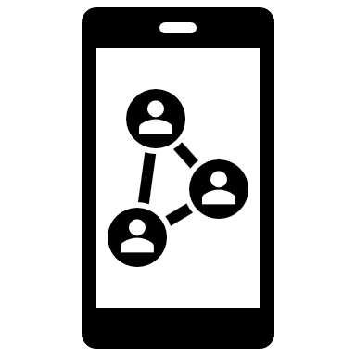
Threat attribution
What is under your control?
Threat Agents
Most important
Insiders
Hacktivists
Cybercriminals
Nation-states
Terrorism
Why
How
(the means)
What
(the target)
Motive
Capability
People
Technology Vulnerability
Impact
Consequences

Slide 6
Cyber attacks & Vulnerability
Preventable
Evolving attack methods & exploits: technical-flaw vs. backdoor
How
(the means)
Vulnerability develops over time
People
Technology Vulnerability
SolarWinds → Supply chain attack
@ Product Supplier
IT
Colonial Pipeline → Ransomware-as-a-Service (RaaS)
@ End User
Ukrainian Grid → CrashOverride
@ End user
OT
Notes:
Crash Override: Modular framework: initial backdoor, loader and payload modules
DarkSide Ransomware model – criminal group develops ransomware and hosts infrastructure, then leases capability to another criminal group
Malicious code inserted @ product fabrication

Slide 7
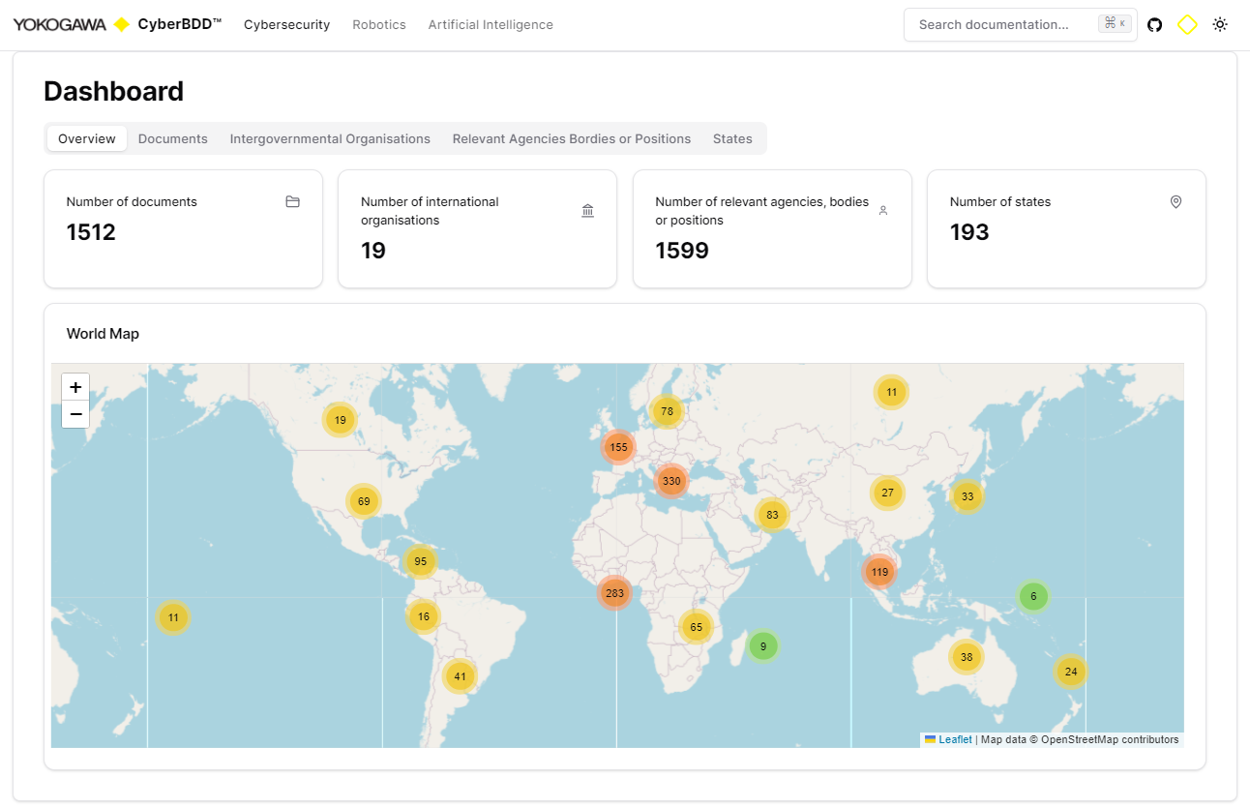
Global Cybersecurity Regulation
Threat is Real
Ranging: 2002 - 2021
Cyber Crime
+
Data Protection
Source: © Yokogawa Electric Corporation 2023
Enacted
vs.
Enforced
Notes:
Places Zambia, Lithuania, Vietnam, Fiji, Tonga, Bhutan

Slide 8
TSA Pipeline Security Directive
Data Protection
Mandate
Scope
Establish and Implement
Cybersecurity Implementation Plan
“Any” IT and OT system or data that, if compromised or exploited, could result in operational disruption.
Including business services that, if compromised or exploited, could result in operational disruption (e.g., billing system)
Develop and Maintain
Cybersecurity Incident Response Plan
Source: TSA SD Pipeline 2021-02C
Establish
Cybersecurity Assessment Program

Slide 9
Supply Chain Cybersecurity

Slide 10
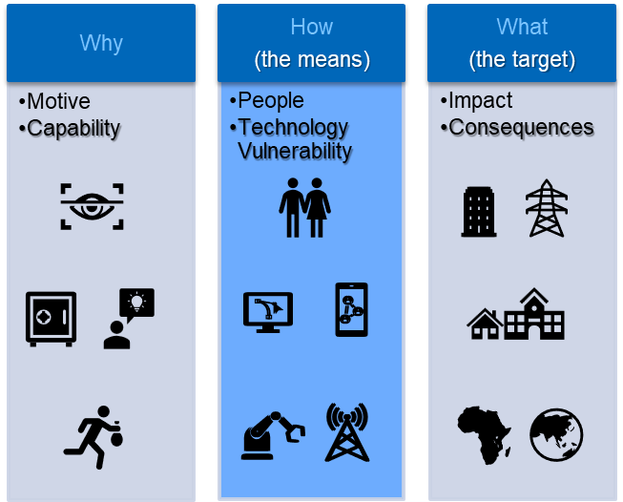
End-to-end supply chain cybersecurity
Persona & Roles
Customer’s
Customers
?
What can you do?
+
My Customers
End-to-End
Responsibility
My
Supply

Slide 11
Security Risk Management
Risk Bowtie
Recovery – Event Mitigation
Protection/Prevention
Cyber
Threat Event
Cyber Threats & Actors
Consequences
Vulnerability / Likelihood
Contain / Respond / Restore
Notes:
Risk Management Bow tie – Center: Possibility of an event; left: what to do prevent; right: what to do if it happen
Purpose: Prevent that if something negative comes in something negative comes out About: Left vulnerability and leikeliihood; right contain respond restore
What to protect: technology supporting business; full red existing vulnerability (known); border red: emerging or unknown

Slide 12
Security Risk Management (cont.)
Lessen the Effect
Recovery – Event Mitigation
Protection/Prevention
Cyber
Threat Event
Cyber Threats & Actors
Consequences
Security Program
Detection Mechanisms
Infrastructure Defense
Products Built-in Defense
Policies Procedures
Triage Procedures & Alerting
Lessons Learned - Forensics
Response & Communication Procedures
Org Impact Management
Drill Exercise
Vulnerability / Likelihood
Contain / Respond / Restore
Cybersecurity Assessment Program
Cybersecurity Incident Response Plan
Cybersecurity Implementation Plan
Notes:
Not a comprehensive list – Connecting with the Security Directive

Slide 13
OT & IT Supply Chain Distinctions
Understand
Challenges
Strengths
Technology refresh
IT: 2-5 years
OT: 5+ years
Typical size of capital projects
IT: Millions
OT: Multimillion to Billions
Weight of Budget (IT & OT)
Capital project: High
Operations: Low
Built-in Capability of Legacy
IT: Somewhat capable
OT: Uncapable/Less capable
Standards
IT: ISO/IEC 27000
OT: ISA/IEC 62443
Product Certification
IT: Unpopular
OT: Prevalent
Standards Supply Chain Assurance
IT: Product
OT: Both Product & Product Supplier organization

Slide 14
How to recommendations?

Slide 15
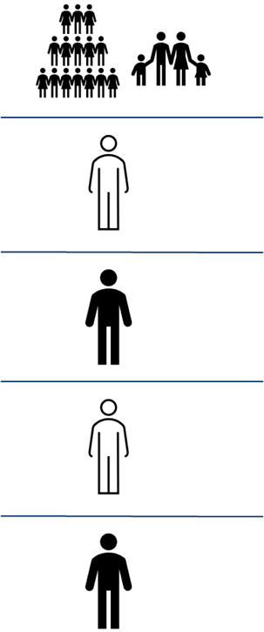
Strategies to prepare for, anticipate, and respond
Best Practices
Standards: ISA/IEC 62443 & Supply-Chain roles
OT Product Security Certification
Asset Owner
62443-2-1 Security Program
62443-3-1 Security Technologies
Service Provider
62443-2-3 Path Management
62443-2-4 Service Providers
System Integrator
62443-2-3 Path Management
62443-2-4 Service Providers
62443-3-2 Security Risk Assessment
Product Supplier
62443-3-3 System Security
62443-3-3 System Security
62443-3-1 Security Technologies
62443-4-2 Component Security
62443-4-1 Secure product development
62443-3-1 Security Technologies
End-of-life Support
Built-in Security Capability
Secured-by-design
Product Lifecycle
Security Capable (Built-in)
New Vulnerability
Free of known vulnerabilities

Slide 16
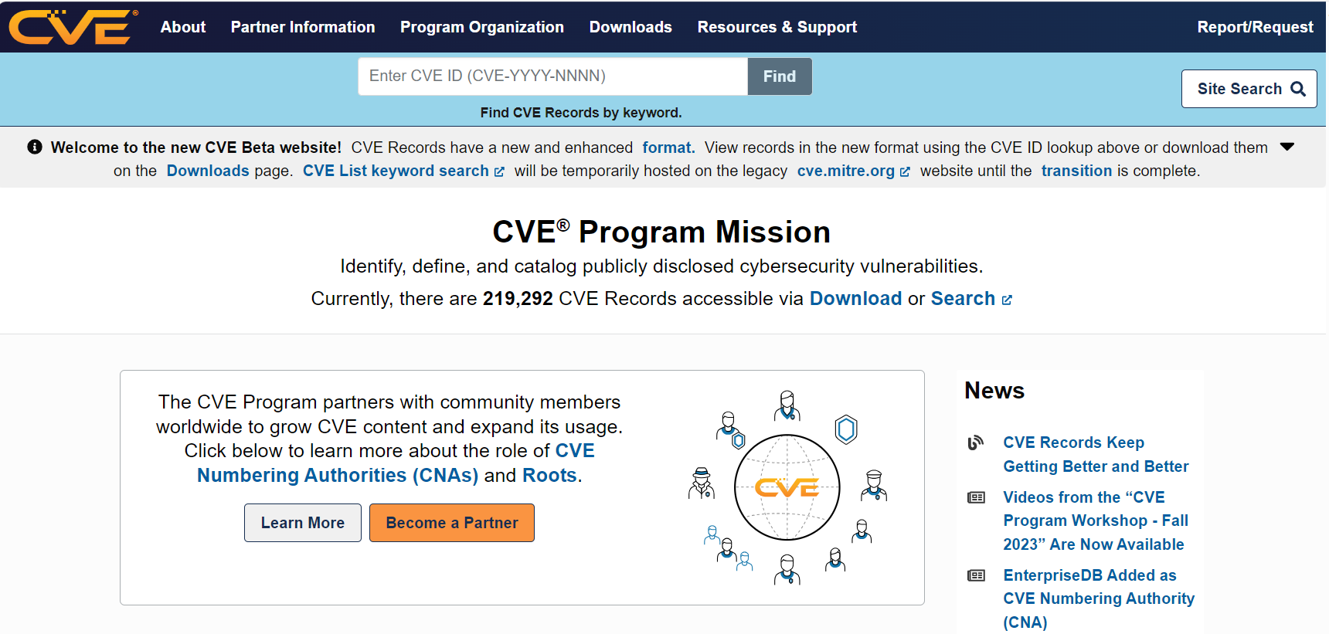
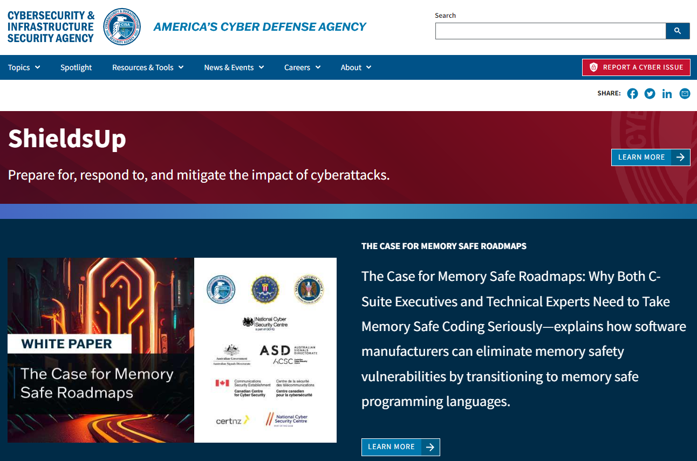
Vulnerability Intelligence & Management
For the more technical
IT - CVE
OT - CISA
Source: www.cve.org
Source: www.cisa.gov

Slide 17
Vulnerability Intelligence & Management (cont.)
Adversary Behavior
OT & IT – MITRE ATT&CK
Source: https://usea.org/sites/default/files/event-/Otis%20Alexander%20Presentation.pdf

Slide 18
References
Resilient Energy Platform: https://www.nrel.gov/docs/fy20osti/76307.pdf
USEA Standards and Best Practices: https://usea.org/event/cybersecurity-standards-and-best-practices-part-2-utilities-and-isoiec-27001-isms-20052013
TSA Pipeline Security Directive: https://www.tsa.gov/sites/default/files/sd_pipeline-2021-01b_05-29-2022.pdf
ISO 27001: https://usea.org/event/cybersecurity-standards-and-best-practices-part-2-utilities-and-isoiec-27001-isms-20052013
ISA Standards: https://www.isa.org
IEC Standards: https://www.iec.ch/homepage
ISASecure Certification: ISASecure - IEC 62443 Conformance Certification - Official Site
IECEE CMC Certification: https://www.iecee.org/certification/cb-test-certificates
CVE: https://www.cve.org/
CISA: https://www.cisa.gov/
MITRE ATT&CK: https://attack.mitre.org/
Notes:
Cybersecurity & Infrastructure Agency,

Slide 19
Thank You YOKOGAWA | Co-Innovating tomorrow https://www.yokogawa.com/

