Slide 1
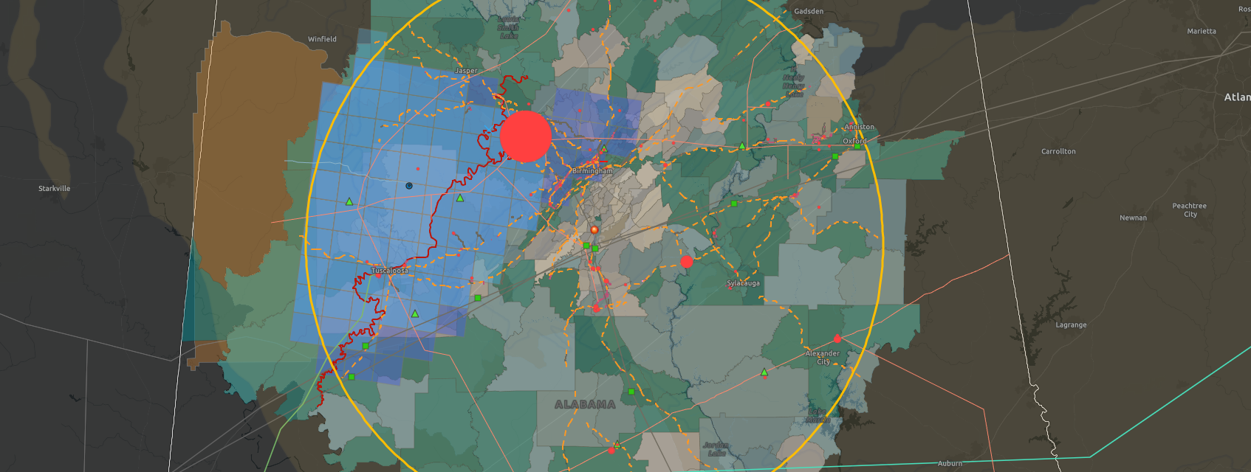
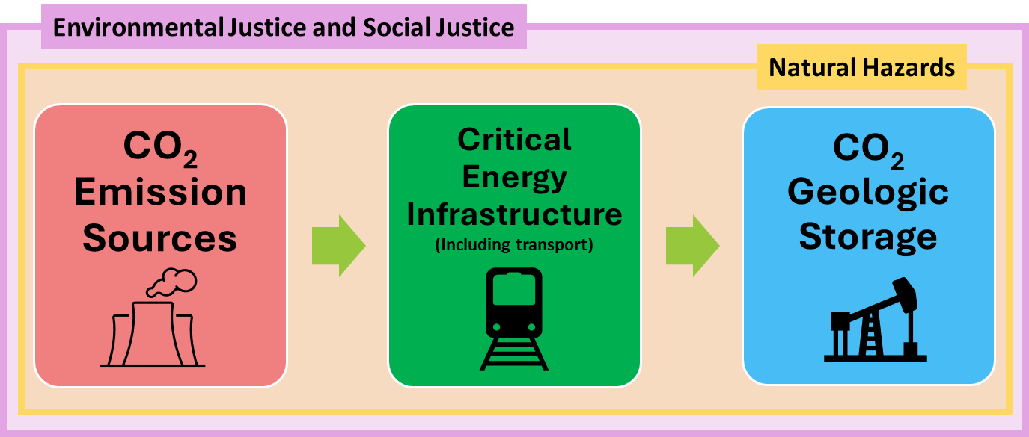
Carbon Storage Planning Inquiry Tool (CS PlanIT)
Providing Data and Insights for Accelerating Carbon Transport & Storage Deployment
Paige Morkner
Geologist + Geo-Data Scientist
USEA Webinar
Nov. 6, 2024

Slide 2
Disclaimer
This project was funded by the U.S. Department of Energy, National Energy Technology Laboratory, in part, through a site support contract. Neither the United States Government nor any agency thereof, nor any of their employees, nor the support contractor, nor any of their employees, makes any warranty, express or implied, or assumes any legal liability or responsibility for the accuracy, completeness, or usefulness of any information, apparatus, product, or process disclosed, or represents that its use would not infringe privately owned rights. Reference herein to any specific commercial product, process, or service by trade name, trademark, manufacturer, or otherwise does not necessarily constitute or imply its endorsement, recommendation, or favoring by the United States Government or any agency thereof. The views and opinions of authors expressed herein do not necessarily state or reflect those of the United States Government or any agency thereof.

Slide 3
Authors and Contact Information
Paige Morkner¹, Devin Justman^{1,2}; Scott Pantaleone^{1,2}; Maneesh Sharma^{4,5}; Lucy Romeo¹; Araceli Lara^{1,3}; Mackenzie Mark-Moser¹ ;Kelly Rose¹
¹National Energy Technology Laboratory, 1450 Queen Avenue SW, Albany, OR 97321, USA
²NETL Support Contractor, 1450 Queen Avenue SW, Albany, OR 97321, USA
³Oak Ridge Institute for Science and Education, 1450 Queen Avenue SW, Albany, OR 97321, USA
⁴National Energy Technology Laboratory, 3610 Collins Ferry Road, Morgantown, WV 26505, USA
⁵NETL Support Contractor, 3610 Collins Ferry Road, Morgantown, WV 26505, USA

Slide 4
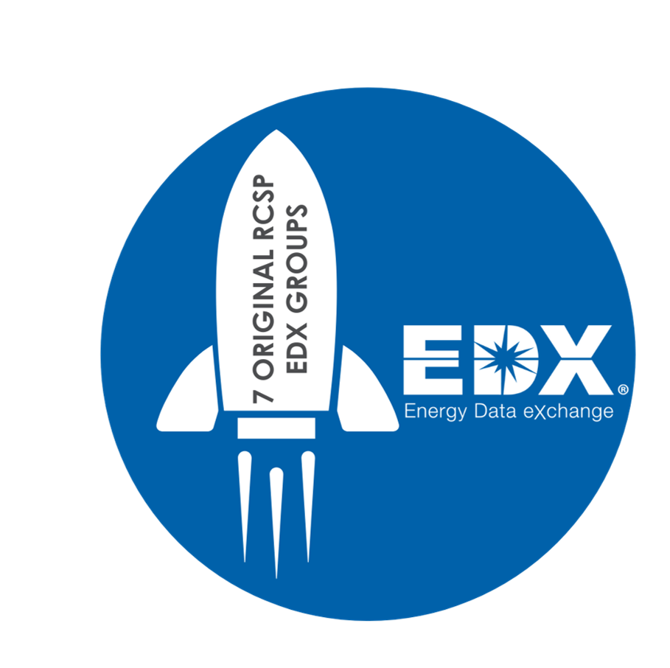
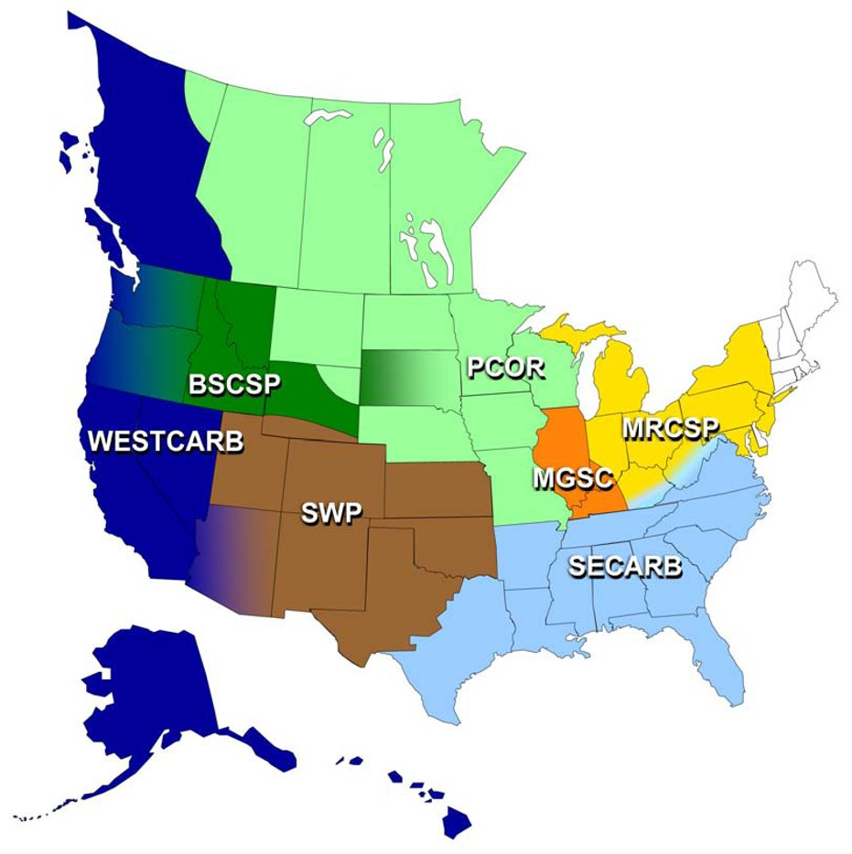
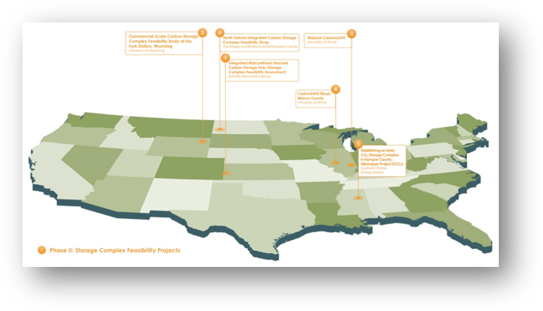
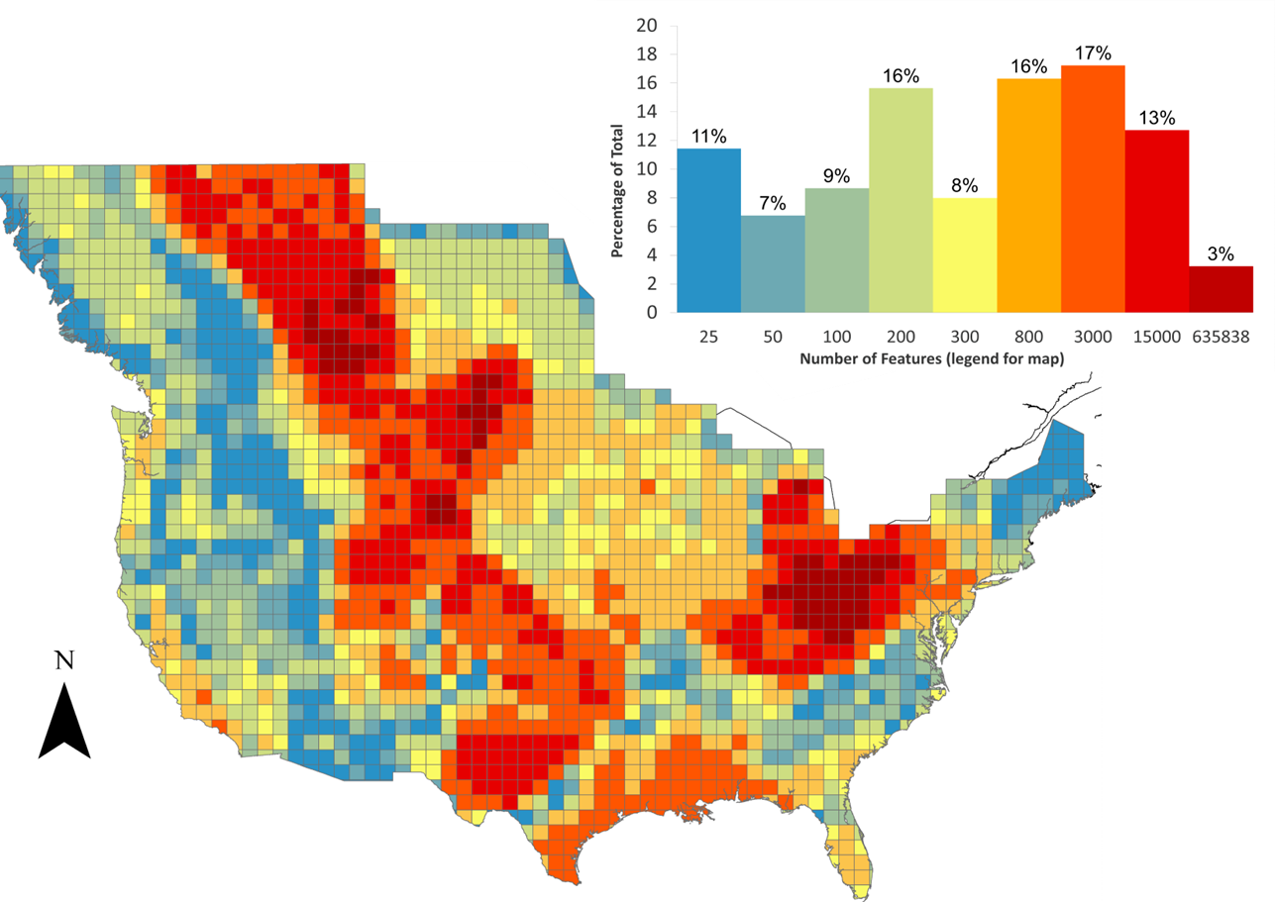
Highlights – How DOE, NETL and EDX have been supporting 25+ years of Carbon Storage
Launch of the 7 Regional Carbon Storage Partnerships
NETL launches the Energy Data eXchange® (EDX)
The Bipartisan Infrastructure law is passed
The launch of EDX DisCO2ver platform and EDX Spatial
The CarbonSAFE Initiative begins.
1997
2003
2007
2011
2015
2016
2019
2021
2023
PUBS | SPATIAL LAYERS
1000+ | 700+
DATA & WEB TOOLS
As a compliment to the NATCARB Database, public spatial data from the RCSPs and EDX are published as the Carbon Storage Open Database.
PUBLIC PRODUCTS*
80+
DOE initiates requirements to contribute digital data products from CTS program to EDX
DOE’s Carbon Storage Research Program was founded
DOE releases the 1st Carbon Storage Atlas of the United States and Canada.
PRODUCTS | GROUPS
>3500k | >20
https://edx.netl.doe.gov/

Slide 5
Enabling data access to support CCS planning and feasibility
The goal of reaching large-scale CS deployment starts with informed planning
Discover and acquire publicly available data for each stage of the CCS supply chain (Source -> Critical Energy Infrastructure -> Storage)
Evaluate impact on the community and environment at each stage in the CCS supply chain
Environmental Justice and Social Justice
Natural Hazards
CO₂ Emission Sources
Critical Energy Infrastructure (Including transport)
CO₂ Geologic Storage
https://edx.netl.doe.gov/dataset/cs-planit

Slide 6
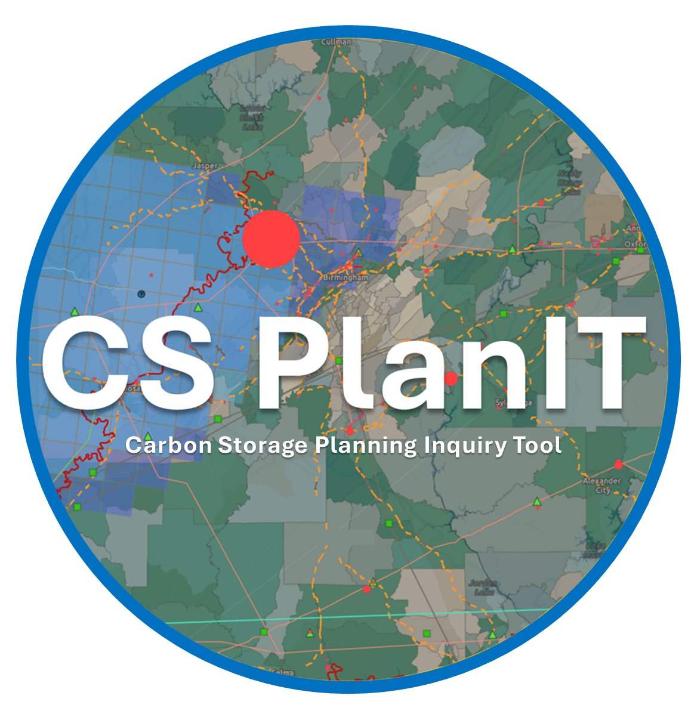
Carbon Storage Planning Inquiry Tool (CS PlanIT) v1.0
Purpose:
Provides easy access to explore, query, and evaluate multiple data layers to support and accelerate carbon storage resource feasibility assessments and planning efforts
Problem:
CS planning requires the consideration of multiple factors linked to a variety of disparate, multi-sourced datasets that require integration
Data Types
CS PlanIT
CO₂ Emission Sources
CO₂ Sinks and CCS Projects
Environmental Justice and Social Justice
Critical Energy Infrastructure
Natural Hazards
User community:
Potential stakeholders include well/plant operators, policy makers, researchers, public communities
Potential insights for a given area…
What are the population/community impacts?
What are the potential natural hazards?
What are the CO₂ emissions sources and amounts?
Are there candidate infrastructure for reuse?
Are there potential CO₂ reservoirs?
What are current storage estimates?
What are the current carbon storage projects?
EDX- Energy Data eXchange
CCS- Carbon Capture and Storage
DOE- Department of Energy
USGS- United States Geological Survey
FEMA- Federal Emergency Management Administration
EPA- Environmental Protection Agency
EIA- Energy Information Administration
CDC- Center for Disease Control
NATCARB- National Carbon Sequestration Database
CS PlanIT v1.0 publicly accessible via EDX
Additional updates expected in March, 2025
https://edx.netl.doe.gov/dataset/cs-planit

Slide 7
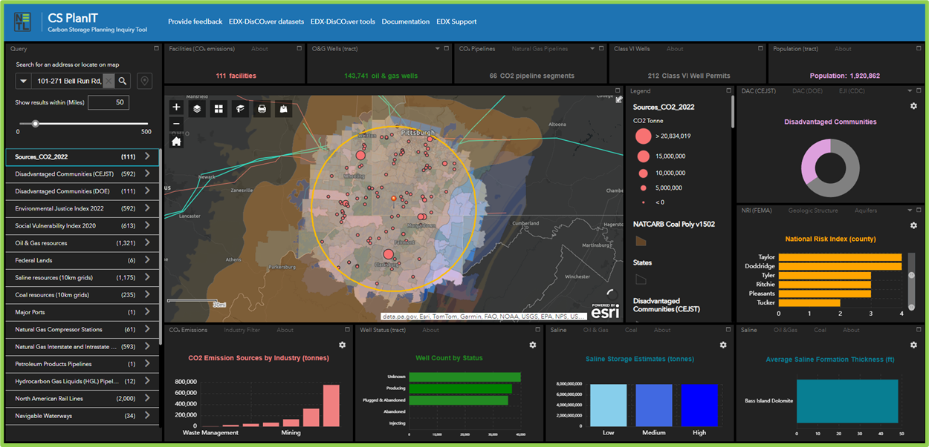
Carbon Storage Planning Inquiry Tool (CS PlanIT) v1.0
Identified, cataloged, integrated ~40 datasets across DOE CCS research portfolios
Organized data/stats into key categories:
Carbon dioxide (CO₂) emission sources
Critical energy infrastructure
CO₂ sinks/CCS (Carbon Capture & Storage) projects
Natural hazards
Environmental & Social Justice
CS PlanIT v1.0
Example spatial data query within CS PlanIT, yellow circle on map represents user defined area of interest.
https://edx.netl.doe.gov/dataset/cs-planit
7

Slide 8
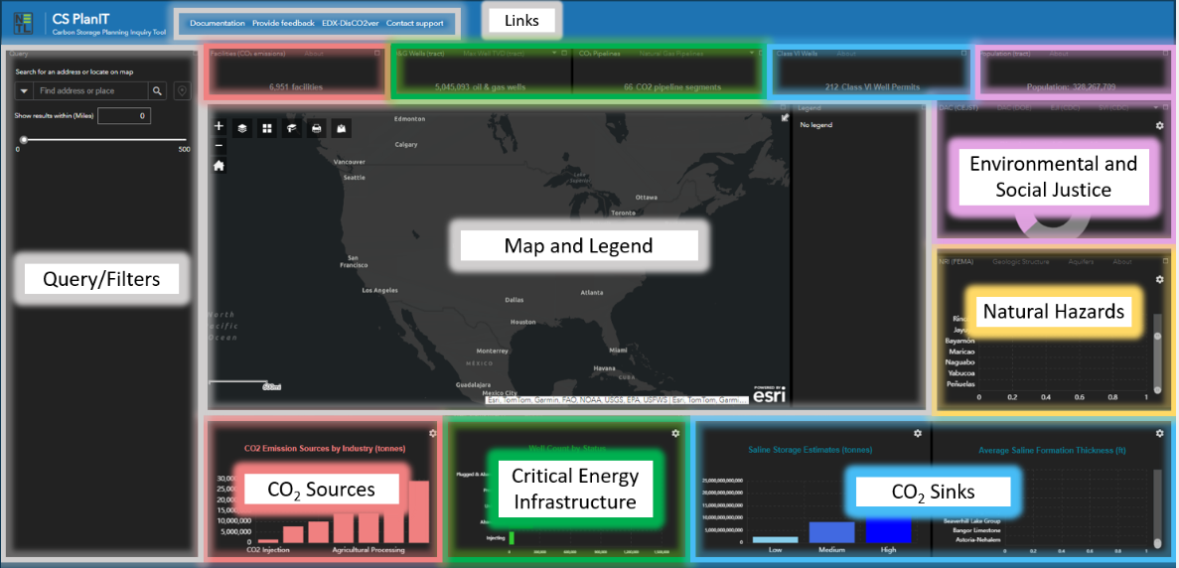
Carbon Storage Planning Inquiry Tool (CS PlanIT) v1.0
General Layout
Data querying/ filtering
Charts and statistics
Map and legend
External links
https://edx.netl.doe.gov/dataset/cs-planit
8

Slide 9
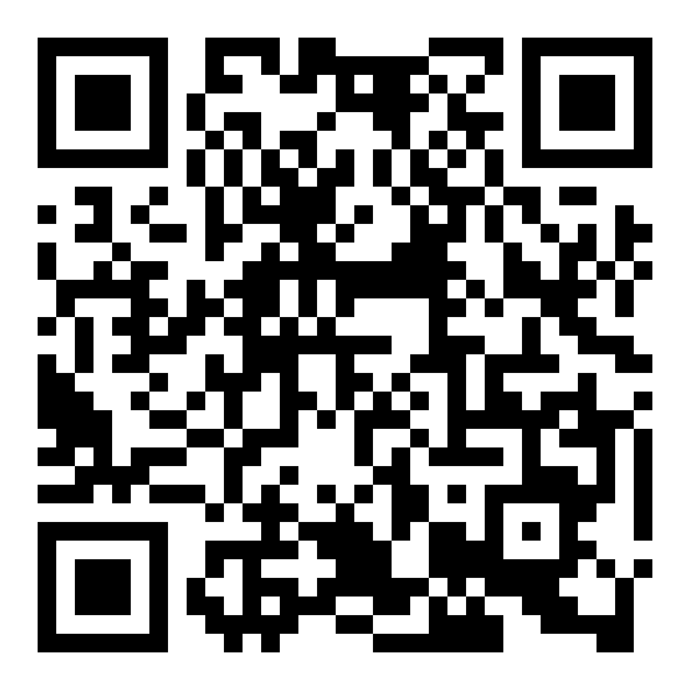
Live Demo
https://edx.netl.doe.gov/dataset/cs-planit
https://edx.netl.doe.gov/dataset/cs-planit

Slide 10
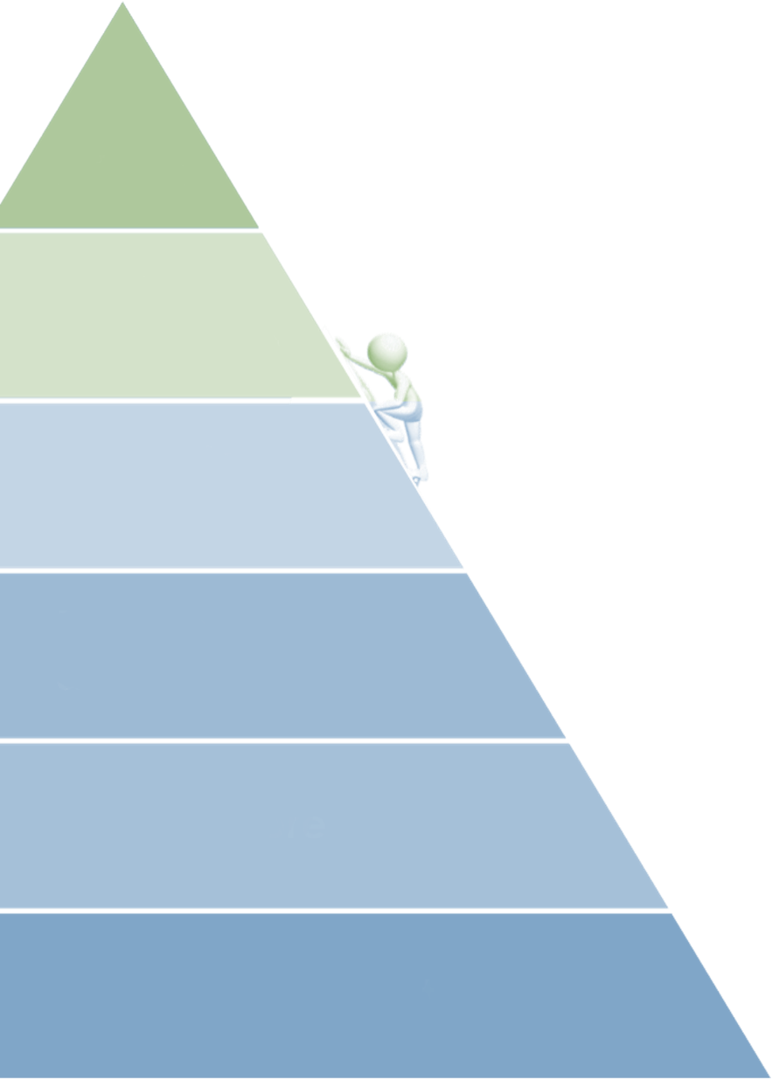
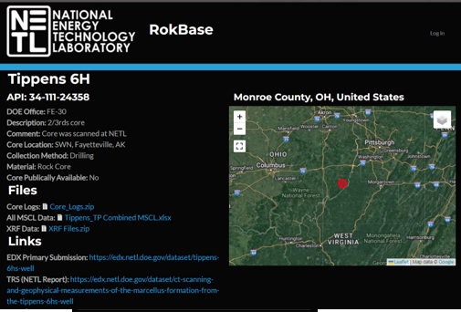
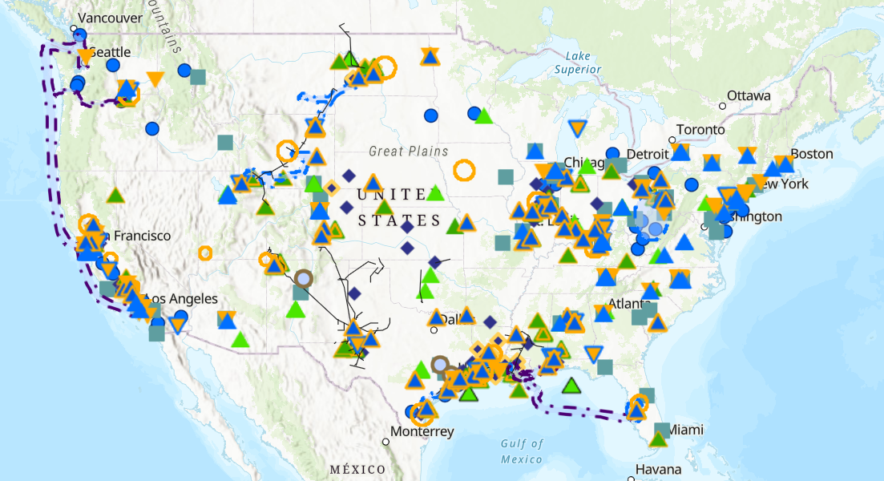
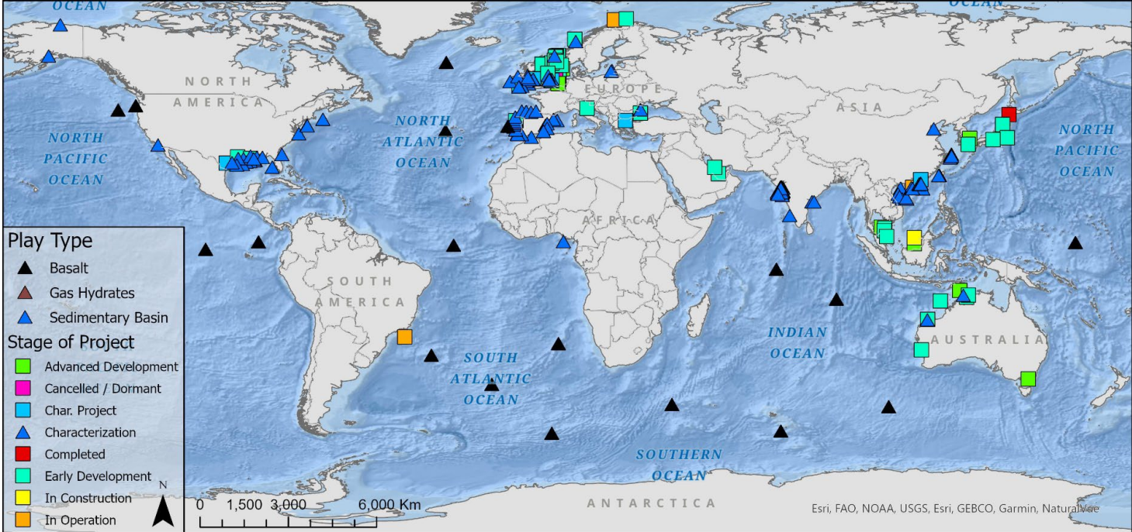
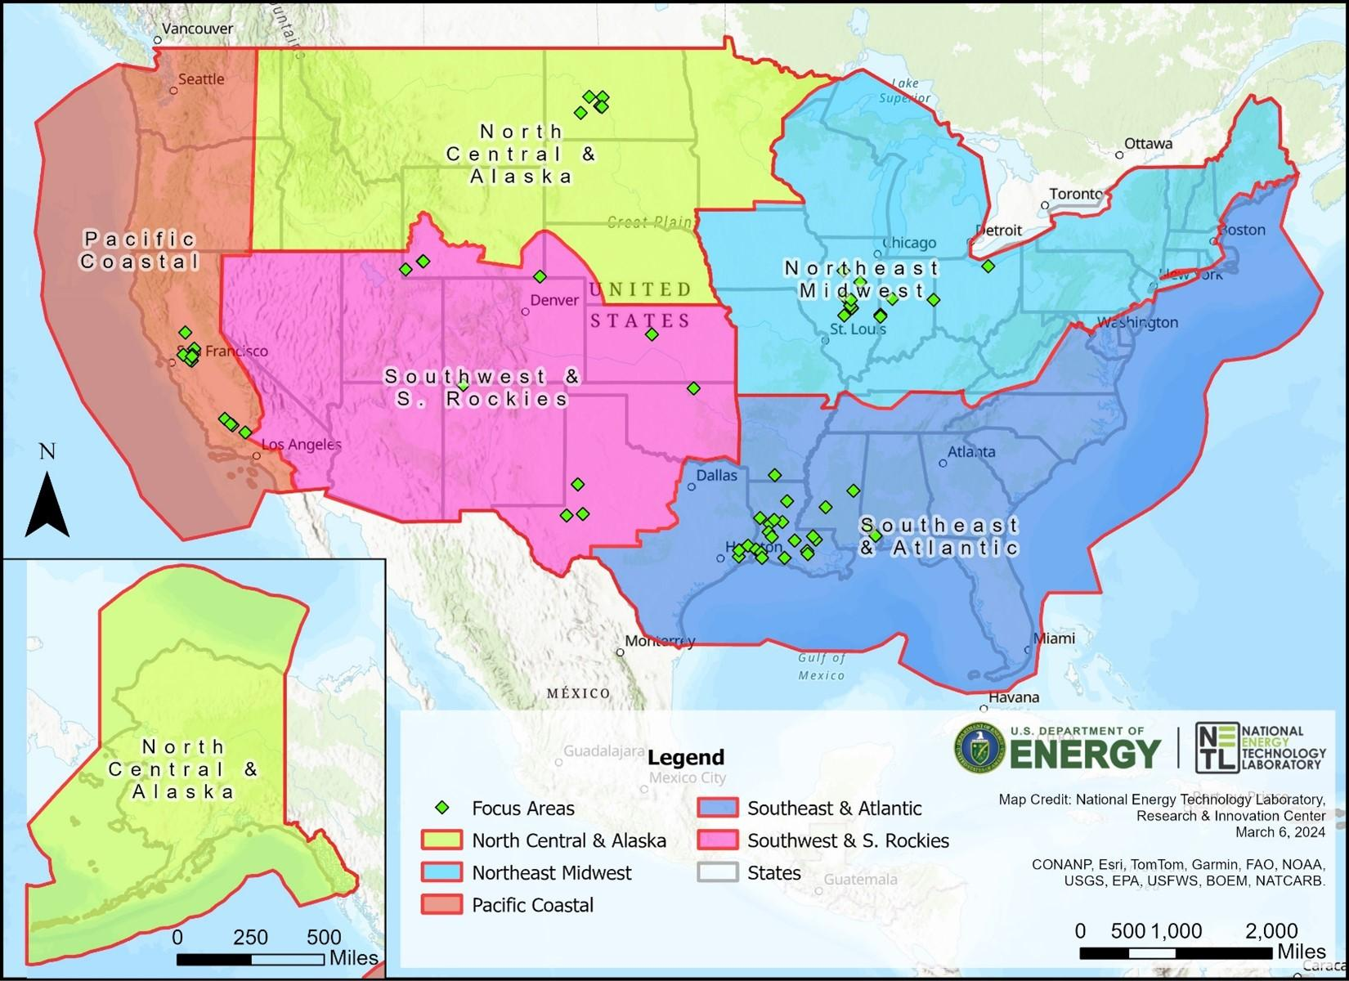
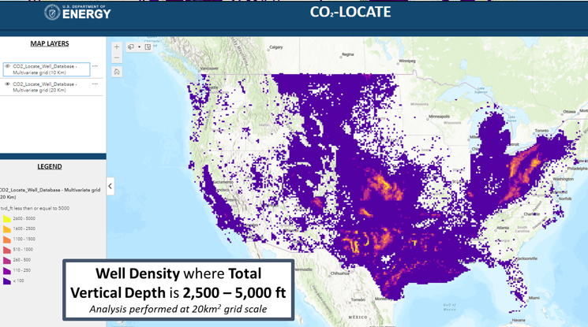
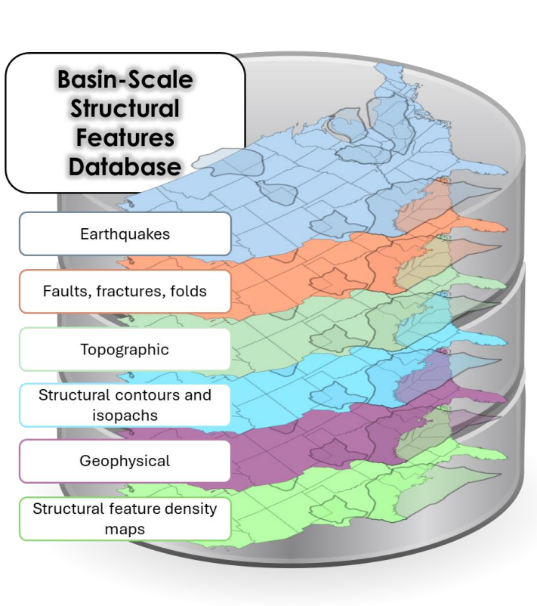
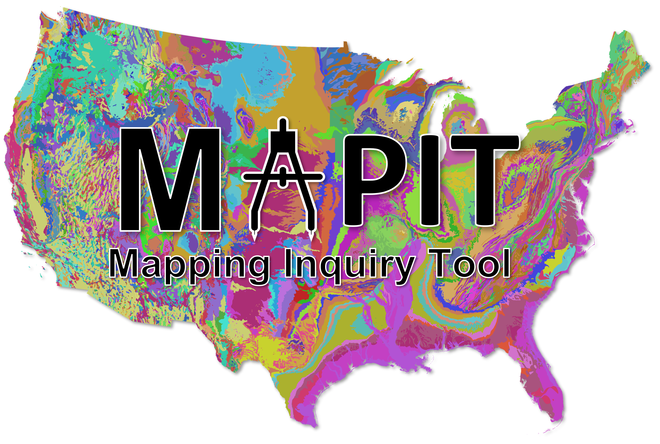
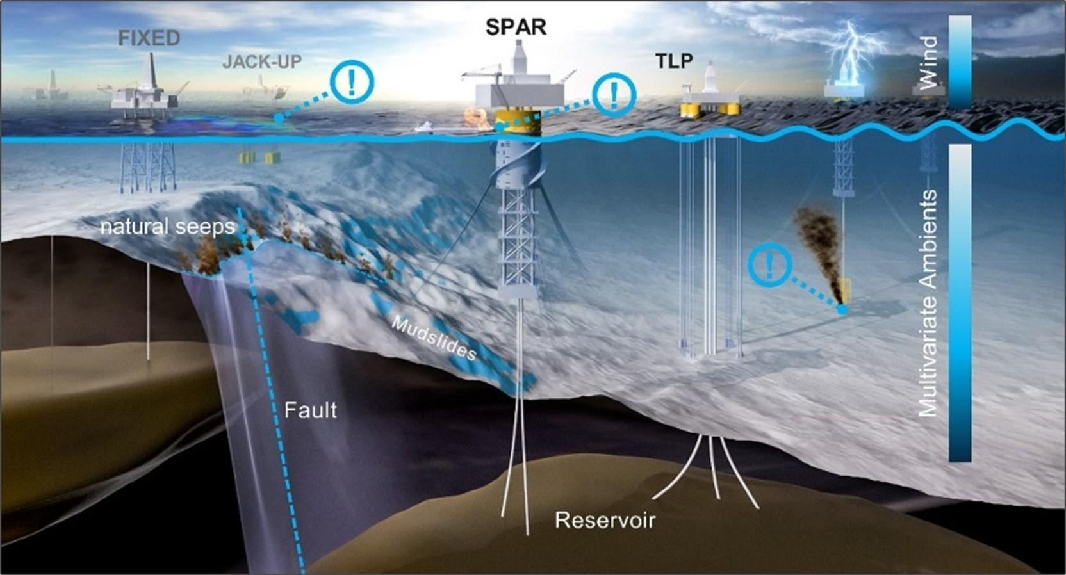
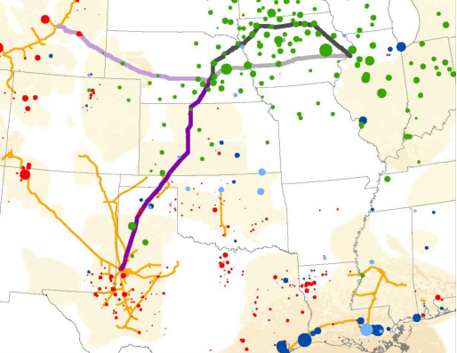
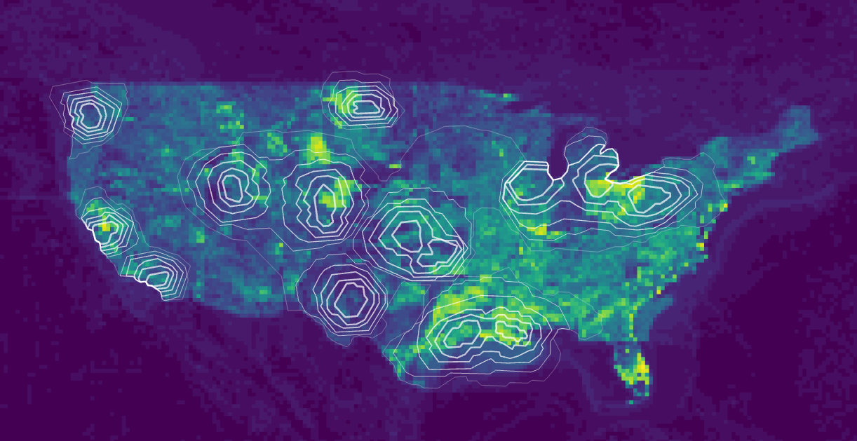
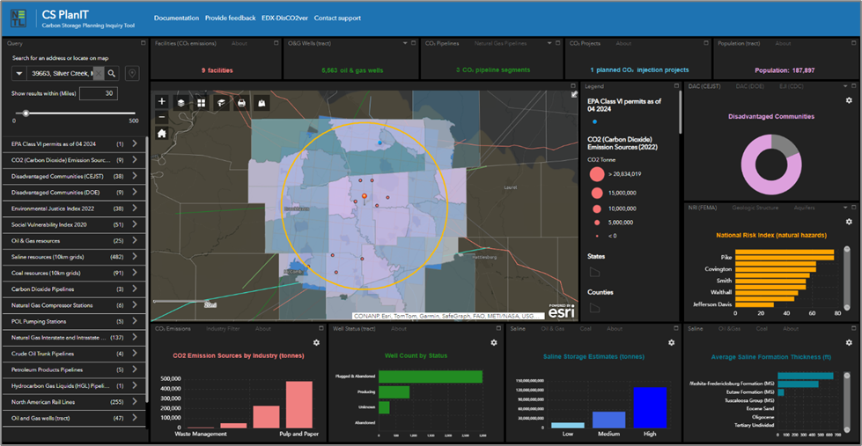
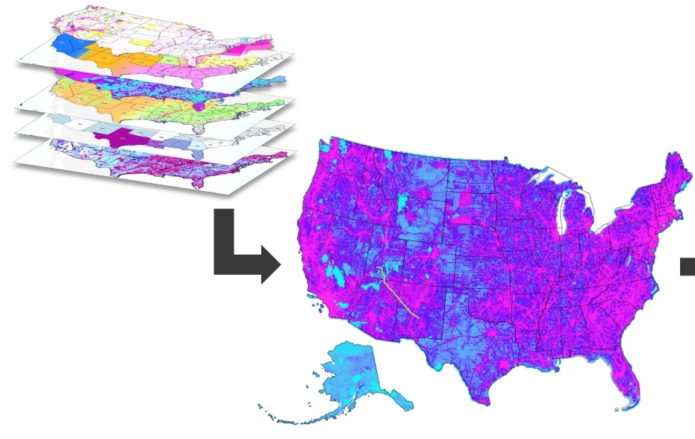
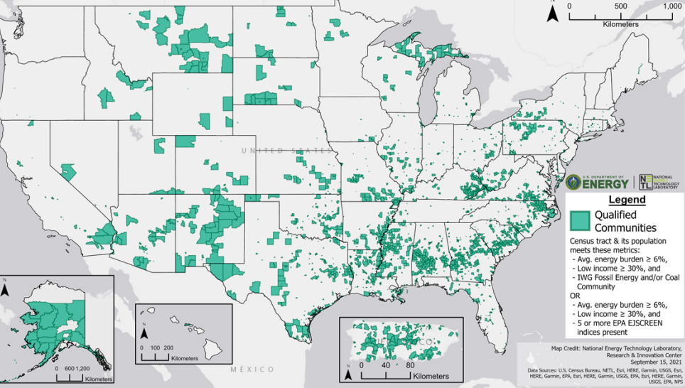
DOE-FECM’s Carbon Management Digital Products to Date
RokBase
CONNECT
Offshore GCS Inventory Web Application
Prospective Seal Name Catalog + Seal Unit Database
CO₂-Locate Database and Web Application
Inform
Analyze & Optimize
Carbon Storage Site Mapping Inquiry Tool (MapIT) + Database
Geospatial and Information Substitution and Anonymization (GISA) Tool
Basin-Scale Structural Features Database
AIIM Onshore Pipeline Database/Offshore AIIM Dashboard
CCS Pipeline Route Planning Database
Integrate & Label
Explore & Transform
CS Technical Viability Assessment Database
Carbon Storage Planning Inquiry Tool (PlanIT)
Smart CO₂ Transport-Route Planning Tool
CCS EJ-SJ Database
Move & Store
Discover & Collect
All Publicly Available Here: https://edx.netl.doe.gov/disco₂ver

Slide 11
Questions?
https://edx.netl.doe.gov/dataset/cs-planit
Paige Morkner
Paige.Morkner@netl.doe.gov

