Slide 1

DUKE ENERGY
Michael Reid, PhD
Director of Technology Development, Emerging Technology Department
April 22nd 2014

Slide 2
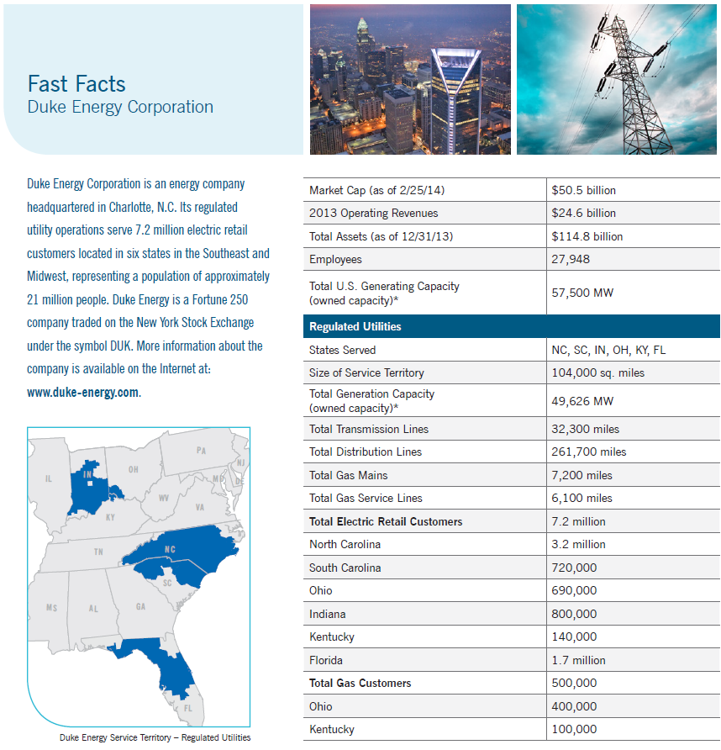

Slide 3
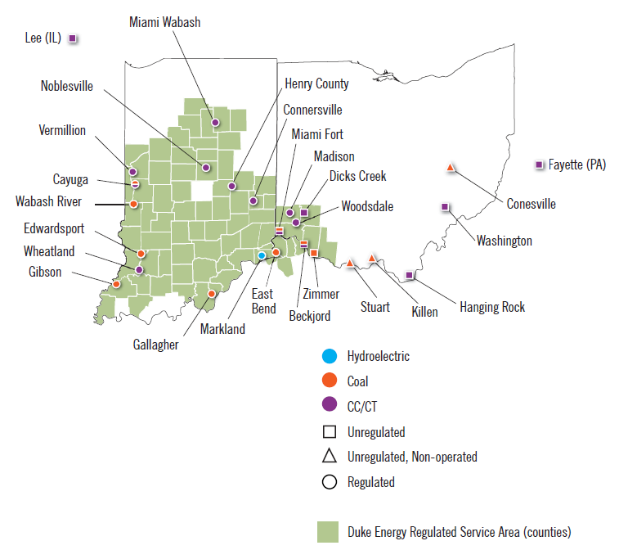
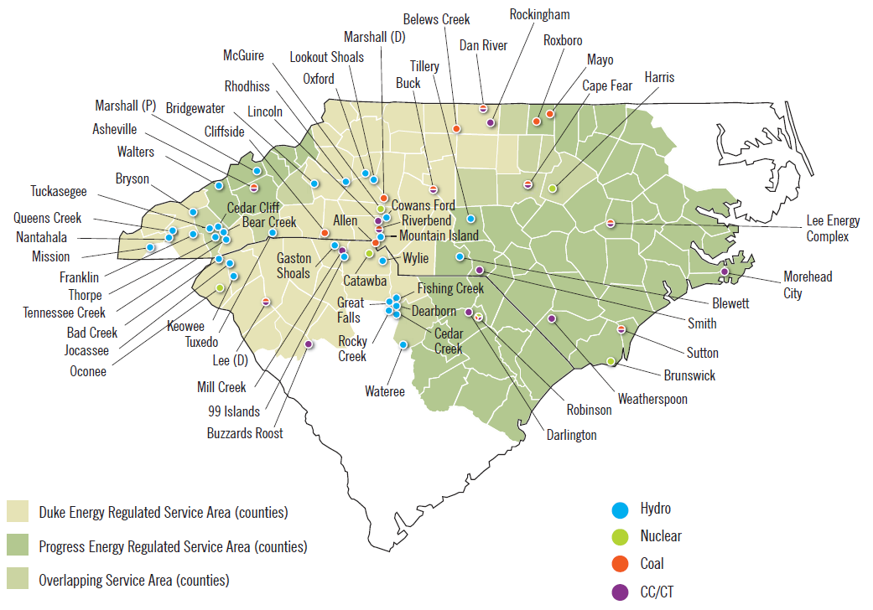
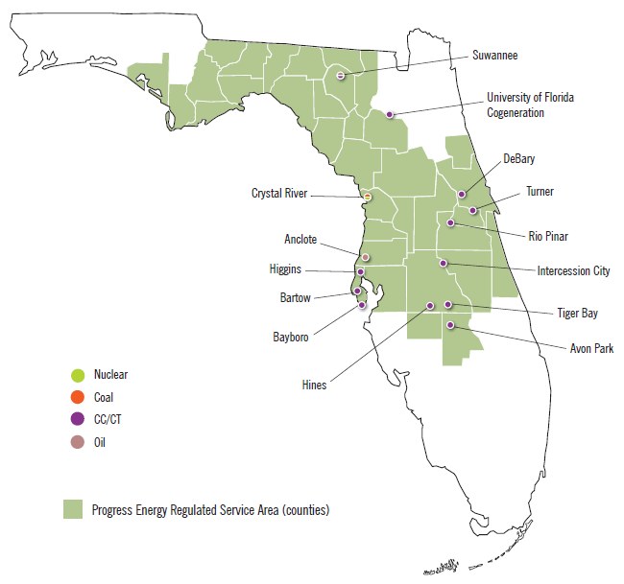
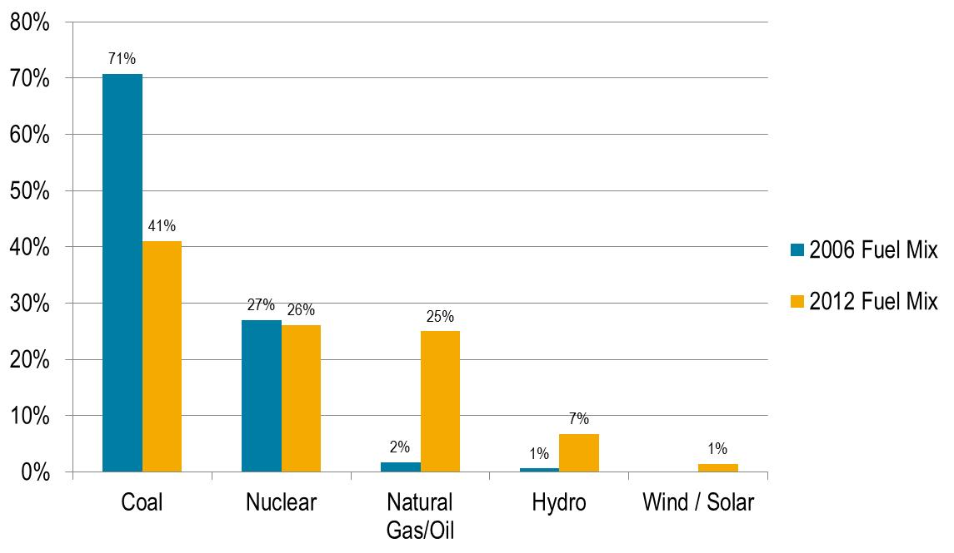

Slide 4
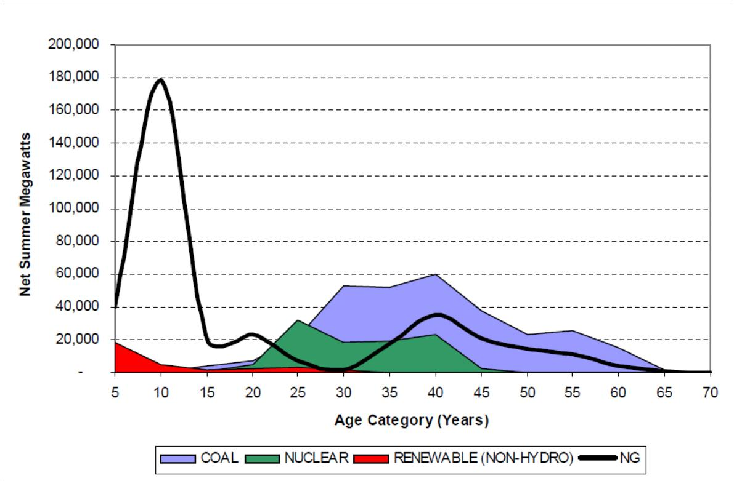
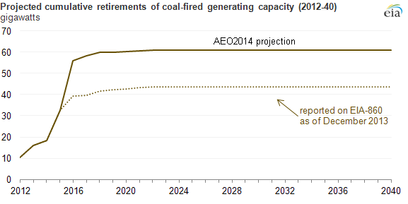
Duke Energy Generation Fleet Transition
US Generation Fleet
Duke Energy Fleet Transition
Retirements - 3,867 MWs | Total | Additions + 4,865 MWs
3 coal units -575 MW | 2014 | 1 gas unit + 622 MW
6 Coal units 3 CT’s -756 MW | 2013 | 1 coal unit (IGCC) + 618 MW
11 Coal units 25 CT’s -1,888 MW | 2012 | 1 coal unit 2 gas units + 2,382 MW
12 coal units -748 MW | 2011 | 2 gas units + 1,243 MW
Duke Energy’s Changing Fuel Mix
Mercury and Air Toxics Standard
Scrubber uneconomical due to:
Higher coal prices / lower gas prices
Lower wholesale electricity prices
Lower utilization

Slide 5
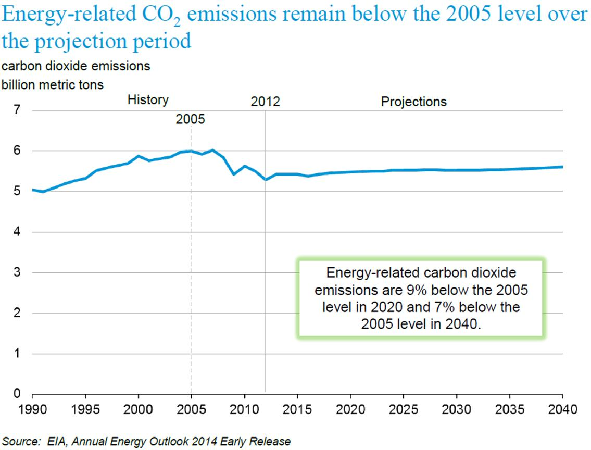
Duke Energy Generation Fleet CO₂ Reduction
Duke Energy’s Sustainability Goals
Reduce CO₂ emissions from our U.S. generation fleet 17% from 2005 by 2020
Reduce carbon intensity of our total generation fleet to 0.94 lbs of CO₂ per kWh by 2020
105 M tons
87 M tons

Slide 6













Duke Energy’s Activities to Help Develop CCS Technology for Power Sector
 | DOE / NETL / Regional Carbon Sequestration Partnerships
 | DOE’s Advanced Research Project Agency – Energy IMPACCT Program: Innovative Materials and Processes for Advanced Carbon Capture Technologies
 | Program 66 Fossil Fleet for Tomorrow Program 165 CO₂ Capture and Storage
 | National Carbon Capture Center
 | Coal Utilization Research Council
 | US-China Clean Energy Research Center Advanced Coal Technology Consortium
 | The Carbon Sequestration Initiative (CSI)
 | Carnegie Mellon Electricity Industry Center (CEIC)

