Slide 1

Powering the Nation, Fueling Innovation

Slide 2

The goals.
How can we maintain fossil energy’s position as a viable and significant aspect of Wyoming’s economy while addressing societal concerns about carbon emissions?
Can we turn a liability into an asset?
Let’s position Wyoming as an energy solution leader!

Slide 3
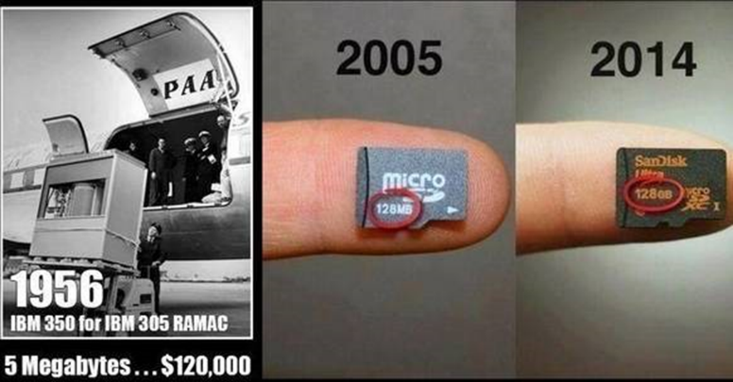
How can we achieve our goals?

Slide 4
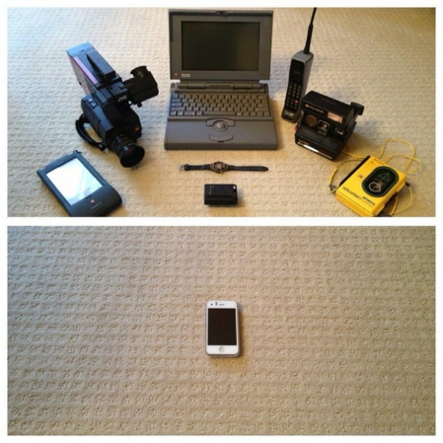
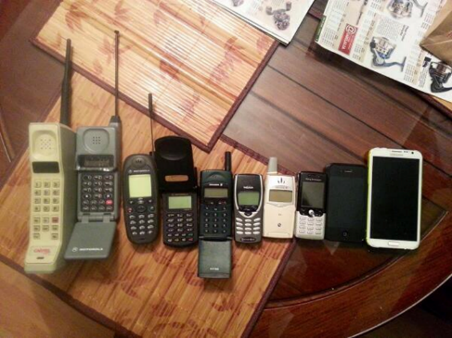
Technology development works.

Slide 5
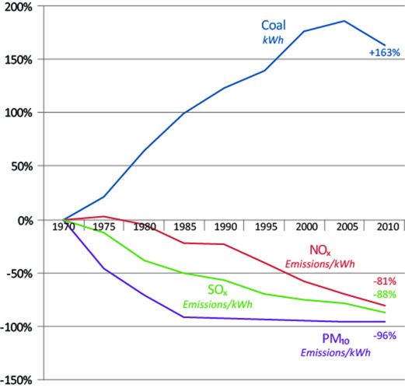
Emissions technology works.

Slide 6
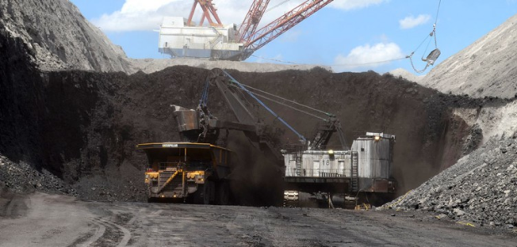
What is Wyoming’s strategy?
Commercialization of new technologies will ensure the long-term viability of Wyoming’s natural resources.

Slide 7

How? Develop the pieces.
Message, Basic Research, Scale-up, Commercialize
  University of Wyoming School of Energy Resources
  Center for Economic Geology Research
  Enhanced Oil Recovery Institute
  Wyoming Integrated Test Center
  Wyoming Corridor Initiatives
  Wyoming Energy Authority

Slide 8
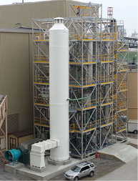
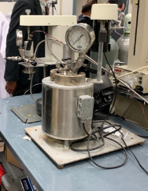


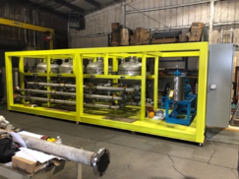
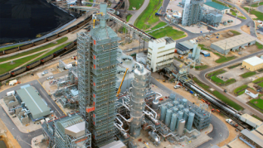
The Integrated Test Center
  20+ MW of coal derived flue gas from the Dry Fork Power Station.
  Simple design minimizes costs, provides flexibility & quick turnaround times.
  Designed for maximum flexibility and scalability for testing.
  Focused on larger scales to compliment NCCC and create a space for further scale up.

Slide 9





ITC Partners
State of Wyoming - $15 million
Basin Electric – Host at Dry Fork Station
Tri-State G&T - $5 million
National Rural Electric Cooperatives Association - $1 million
Wyoming Infrastructure Authority – Managing Entity
Black Hills Corp. and Rocky Mountain Power providing technical expertise and in-kind contributions

Slide 10
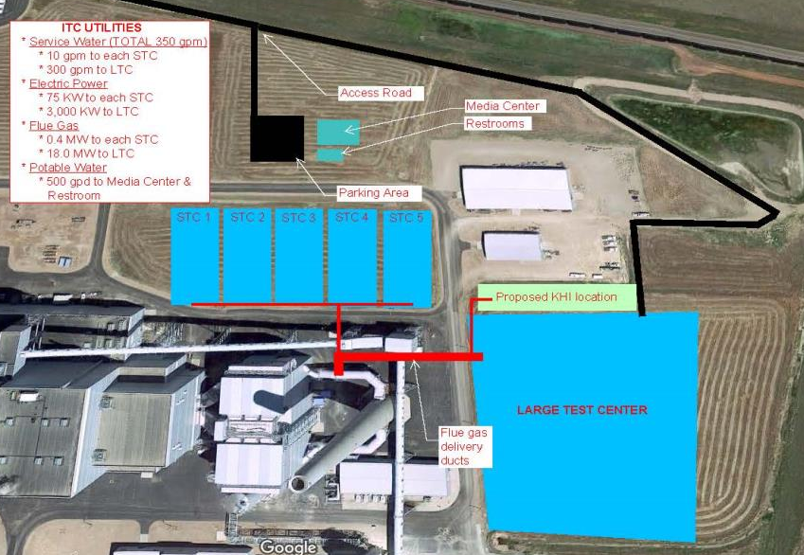
The ITC Layout
Credit: Basin Electric Cooperative

Slide 11
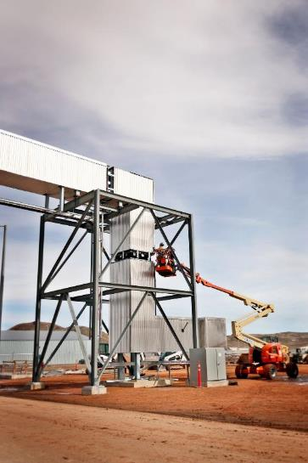
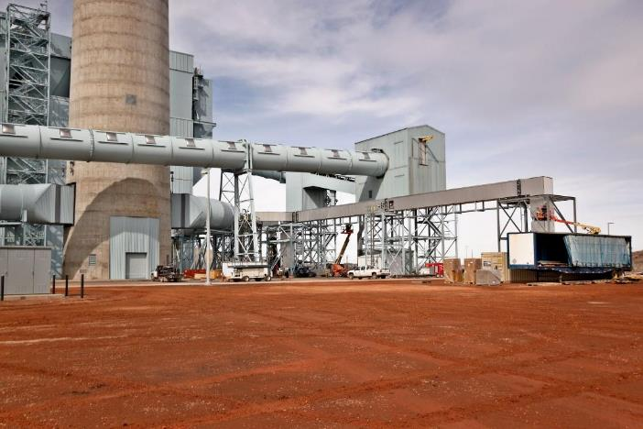

Large Test Bay

Slide 12
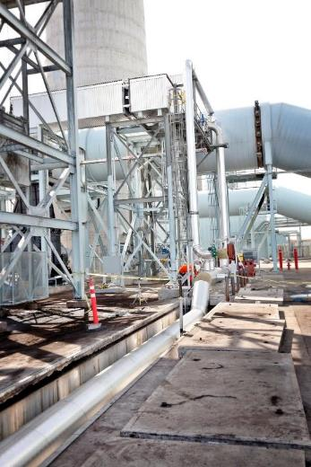
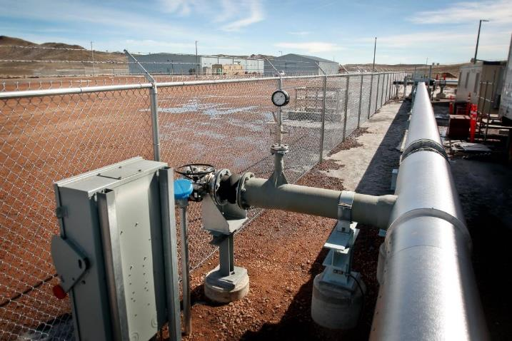
Small Test Bays

Slide 13
Tenant Summary
  TDA Research
    - Currently testing.
  Kawasaki Heavy Industries (KHI)
    Fixed bed adsorbent optimization testing.
  GreenOre
  - Carbon dioxide and fly ash utilization to calcium carbonate.
  Membrane Technology Research (MTR)
    - Completed phase 1 200 ton per day CO₂ capture project in the large test bay using membrane separation system combined with cryogenic distillation.
  University of Kentucky (UK)
    - Completed phase 1 10 MWe large pilot also awaiting phase 2 funding decision announcement.
  XPRIZE
    - 5 teams competing for best commercial CO₂ utilization offering will produce building materials, polymers, and methanol using various CO₂ capture technologies.

Slide 14
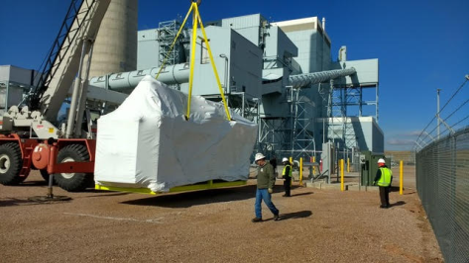
TDA Research
Extensive research program in cooperation with DOE/NETL.
Hybrid skid system using membrane and adsorbent technology.
Testing underway!

Slide 15
JCOAL – Kawasaki Heavy Industries
July 2016 – State of Wyoming - JCOAL (Japan Coal Energy Center) MOU.
April 2018 – Announcement of JCOAL-KHI (Kawasaki Heavy Industries) test at ITC – dry adsorbent, fixed bed technology.
Completed initial engineering design.
Currently receiving bids for detailed engineering and balance of EPC work.
Construction to commence in 2021.

Slide 16
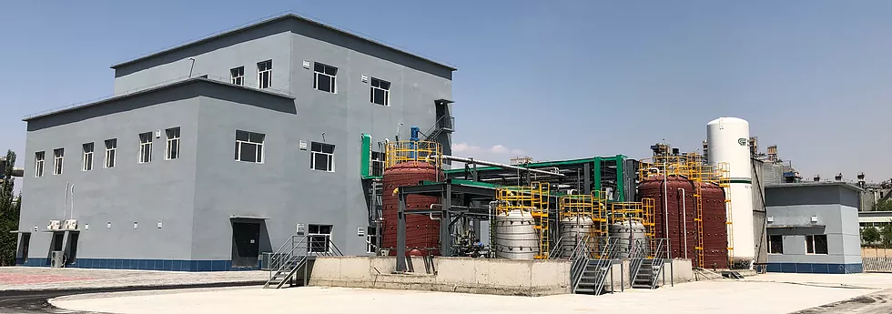
JCOAL – GreenOre
June 2019 – Wyoming Infrastructure Authority, JCOAL (Japan Coal Energy Center), Columbia University MOU.
November 2019 – ITC site visit
November 2019 – Agreement reached to proceed with test skid
A slag carbonation pilot plant owned by the JV between GreenOre and Baotou Steel Group (China), commissioned Spring 2019.

Slide 17
Membrane Technology and Research
MTR has a successful CO₂ capture research portfolio.
Has received initial phase 1 funding from U.S. DOE.
Partnering with Wyoming ITC for phase 2 application for design and permitting and phase 3 operation.
200 ton per day of liquid CO₂ product system will be located in the large test bay.
Photo Credit: NETL

Slide 18
University of Kentucky
UK has a successful CO₂ capture research portfolio.
Has received initial phase 1 funding from U.S. DOE for a large pilot.
Partnering with Wyoming ITC for phase 2 application for engineering design.
10 MWe scale.
Currently have a 0.7 MWe pilot at LGE’s Brown Station (left)
Photo Credit: NETL

Slide 19


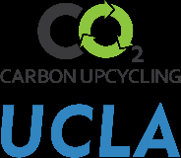

XPRIZE competition
Breathe (Bangalore, India) – Led by Dr. Sebastian Peter, the team is producing methanol, a common fuel and petrochemical feedstock, using a novel catalyst.
Carbon Capture Machine (Aberdeen, Scotland) – Based out of the University of Aberdeen, the team is producing solid carbonates with applications to building materials.
C4X (Suzhou, China) – Led by Dr. Wayne Song and Dr. Yuehui Li, the team is producing chemicals and bio-composite foamed plastics.
Dimensional Energy (Ithica, New York, US) – CEO Jason Salfi is using photocatalysis to convert CO2 to fuel.
Carbon Upcycling UCLA (Los Angeles, CA, USA) – Led by Dr. Gaurav Sant, the team is producing building materials that absorb CO₂ during the production process to replace concrete.
XPRIZE is a temporary tenant of the ITC and at the completion of the competition, the space will be available to new testers.

Slide 20




The next steps.
  University of Wyoming School of Energy Resources
  CarbonSAFE
  Center for Economic Geology Research
  Enhanced Oil Recovery Institute
  Wyoming Integrated Test Center
  Wyoming Corridor Initiatives
  Campbell County Wyoming

Slide 21
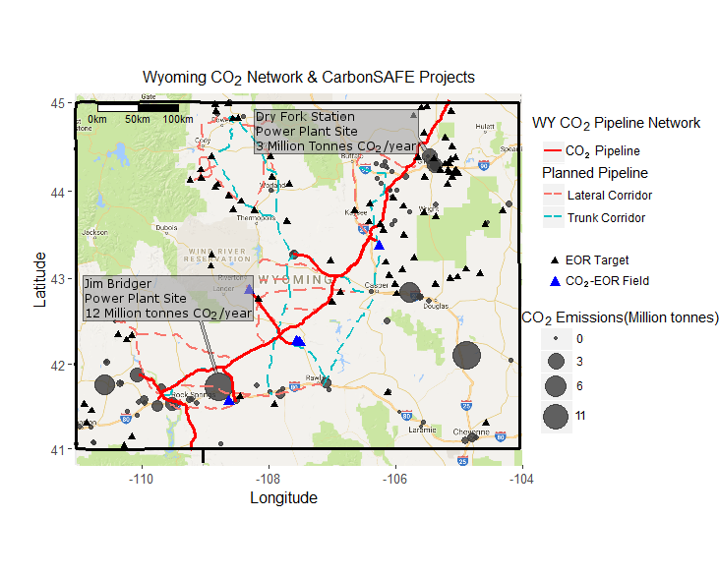
Why Wyoming?
Credit: School of Energy Resources University of Wyoming

Slide 22
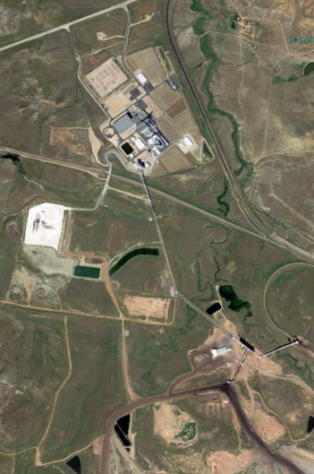
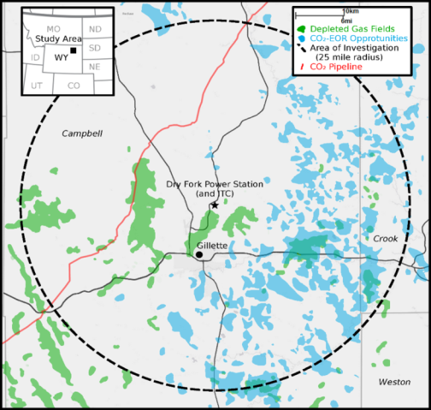

The value proposition
Dry Fork Power Station
(CO₂ Source)
Integrated Test Center
Integrated Test Center
Wyoming CarbonSAFE Phase II
(CO₂ Storage)
Credit: School of Energy Resources University of Wyoming

Slide 23

Stay in Touch!
Jason Begger
Executive Director
Wyoming Infrastructure Authority
jason.begger@wyo.gov
(307) 256-0098
wyomingitc.org
twitter.com/WyomingITC
facebook.com/WyomingITC

