Slide 1
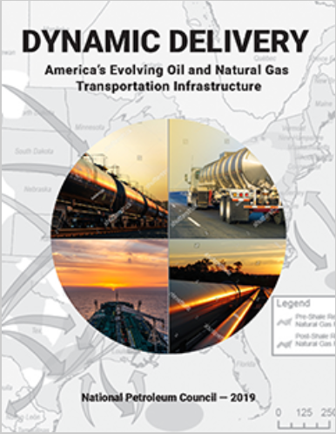
Dynamic Delivery: America’s Evolving Oil and Natural Gas Transportation Infrastructure
United States Energy Association (USEA) Webinar
September 22, 2020
Amy Shank, Williams Companies
Shawn Bennett, DOE
Paul McNutt, ConocoPhillips
Brooke Harris, ExxonMobil
Maria Dunn, Phillips 66
Doug Sauer, Phillips 66
Notes:
NPC speaker – slide 1
Introduction – Key Points
Introduction to the presentation should be tailored to the audience and include:
Thank all participants and speakers
Introduction of the presenters
The purpose of the presentation is to provide an overview of the National Petroleum Council (NPC) report on Dynamic Delivery: America’s Evolving Oil and Natural Gas Infrastructure
How the study might be of interest to the audience and their organization’s mission [IOGCC June 24, 2020 – objective is to provide an overview of the study with emphasis on findings and recommendations directed to the IOGCC specifically or to States generally. IOGCC will follow-up in areas where greater detail is desired through their committee structure.]

Slide 2
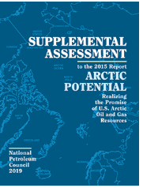
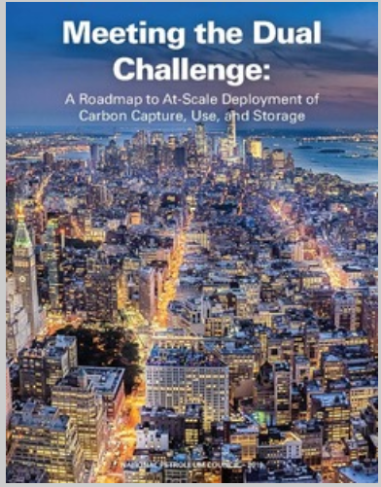
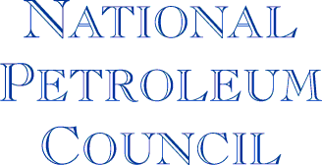
What is the National Petroleum Council?
The purpose of the National Petroleum Council (NPC) is solely to advise, inform, and make recommendations to the Secretary of Energy.
Federally chartered advisory committee that advises the Secretary of Energy on matters related to oil and natural gas and the oil and natural gas industries
Established in 1946 at request of President Truman
About 200 CEO-level executives
Advice in form of studies with findings and recommendations pertinent to broad public policy
Since its establishment, the NPC has prepared over 200 reports for the Department
The NPC is a well-balanced representation from all segments of the oil and gas industries, and also has members with interests outside of oil or natural gas operations, including representatives from academic, financial, research, Native American groups, and public interest organizations and institutions.
2019
2019
2019
Notes:
Slide 2 (NPC or DOE)
NPC Background - Key Points
The National Petroleum Council was established in 1946 at the request of President Harry S. Truman
The NPC is a federally chartered and privately funded advisory committee that advises the Secretary of Energy on matters related to oil and natural gas. The NPC provides advice in the form of studies with findings and recommendations relevant to public policy. The NPC undertakes studies for the Administration solely at the request of the Secretary of Energy.
Since its establishment, the NPC has prepared over 200 reports.
In 2019, the NPC delivered three reports in response to requests from the Secretary of Energy:
Supplemental on Arctic Potential, which was a follow-up from the 2015 Arctic Potential Study
Meeting the Dual Challenge which is focused on Carbon Capture, Use, and Storage AND,
Dynamic Delivery, which focuses on U.S. oil and natural gas infrastructure
Additional Information
The Council membership consists of approximately 200 persons and is selected and appointed by the Secretary of Energy.
The Council is a well-balanced representation with two-thirds of the membership from all segments of the oil and gas industry, all sections of the country, and from large and small companies, and the balance from academic, financial, research, Native American, and public interest organizations and institutions.

Slide 3
Dynamic Delivery Report Overview
Dynamic Delivery: America’s Evolving Oil and Natural Gas Transportation Infrastructure
Key Questions to Be Addressed Include:
Infrastructure improvements required to meet the changes in future supply and demand patterns
Advances in technology that can improve the safety, reliability, efficiency, and environmental performance of the oil and natural gas transportation system
Regulatory requirements or policies that may inhibit energy system resilience and proposed solutions
Other emerging issues that policy makers should consider (e.g., cybersecurity)
Notes:
DOE Speaker – Slide 3
Study Request - Key Points
The Secretary’s request for the study defined the key questions and topics that should be addressed:
Provide an overview of existing infrastructure and the need for additional infrastructure to address potential changes as supply and markets develop in new locations
Review and understand any constraints and bottlenecks that could arise. In particular, constraints that might limit the industry’s ability to continue to produce and grow U.S. oil and natural gas production
Technology advances that can improve the safety, resiliency, efficiency, and environmental performance of the infrastructure system
Identify regulatory or policy challenges to infrastructure development and potential solutions
Other emerging topics such as cybersecurity
All of these topics are significant in their own right which is why the study required expertise from multiple perspectives, topics, and segments within the industry.
Comments regarding COVID-19 and current environment
The COVID-19 pandemic has introduced a heightened degree of uncertainty in the institutions that make up our country’s energy production and delivery system. Over the past two months, most of the world’s industrialized countries have essentially shut down their economies. As a result, demand for motor gasoline, jet fuel, and other refined products has seen an unprecedented reduction. In response, North American refineries have scaled back their operations by 30%-40% or shut down entirely, according to the energy trade press. Simultaneously, this broad impact is being felt upstream and downstream in energy economies throughout the world. An ill-timed global oil market price collapse has compounded this dramatic impact, aggravating the sense of unpredictability in the oil and gas marketplace.
The NPC study was completed and reported out to the Secretary of Energy on December 12, 2019. Many of the outlooks in the Supply & Demand section were prepared in 2018-2019 and do not reflect current oil and gas market conditions. However, as the United States and the world emerge from the pandemic, demand for petroleum products will rebound to drive economic recovery. Even though the timing and path to economic recovery are uncertain, the oil and gas industry will undoubtedly play a central role in propelling the recovery forward. As we think of what will be needed for the oil and gas sector to thrive beyond this time of disruption and uncertainty, the findings and recommendations from this study provide insights for policy makers and business leaders to consider and act upon to support the return of prosperity.
The Department of Energy considers the ability to deliver energy equally important to producing and processing energy.
The oil and natural gas transportation systems are essential to maximizing the economic value of the nation’s resources and to ensuring the health, safety, and standard of living for America’s citizens. We only have to look to look at energy delivery challenges during events, such as hurricanes, etc., that disrupt supply to appreciate the importance of the oil and natural gas delivery system.
It was because of the critical role that the transportation system plays that the Secretary of Energy asked the National Petroleum Council for advice on improving the ability of the transportation system to change and evolve as the energy system changes.
Additional Information
Infrastructure Study was requested in September 2017

Slide 4
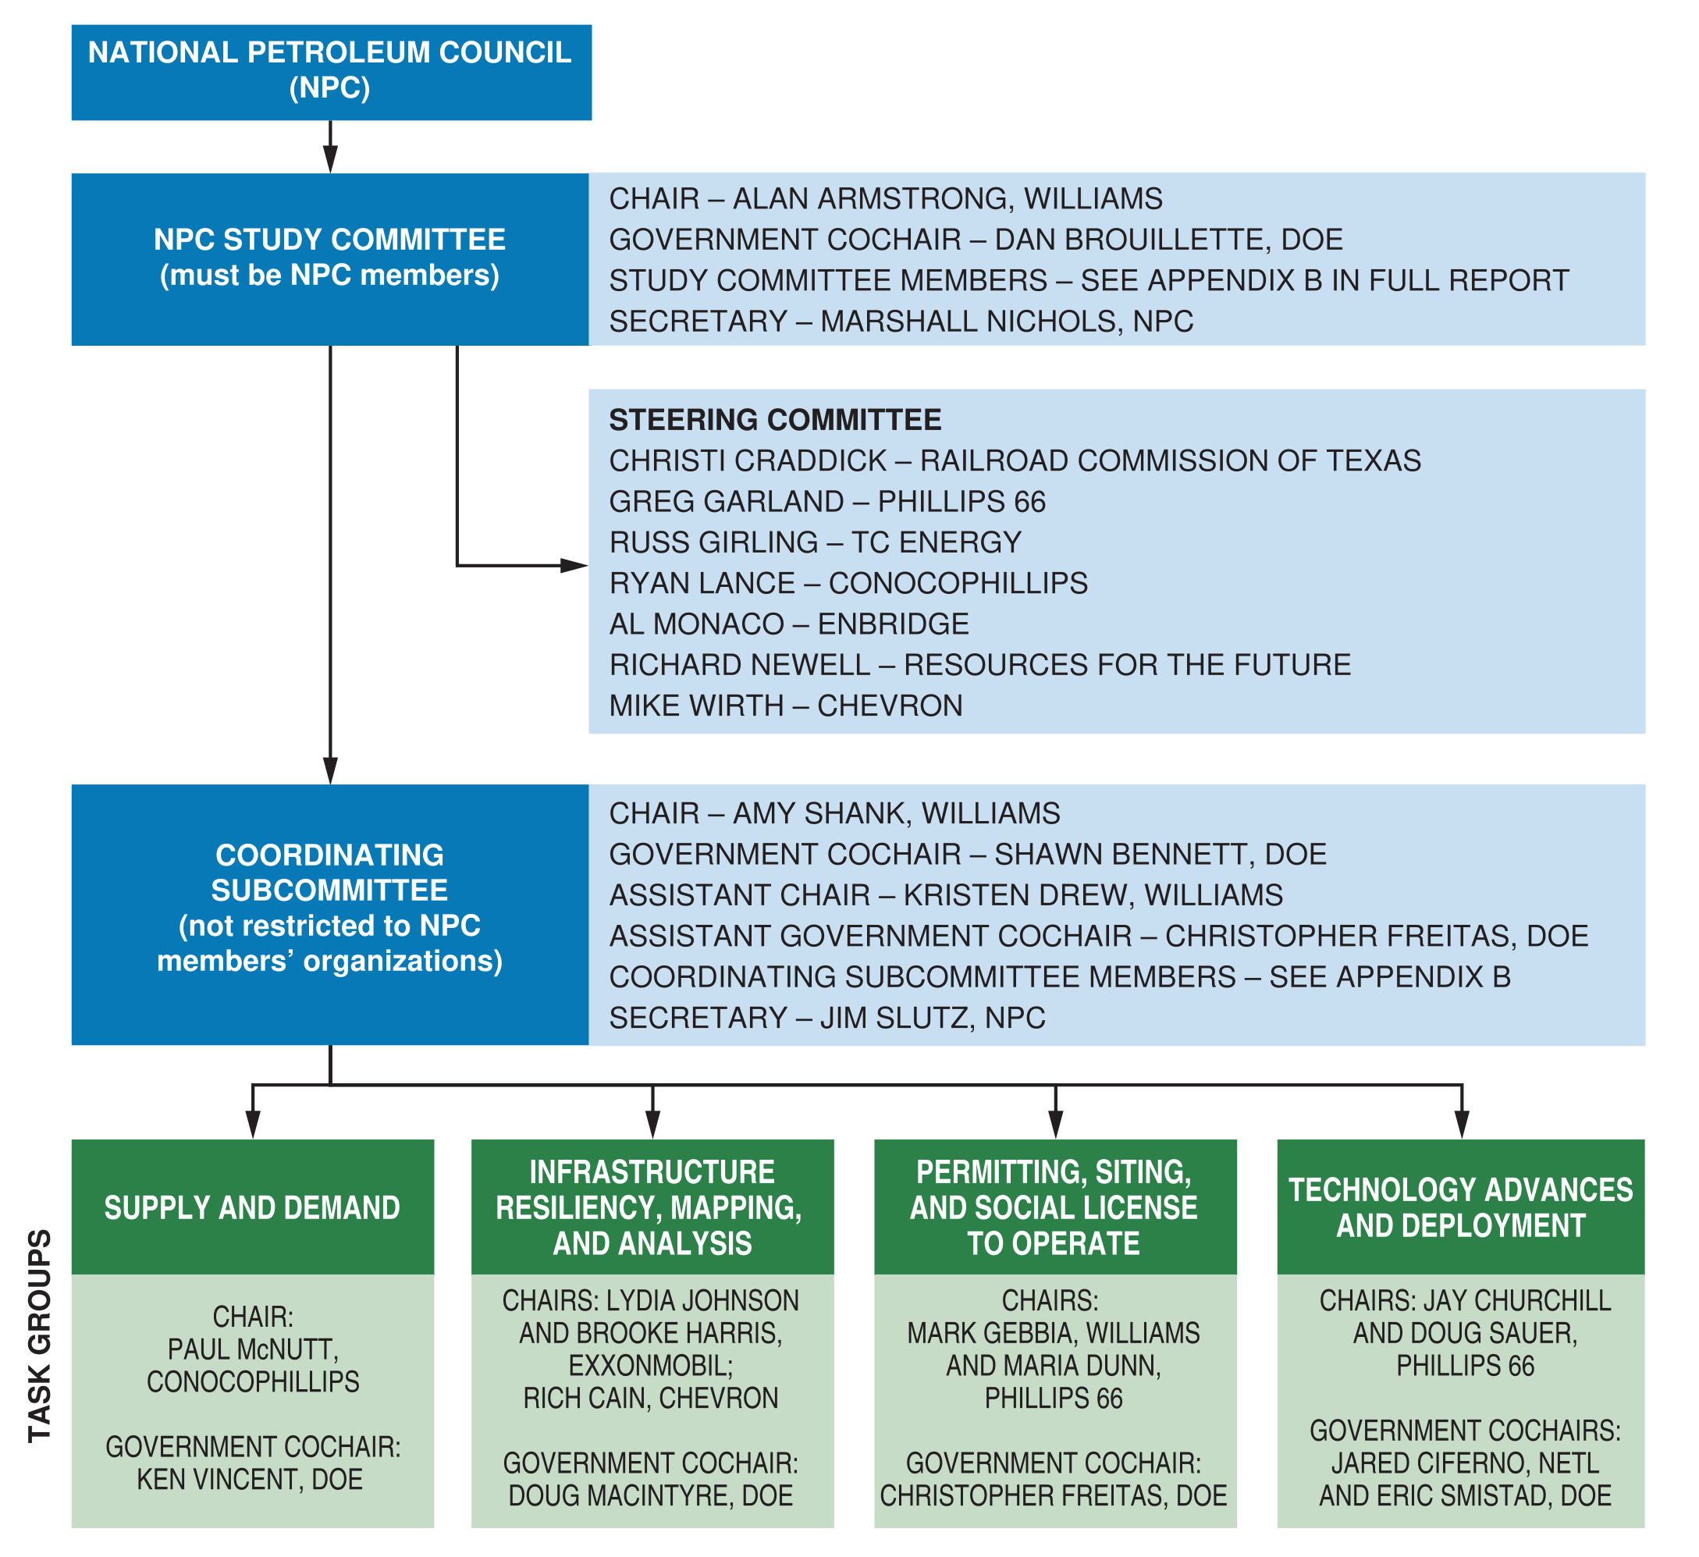
Dynamic Delivery Study Organization
The study organization is rooted in strong governance and comprehensive representation from across the industry to support in-depth analysis and well-informed recommendations.
Notes:
CSC Chair – slide 4
Infrastructure Study Organization - Key Points
The structure of the study team included the Study Committee, Steering Committee, the Coordinating Subcommittee (CSC), and the study Task Groups.
At the NPC level, there were 55 Council Members that were appointed to the Dynamic Delivery study and made up the Study Committee.
From that group, there were nine Steering Committee members engaged, with the role of making sure that the efforts were adequately resourced and providing direction on more contentious issues.
The Coordinating Sub-committee (CSC) led the development of the report including defining the scope and structure, establishing the timeline, and guiding the analysis and content development, and generally served as the day to day management group for the study. The CSC was at the helm of over 300 different study participants that were divided into four task groups:
Supply, Demand, and Resiliency;
Infrastructure Mapping and Analysis;
Permitting, Siting, and Social License to Operate; and
Technology Advances and Deployment group.
All of the study committees, subcommittees, and tasks groups have a government cochair.
[Note: Depending on audience, note compliance with antitrust.]
Additional Information
The leadership of the coordinating subcommittee included Amy Shank and Kristen Drew from The Williams Companies, Shawn Bennett and Christopher Freitas from the DOE, and Jim Slutz from the NPC.

Slide 5
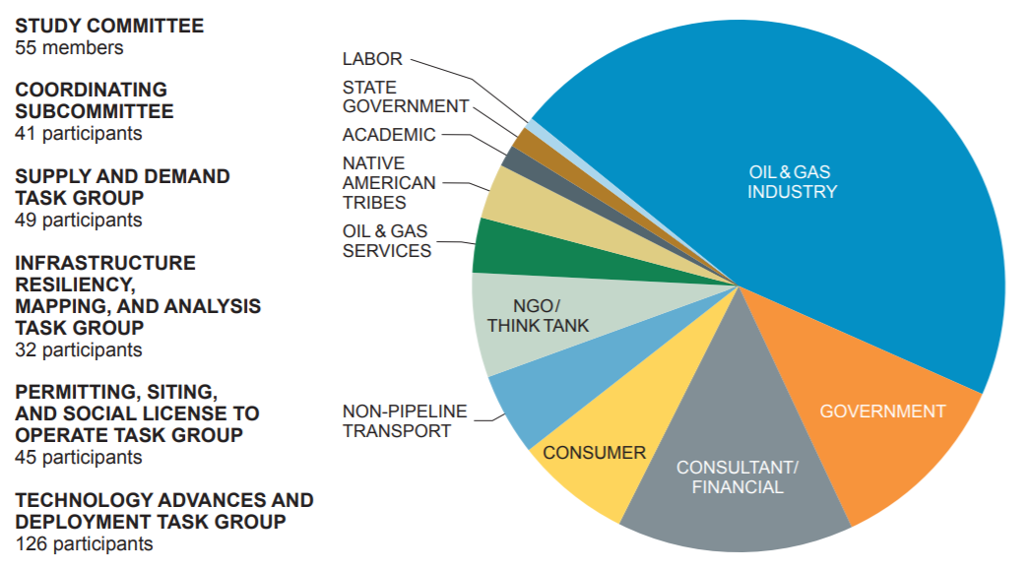
Dynamic Delivery Study Composition
The NPC Infrastructure Study is comprised of a diverse array of individuals, representing and providing the views and perspectives of a wide breath of the oil and natural gas industry and related sectors.
Over 300 individuals from the oil and natural gas industry, consulting, financial services, government, non-government organizations, and other entities contributed to the study
Notes:
Slide 5
Infrastructure Study Composition - Key Points
The NPC Infrastructure Study included a diverse group of participants and contributors.
There were over 300 study participants including representation from: most of the major oil and gas companies; transportation companies including the pipeline, marine, rail, and trucking sectors; various government agencies such as the Department of Energy, Department of Transportation, Department of State, Department of the Interior, the Federal Energy Regulatory Commission, the Army Corps. of Engineers, and state government representatives; Native American tribes; the consulting and financial sectors; non-government organizations; labor representation; academics; and others.
Less than half of the study participants work in the oil and gas business directly
The intent behind assembling such a diverse group was to allow for different perspectives to be considered and to make recommendations that allow us to move jointly ahead rather than continue to have a very divided perspective on how infrastructure is permitted and constructed that we all recognize is needed going forward.
Example of working together with a diverse group – climate change and NEPA provides and example of the value of diverse views and the importance of finding a shared agreement on a path forward.

Slide 6
Factors That Shape Oil & Natural Gas Production
Long-term projections of production show a wide range of outcomes. The variations reflect diverse assumptions about price, technology, policy, and resources.
Access to Capital
The oil and natural gas industry is capital intensive. Access to capital—internally within a company or from external sources—is essential to oil and natural gas production.
Access to Resource Base
Commercial scale oil and natural gas production can only take place where resources exist in adequate volumes and companies have access to develop the resources.
Costs and Resource Prices
The price that producers plan to receive for what they produce, and the cost of finding and developing oil and natural gas, are fundamental elements driving production trends.
Market Access
Successful oil and natural gas development requires access to domestic and international markets, which requires transportation. Market access is a key variable in the price that producers receive for oil and natural gas deliveries.
Government Policy
Policy at local, national, and international levels is an overarching influence. Policy can impact each of the fundamental factors that shape oil and natural gas production trends.
Technology
Technology to produce oil and natural gas is constantly evolving. As technology advances, so do the frontiers of production. For example, advances in well construction and completion are behind the growth of tight oil production in the United States.
Notes:
Factors that influence Oil and Natural Gas Production - Key Points
Oil and natural gas production is shaped by several factors such as access to capital, access to a resource base, the difference between the cost and price of resources, market access, government policy, and technology.
The study team looked at a variety of different supply and demand outlooks which have varying assumptions about these factors to understand what impacts they would have long-term on U.S. infrastructure.
Additional information
Access to Capital: According to IHS Markit, annual upstream spending in recent years in North America (United States and Canada) has ranged from $330 billion in 2014 to $95 billion in 2016. Spending in 2018 was $154 billion.
Access to Resource Base: Identifying where commercial production can take place comes with risk. There is no certainty about production volumes until wells are drilled and production begins.
Cost and Resource Prices: The difference between these two variables—revenue versus cost—and how they compare to other investment options drives the attractiveness of upstream investment.
Market Access: Market access requires transportation—most often by pipeline, but also by rail, truck, and marine vessel.
Government Policy: Government policy and interference in markets can be beneficial but can also impede innovation or result in costly compliance for industry.
Technology: Technology is a key input of innovation. As technologies advance, novel methods emerge to produce more oil and natural gas and deliver it safely and reliably to demand centers.

Slide 7
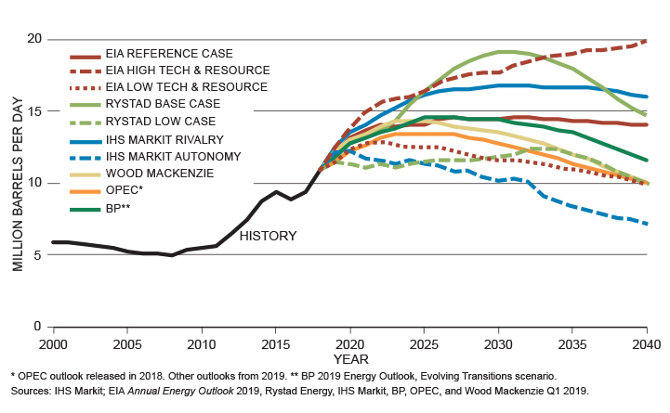
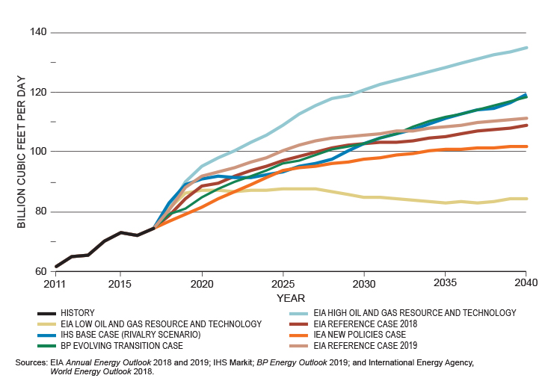
Crude Oil and Natural Gas Production
Key Finding
The US has become the largest producer of both oil and natural gas in the world, which has provided the nation with increased employment and economic growth, reduced energy imports, and reduced greenhouse gas (GHG) emissions. Increased natural gas use replacing coal to generate electricity has been the single largest contributor to reducing U.S. CO₂ emissions by 15% since 2005.
U.S. Crude Oil Production Forecasts through 2040
Crude Oil Production Growth
U.S. oil production has more than doubled since 2008
Hydraulic fracturing and directional drilling technology have helped drive the growth by enabling increased production from unconventional reservoirs
U.S. Natural Gas Production Forecasts through 2040
Natural Gas Production Growth
Natural gas production started increasing in 2006, aided by technology that unlocked production from tight and shale formations
Notes:
Crude Oil and Natural Gas Production - Key Points
The U.S. is now the largest producer of oil and natural gas in the world and that production has provided phenomenal and historic economic, environmental, and reliability benefits.
At the time that the U.S. was seeing substantial growth in oil and gas development, overall CO2 emissions decreased by 15 %. This reduction is primarily due to natural gas replacing coal for electricity generation, but there’s also the benefit of some technology advancements.
Crude Oil
Looking more closely at crude oil production, hydraulic fracturing and directional drilling technology have enabled U.S. oil production to more than double since 2008, gaining 5.9 million barrels per day (MMB/D) by 2018.
This increase represents an economic gain for the United States of $130 billion per year at $60 per barrel of crude oil.
Crude oil production projections to 2040 analyzed for this study range from a high of nearly 20 MMB/D to a low of 7 MMB/D. Most forecasts examined by this study show increasing production through the mid-2020s, followed by generally flat to slightly declining production.
Natural Gas
Growth in natural gas supply has been propelled by development in Appalachia—the Marcellus and Utica formations in Pennsylvania, West Virginia, and Ohio—and from increased associated natural gas production in the Bakken, Eagle Ford, and Permian Basin formations in North Dakota, Texas, and New Mexico.
Outlooks generally project increasing U.S. natural gas production, driven by growth in the Appalachian Basin as well as the Permian Basin.
In the Appalachian Basin, forecasts project production to double between 2018 and 2040.
In the Permian, there is expected growth through 2030 and then production levels off.
Additional Information
U.S. crude oil, natural gas, and NGLs production outlooks to 2040 were collected from a number of sources for this study, including EIA, IHS Markit, BP, Rystad, Wood Mackenzie, OPEC, and IEA.

Slide 8
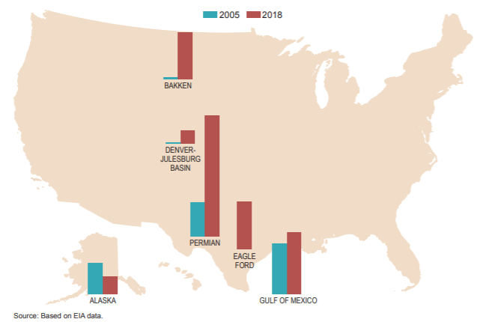
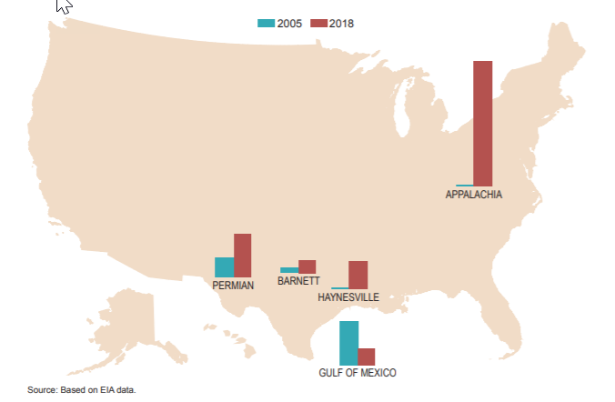
Geographic Shifts in Production
Crude oil production growth has been led by:
Tight oil development in the Permian Basin - West Texas and SE New Mexico
Shale oil production in the Eagle Ford - South Texas and Bakken - North Dakota
Natural Gas production has been propelled by:
The Appalachian Basin – the Marcellus and Utica formations in PA, WV, and OH.
Increased associated natural gas production in the Bakken, Eagle Ford, and Permian.
Oil Production Geographic Shifts,
2005 to 2018
Natural Gas Production Geographic Shifts,
2005 to 2018
Declines in traditional production regions like Alaska (crude oil) and the Gulf of Mexico (natural gas) have partially offset the growth.
Notes:
Geographic Shifts in Production – Key Points
The shale revolution has been a monumental change for the industry resulting in significant shifts in the geography of supply sources and energy flows across the country.
Recent oil production growth has been led by tight oil development in the Permian Basin of west Texas and southeast New Mexico, and two new areas of major U.S. shale oil production—the Eagle Ford formation in south Texas and the Bakken formation in North Dakota.
The exceptional rate of crude oil production growth in the Permian Basin of west Texas and southeast New Mexico has resulted in pipeline capacity additions struggling to keep up with production.
During 2012, 2014, 2017, and 2018, takeaway capacity was strained. When this happens, demand rises for additional transportation by rail or truck, and some production can become uneconomic. This demonstrates the importance of allowing infrastructure to adapt and grow as necessary. We will talk more about pipeline takeaway capacity in the Infrastructure Mapping & Resiliency section.
From 2010 through 2018, crude oil transportation capacity was increased and modified with expansion, flow reversal, and greenfield projects adding more than 7 MMB/D of capacity to accommodate the change in historical crude oil flow patterns.
Most significantly, oil imports into the U.S. Gulf Coast and flows toward the Great Lakes area have reversed, with oil now flowing from Canada and North Dakota toward the Great Lakes area and on to Oklahoma and Texas, backing out imports.
Natural gas production geographies have also changed dramatically in recent years.
Production in the Marcellus and Utica formations in PA, WV, and OH has grown from essentially zero in 2009 to about 31% of total U.S. production in 2018.
Growth in production of oil and natural gas has been partially offset by declines in traditional production regions.
Crude oil production in Alaska declined from ~1 MMB/D in the early 2000s to ~0.5 MMB/D in 2018.
Natural gas production in the Gulf of Mexico declined from 13.6 BCF/D in 2001, about 25% of total U.S. production, to less than 4 BCF/D in 2018, less than 5% of total U.S. production.

Slide 9
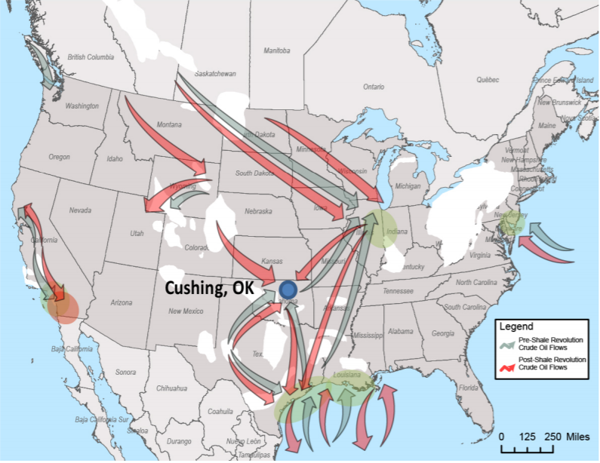
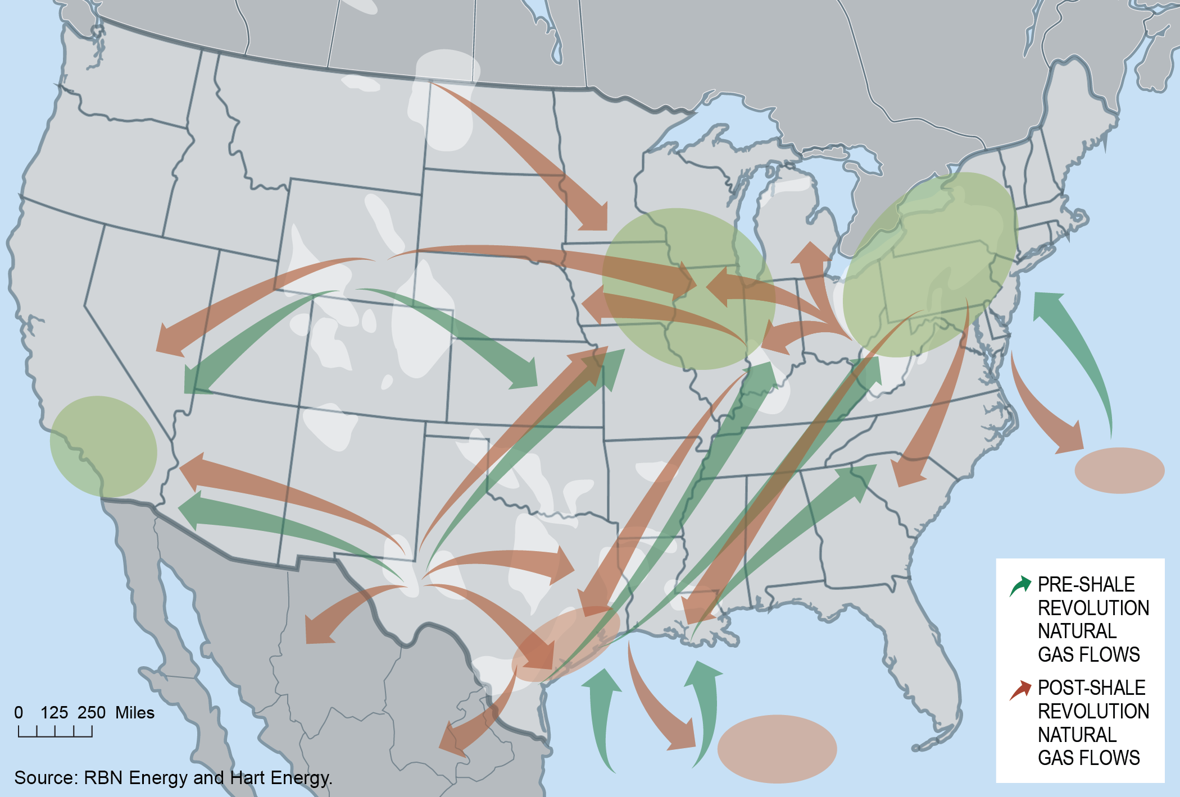
Shifting of Flows
Crude Oil Flows Pre- and Post-Shale
Natural Gas Flows Pre- and Post-Shale
Pre-Shale
Crude oil imports into the U.S. Gulf Coast and flows toward the Great Lakes area have reversed
Post-Shale
Crude oil now flows from Canada and North Dakota toward the Great Lakes and on to Oklahoma and Texas backing out imports
Pre-Shale
Pipelines delivered natural gas from Texas and Louisiana to the Northeast
Post-Shale
Large production increases in the Northeast have resulted in natural gas flowing south and west, supporting multiple new LNG export facilities on the Gulf Coast
Geographic shifts in production have led to significant changes in traditional crude oil and natural gas flows.
Notes:
Shifting of Flows – Key Points
Note on graphics: Green arrows are pre-shale flows and red arrows are post-shale flows
Crude oil flows pre-shale primarily went from the Gulf Coast (GC) to refineries in the region and some through Cushing, OK into Midwest markets.
Imports from Canada supplemented Midwest refinery feedstocks.
Waterborne crude oil imports arrived on the East Coast while West Coast refinery demand was met primarily with local supplies and inflows from Alaska.
Crude oil flows post-shale shifted and created new flow patterns
Incremental crude oil supplies began flowing south to the Gulf Coast from the Bakken, Oklahoma, and the Rockies and east from the Eagle Ford and Permian Basin
Canadian supplies flow to the Midwest and south by pipeline and rail to supply Gulf Coast refineries and for possible export.
Bakken crude oil also moved by rail to the West Coast, filling in partially for declining Alaskan supplies and backing out some overseas imports on the West Coast.
Natural gas flows pre-shale flowed from the Gulf Coast and midcontinent to the Midwest, West Texas, New Mexico, and the Northeast.
This was supported with some LNG imports into New England.
Rockies natural gas flowed both east and west, but primarily to California.
Natural gas flows post-shale have also significantly shifted flow patterns.
Flows from Texas and Louisiana to the Northeast have reversed to supply markets in the Gulf Coast, including multiple LNG export facilities.
Appalachian Basin natural gas began to flow south and into the Midwest.
Bakken natural gas also began to flow to the Midwest.
Rockies natural gas continued to flow both west and east, but the eastbound flows could not go past Illinois because of market pressure from Northeast supplies.
Permian natural gas continues to supply the Southwest and California and will be a primary supply source into South Texas exports to Mexico and LNG exports from the Gulf.
Shifting flows of both crude oil and natural gas will require additional infrastructure.
Crude oil infrastructure projects in the early phases of shale development were accomplished using existing pipeline paths making them relatively economic and with minimal environmental and land impacts. Going forward, they will require additional infrastructure and different routes.
New supply sources of natural gas have fewer transportation options, and production levels may be impacted without significant natural gas pipeline investment.

Slide 10
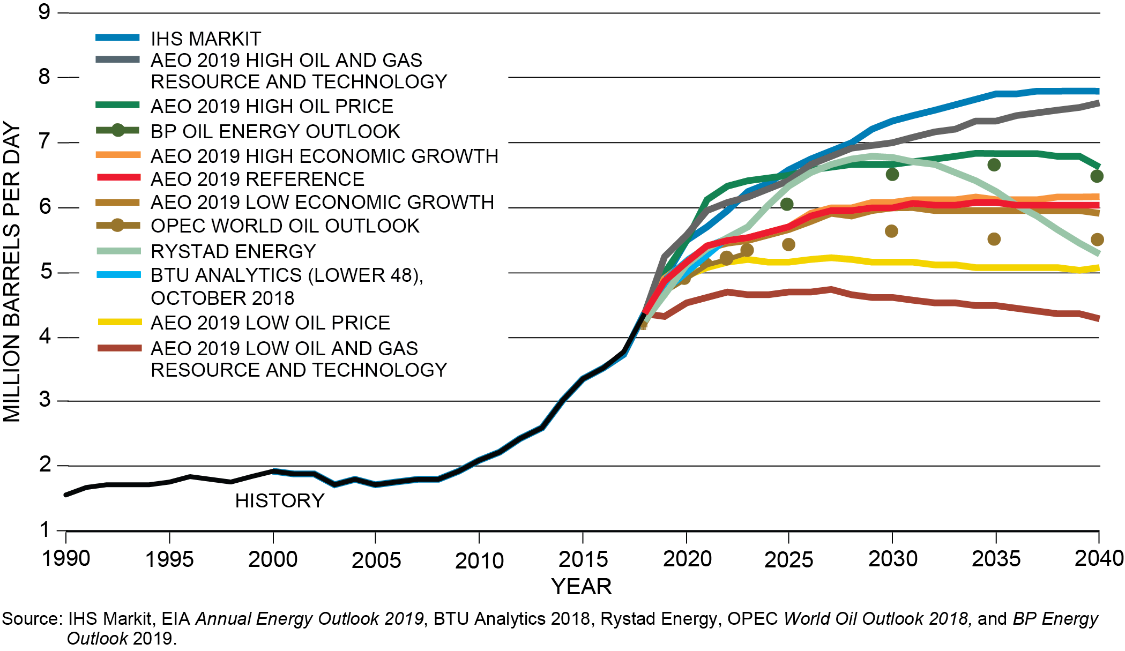
Natural Gas Liquids
With limited exception, the consensus is for natural gas liquids (NGLs) supply growth to continue. The average growth across outlooks represents a 40% increase in total NGL production as compared to 2018.
U.S. NGL Production Forecasts Through 2040
By 2050, the Southwest (Permian plays) and East (Marcellus and Utica plays) regions account for more than 50% of total U.S. NGL production.
Notes:
Natural Gas Liquids (NGLs) – Key Points
The trajectory of oil and natural gas production will directly shape that of NGLs production.
With limited exception, the consensus is for NGL supply growth to continue.
The average growth [to 2040] across forecasts is 1.6 MMB/D, representing a 40% increase in total NGL production compared to 2018.
By 2050, the Southwest (Permian) and East (Marcellus and Utica) regions account for more than 50% of total U.S. NGPL production.
Most outlooks are consistent in anticipating that the increase in NGL production in the East (Marcellus and Utica plays) and Southwest (Permian) during the next 10 years is mainly a result of the close association NGLs have with the development of crude oil and natural gas resources.
Additional Information
NGLs are a byproduct of “wet” natural gas production and used as petrochemical feedstocks and for heating and gasoline blending.
NGLs are principally ethane, propane, butane, and natural gasoline (also called C5+ naphtha.)
“Liquids-rich plays” are those geological areas or plays like the Marcellus and Utica (both in the Appalachian Basin) in which hydrocarbon production has more NGLs, or liquids, relative to dry gas, or methane, compared to other plays. The more “liquids-rich” a play, the more NGLs it will produce per unit of natural gas production.

Slide 11
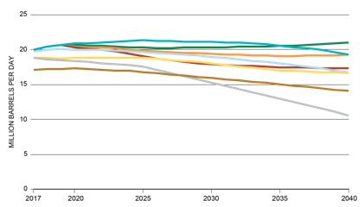
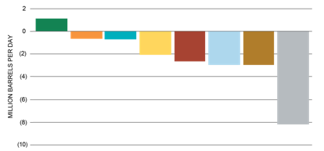
Refined Products Demand
Most outlooks reflect U.S. demand for petroleum liquids flat to declining through 2040
Gasoline demand sees the most prominent decline
Jet fuel demand increases in most outlooks
U.S. Liquids Consumption Outlooks
U.S. Liquids Consumption Outlooks
(Change in Liquids Demand Between 2017 and 2040)
Maintaining supplies of domestically manufactured jet fuel and diesel in the face of declining domestic gasoline demand will require increased exports of gasoline.
Notes:
Refined Products Demand – Key Points
The general view from all the forecasts reviewed is that, in total, U.S. liquids demand will decrease moderately between 2017 and 2040.
Forecasts that include additional policies to limit greenhouse gas emissions moderately reduce liquids demand. For individual refined transportation fuels, forecasts generally show flat-to-declining demand, with the majority of the demand decline in gasoline.
The exception to this trend is jet fuel, which increases an average of 2% annually over the period.
As jet fuel demand continues to increase, and there is a significant concern that many major airports are served either wholly by truck or by a single pipeline designed originally for much lower volumes, the jet fuel supply chain is vulnerable and unprepared for the next two decades of growth.
Note: The outlooks on U.S. liquids consumption shown in the slide are not all on the same basis. For example, some of the outlooks do not start at the same liquids-consumption level in 2017, which would be a historical data point. This is due to the exclusion of certain product categories from data, such as bunker fuel in the IEA New Policies Scenario. In addition, the IHS Rivalry Scenario is for refined products only.
Additional Information
Refinery equipment and the type of crude oil processed dictate the relative amounts of gasoline, jet fuel, and diesel produced; major new refining investment would be required to change these relative yields significantly.
Just maintaining supplies of domestically manufactured jet fuel and diesel in the face of declining domestic gasoline demand will require increased exports of gasoline to allow the existing refinery capacity to operate efficiently.
If gasoline exports cannot be increased, refining jobs and economic value could be lost.
Refinery Capacity: EIA forecasts modest growth in U.S. refining capacity of 500 KB/D to 2040.

Slide 12
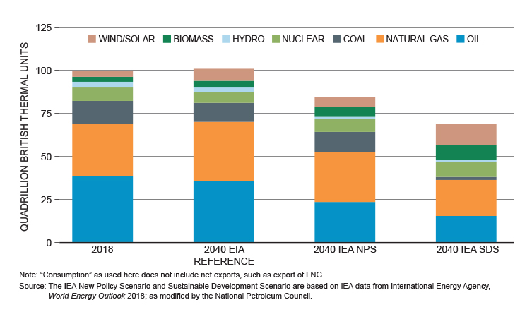
Implications of carbon-constrained scenarios
Key Finding
Even in energy forecasts designed to meet climate change targets, the largest energy sources continue to be oil and natural gas through at least 2040 to provide reliable and affordable energy.
Notes:
Implications of carbon-constrained scenarios – Key Points
One of the stand-out findings of the study is that no matter what scenario, even the low-carbon, high-renewable scenarios, America’s need for oil will remain significant, and the demand for natural gas will continue well into 2040.
Even in forecasts designed to meet climate change targets, the largest energy sources will continue to be oil and natural gas through at least 2040 to provide reliable and affordable energy.
The chart in the slide compares U.S. 2018 energy consumption by type to three energy forecasts for 2040:
EIA Annual Energy Outlook (AEO) 2018 Reference Case projects U.S. energy demand in 2040 about the same as in 2018 with oil declining slightly and natural gas increasing.
IEA World Energy Outlook (WEO) 2018 New Policies Scenario (IEA NPS) projects oil declining further than EIA’s forecast and natural gas staying about the same.
IEA WEO 2018 Sustainable Development Scenario (IEA SDS) forecasts a further decline in oil, near elimination of coal, and increasing renewables. Even in the SDS, natural gas and oil remain the first and second largest providers of U.S. energy in 2040.
With the exception of the IEA SDS, natural gas demand is generally projected to increase over the period as electricity generators rely on natural gas to replace coal and to provide backup for increasing supplies of intermittent wind and solar power.
Even in the IEA SDS, natural gas still comprises 32% of U.S. primary energy demand in 2040.
Natural gas-fired generators can quickly ramp up and down, allowing natural gas to complement increasing supplies of intermittent wind and solar power, assuring electrical grid stability and reliable supplies of electricity.
In 2018, natural gas was the single largest domestic electricity generation source, comprising 34% of total U.S. generation. More than 60% of U.S. electricity generating capacity installed in 2018 was fueled by natural gas.

Slide 13
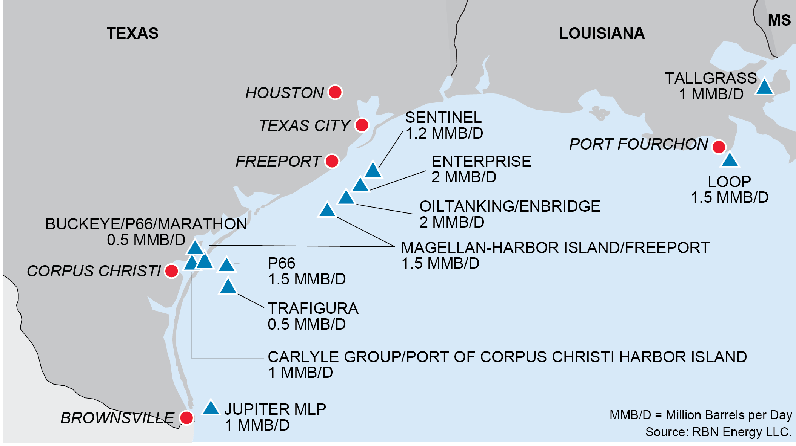
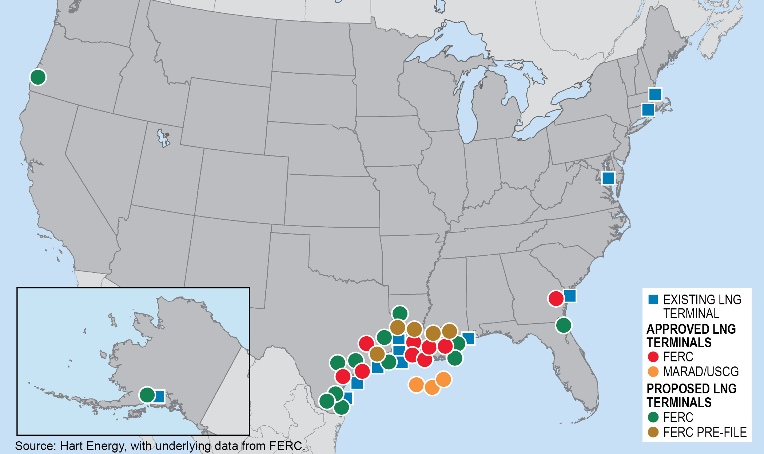
Demand for Exports
Key Finding
The. U.S. economy can benefit even further from increased export of oil and natural gas.
Planned New Gulf Coast Crude Oil Export Capacity Projects
Recent and Announced LNG Export Projects
Drivers for increased exports
Increased U.S. production of light oil will continue to exceed the requirements of the domestic refining capacity, driving the need for crude exports.
Declining domestic demand for gasoline will mean a requirement for increased exports of gasoline to international markets to maintain high crude oil runs and refinery capacity utilization.
Natural gas is expected to displace higher-carbon fuel for power generation in the U.S. and overseas. The latter will drive the need for increased Liquified Natural Gas (LNG) export capacity.
Notes:
Demand for Exports – Key Points
To understand the demand for exports, it is important to look at world energy demand, not just U.S. domestic demand. In its 2018 New Policies Scenario, the IEA forecasts that the world will need 27% more total energy in 2040 versus 2017. This is despite the fact that EIA and other forecasts estimate a ~5% reduction in U.S. liquids demand (Slide 12).
The IEA forecast aligns directionally with the U.S. EIA, which projects in its 2017 International Energy Outlook Reference Case that total world demand for energy will grow by 25% through 2040.
The EIA projects that natural gas will be the largest growing source of energy, with demand growing by 41% over 2017 levels.
The EIA also forecasts that there will be an increasing world need for oil, which grows by 15% and remains the single largest source of energy, providing 31% of all energy consumed in 2040.
U.S. exports will play a vital role in supplying oil, natural gas, and chemical feedstocks into this growing world demand and will support global energy security, improve the balance of trade, and create economic value for the United States.
U.S. oil demand outlooks provided to this study generally show demand flat to declining to 2040 with limited gains, if any, in refining capacity. This means that most, or even all, of the growth in U.S. crude oil production is assumed to be exported.
While strong demand growth is expected in the natural gas market, natural gas production growth is expected to outpace domestic demand. Exports—both to Mexico via pipeline and as LNG to global markets—are expected to grow.
Growing exports will require continuing improvements and expansion of U.S. infrastructure assets such as LNG export terminals.
Transition to Infrastructure Resiliency, Mapping, and Analysis
If history has taught us anything it’s that when it comes to oil and gas supply sources and markets the only constant is change. Tomorrow’s supply centers will most likely not be where they are today. American ingenuity will continue to surprise us. And while our existing oil and natural gas infrastructure is amazingly flexible and resilient, the study shows that it has flexed just about as much as it can. Additional infrastructure will be needed to meet future demands.

Slide 14
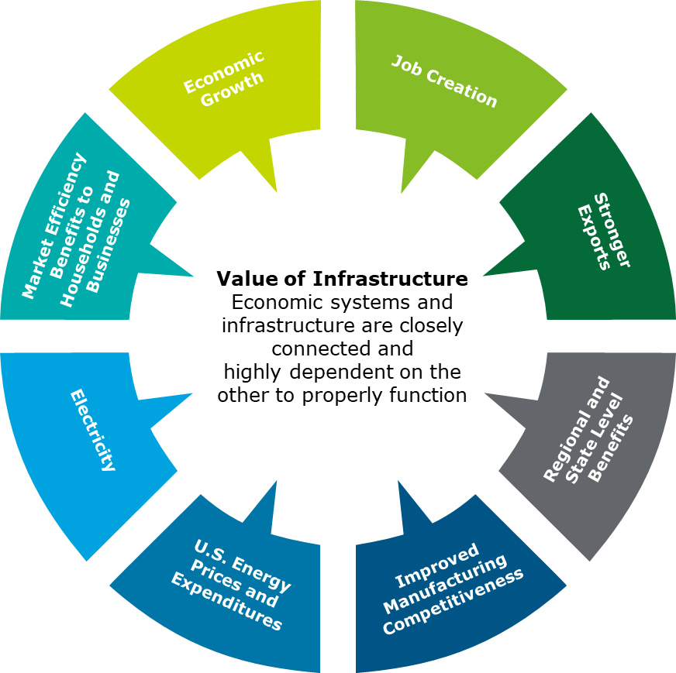
Value of Infrastructure
Key Finding
The benefits of the increase in oil and natural gas production could not have come about without the significant expansion and adaptation of transportation infrastructure capacity.
Economic Benefits of Infrastructure
The direct economic activity resulting from infrastructure investment, and the indirect and effects on supply chains
The jobs created from the construction and operation of midstream infrastructure
The infrastructure investment supports higher domestic energy production
Reliable energy infrastructure has supported growing U.S. energy production, lowering costs for domestic manufacturers
More efficient transport of energy lowers costs to consumers, reducing energy bills
Notes:
Value of Infrastructure – Key Points
The economic value specific to midstream infrastructure generally falls into five categories: 1) Economic growth, 2) Job creation, 3) Increased exports, 4) Improved manufacturing competitiveness, 5) Market efficiency benefits to households and businesses.
Economic Growth: Infrastructure investment has a direct impact on economic growth and so-called “multiplier effects” as the initial capital outlay ripples through the economy. By enabling the energy sector to function efficiently, midstream infrastructure supports the overall oil and gas sector, which is responsible for $1.3 trillion (7.6%) of U.S. gross domestic product (GDP), 10.3 million direct, indirect, and induced American jobs, and $714 billion in labor income in 2015. (based on a PWC analysis)
Job Creation: Similar to the economic impacts, the construction and operation of midstream infrastructure generates direct, indirect, and induced employment. ICF International estimates that annual midstream infrastructure (pipeline and gathering) spending of $22 billion per year, will generate more than 325,000 U.S. jobs per year. About 1/3 of those jobs would be directly involved in infrastructure development and the other 2/3 would be indirect or induced employment.
Increased Exports: This paradigm shift in U.S. net energy trade has had large impacts on the country’s overall trade deficit. EIA calculates that the total U.S. merchandise trade deficit in 2017 was nearly $250 billion lower than it otherwise would have been if the petroleum (crude oil, refined products, and NGLs) trade deficit had remained at its 2007 level.
Improved Manufacturing Competitiveness: Infrastructure and access to reliable, affordable energy are important dimensions in the competitiveness of U.S. manufacturing because they have helped to drive lower cost energy and raw materials for manufacturers.
A study by the Boston Consulting Group estimated cost savings from unconventional natural gas to be 4% or more of total manufacturing costs in a variety of industries.
Due to low-cost, abundant supply of natural gas and natural gas liquids, U.S. chemical manufacturing has seen increased investment in new projects to build or expand their shale advantaged capacity in the United States. Since 2010, 334 projects valued at $204 billion have been announced, with more than half under construction and/or having capital fully invested.
Market Efficiency Benefits to Households and Businesses: The ability to use infrastructure to align supply to customer demand has led to restrained prices of electricity.
Low-cost natural gas supplies enabled average retail electricity prices to grow at only about 8% from 2008 to 2018, a significant reduction from the 40+% increase the prior decade.
Consumers have benefited from a 15+% decline in motor gasoline prices.
Energy expenditures as a share of GDP have fallen from about 10% to 6-8%.
More infrastructure will be needed if we’re going to allow these benefits to continue.

Slide 15
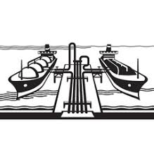
Infrastructure Constraints
Key Finding
Existing infrastructure has been modified and adapted to near-maximum capacity, requiring significant investment in new and existing pipelines, ports, rail facilities, and inland waterways.
Critical Infrastructure Bottlenecks
Takeaway Capacity Limitations
Lack of sufficient takeaway capacity for crude oil, natural gas, and NGLs in certain regions can hinder production growth and lead to increased flaring.
Three regions where this could continue to be a challenge are:
Permian Basin
Bakken Formation
Appalachia
Natural Gas Pipeline Access in New England and New York
Port of Houston Capacity
Oil and Natural Gas Export Capability
Enabling US Liquids Exports will require:
New greenfield pipelines
Additional expansion of existing pipelines
Increased marine terminal and waterway capacity
Enabling US LNG Exports will require:
Additional liquefaction, terminal, storage, and waterway capacity
Increased pipeline capacity from producing fields to the new export terminals
Notes:
Infrastructure Constraints – Key Points
Connecting new supply and demand centers in the future will hinge on the industry’s ability to secure significant public and private investment that’s needed to expand pipelines, ports, rail, and inland waterways.
When new infrastructure is delayed, bottlenecks form or worsen, such as what we’re already seeing today in New England or the Port of Houston, and also, in the form of export capacity limitations. These bottlenecks result in regional pricing discrepancies, fuel shortages, and the missed opportunity for all U.S. citizens to benefit from the lowest priced energy alternatives.
Natural Gas Pipeline Access in New England and New York: As Appalachian production grows, more pipeline capacity will be needed to bring production to market. However, pipeline construction to New York, New England, and some other regional markets has been constrained by regulatory and permitting delays, denials, public protest, political issues, and long-standing market structures.
Port of Houston Capacity: The Port of Houston’s proximity to the NGL infrastructure in Mont Belvieu, TX, makes the Port of Houston the largest exporter of NGLs in the U.S. The port is also a significant container port and receives other bulk cargoes. Congestion is significant, and the need to restrict the channel to one-way traffic when very large ships enter or leave has exacerbated the issue. The U.S. Army Corps of Engineers is currently studying alternatives to deepen and widen the channel.
Oil and Natural Gas Export Capability: Domestic infrastructure will be required to serve both foreign waterborne crude oil imports and growing exports. These challenges will be further amplified given the concurrent expansion of export infrastructure for NGL, LNG, and other associated commodities. The expected increase in exports will require dedicated export infrastructure and common infrastructure such as marine waterways and ports.
The ability to produce crude oil is frequently dependent on the ability to take away the natural gas and NGLs that are produced with crude oil.
Permian Basin takeaway capacity for crude oil, natural gas, or NGLs has occasionally been constrained, leading to situations in which producers have needed to defer drilling until new capacity is built.
Lack of natural gas takeaway capacity led to increased flaring of natural gas in 2019. Waivers have allowed for temporary flaring, but this may not possible long-term.

Slide 16
Labor Shortages and Lack of Specialized Skillsets
Key Finding
It is becoming increasingly challenging to keep pace with hiring and developing a well-qualified workforce to build and maintain existing and future infrastructure. This skilled labor shortage will continue to grow as the current workforce continues to retire.
The labor market is uncertain…
Continued energy market expansion is leading to a need for skilled workers
Skilled labor shortage is taking a toll on the oil and natural gas sector
Skilled labor is needed to build and maintain more than 2.5 million miles of pipelines and other critical infrastructure
Labor issues have impacted the Texas energy industry in the Permian Basin
15,000 jobs are found vacant at any given time.
Oil executives fear that the acute shortage could hinder the industry for decades to come.
…leading to industry pressures
Notes:
Labor Shortages and Lack of Specialized Skill Sets – Key Points
Addressing labor shortages and a lack of specialized skillsets will be necessary to support future infrastructure development.
As the energy sector market expands, an acute skilled labor shortage is taking a toll on the oil and gas sector. A 2018 industry-wide survey by the Associated General Contractors of America determined that 80% of construction firms were having a hard time filling hourly craft positions.
There is also a lack of skilled labor training of workers at the community level. In the absence of adequate supply of skilled workers in the community, projects must use transitory labor to meet their needs, which increases the unpredictability of labor availability and limits direct economic benefits to the communities from job creation.
Skilled trades training and apprenticeship programs will not only help build a skilled workforce on the community level, but they will also maximize the economic earning potential for those communities.
Supply & Demand Labor Statistics Industrial Information Resources Table: At a metropolitan area level, statistics are summarized into labor demand requirements by craft type, supply estimates and the estimated travelers expected to perform the work.
Table: Industrial Information Resources, Inc., 2019, provided May 7, 2020

Slide 17
Infrastructure Development Recommendations
Key Recommendations
Value of Infrastructure
Infrastructure Constraints
Labor Shortages & Lack of Specialized Skillsets
To mitigate negative impacts on interstate commerce, all levels of government should have constructive dialogue about the overall economic benefits from the nation’s energy resources and effectively engaging stakeholders and minimizing local impacts and risks.
Congress should fully appropriate the revenue coming into the Harbor Maintenance Trust Fund and the Inland Waterways Trust Fund to restore and fully maintain all U.S port and waterways infrastructure at their authorized dimensions.
Where warranted, Congress should authorize widening and/or deepening of channels to increase the capacity of ports to safely and efficiently transport energy cargoes.
The U.S. government, states, local communities, secondary schools, and industry should promote vocational career education and technical training of their constituents, members, and communities.
Industry, along with secondary and technical schools should support registered and accredited apprenticeship programs to ensure an adequate supply of skilled industrial construction, operations, and maintenance workers.
Notes:
Infrastructure Development Recommendations – Key Points
In order to maximize infrastructure value, the NPC recommends the following:
Interstate Commerce: To minimize the negative impacts on interstate commerce brought on by friction between federal and state interests and preferences, the NPC recommends that all levels of government should engage in constructive dialogue about the overall economic benefits from the nation’s energy resources. At the same time, industry must engage with stakeholders and work to minimize impacts and risks.
Ports and Inland Waterways: In order to maximize economic contribution of ports and inland waterways, the NPC recommends that Congress fully appropriate the revenue coming into the Harbor Maintenance Trust Fund and the Inland Waterway Trust Fund to restore and maintain all of our U.S. ports and waterways to their authorized dimensions and expand where needed.
Harbor Maintenance Trust Fund: The government collects a tax on imported cargoes to fund a Harbor Maintenance Trust Fund. Funds are received each year to maintain all coastal ports at their authorized dimensions, but appropriations from the fund are insufficient to maintain even the most critical energy ports at their authorized dimensions.
Labor Shortages & Lack of Specialized Skillsets: To ensure a skilled workforce is ready and able to build and maintain the infrastructure that we need, the NPC recommends that the Federal Government, states, secondary schools, and industry work together to promote vocational career education and advocate for registered and accredited apprenticeship programs

Slide 18
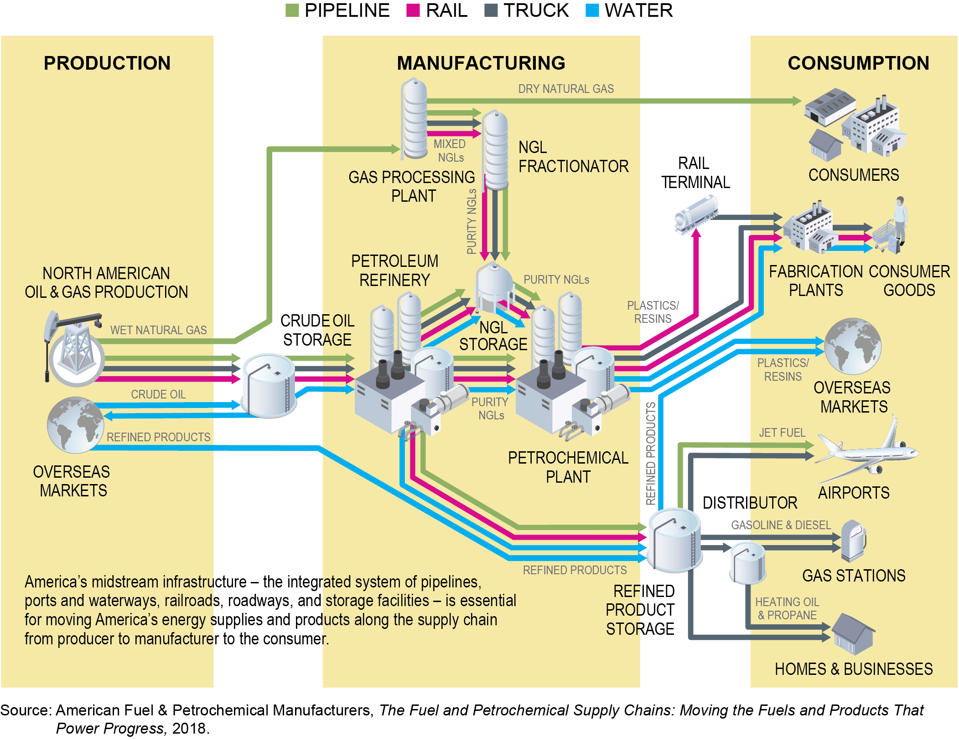
Infrastructure Resiliency
Key Finding
An interdependent infrastructure system of pipelines, truck, rail, and marine transport working together with storage ensures the delivery of reliable affordable energy.
U.S. Fuel and Petrochemical Supply Chain
Multiple Modes
The integration of various modes (pipeline, rail, trucks, and marine), is a key characteristic that enables a high level of reliability and flexibility.
Storage
Storage provides resiliency at production centers, market centers, and demand centers.
Multiple Routes
The presence of various routes enables hydrocarbons to reach their intended destinations.
Notes:
Infrastructure Resiliency – Key Points
Energy transportation resiliency is the ability of an infrastructure network to continue meeting demand even when portions of the network have been disrupted.
The graphic illustrates the various supply chains that were studied and that it takes many types of infrastructure working together to provide the resilient systems we enjoy.
The shale revolution illustrates the resiliency of U.S. oil and natural gas infrastructure. Up to now, our flexible, resilient, interdependent infrastructure systems have combined with technology improvements to facilitate the development of the tight geologic formations that previously had been inaccessible, bringing tremendous benefits to consumers.
The resiliency of the U.S. oil and natural gas infrastructure relies on the following:
Multiple Modes: The integration of various modes (pipeline, rail, trucks, and marine) at multiple places, is a key characteristic that enables a high level of reliability and flexibility.
Storage: Storage provides resiliency at production, market, and demand centers.
At demand centers, storage provides resiliency for consumer supply.
Near the point of production, storage guards against having to shut in production should a problem occur with the transportation infrastructure. Since a short-term production shut-in can degrade the performance of a well, producers have an incentive to plan for resilient offtake.
Multiple Routes: The presence of various routes enables hydrocarbons to reach their intended destinations.
An example would be two pipelines, one moving crude oil directly from west Texas to the Texas Gulf; and the other moving crude oil from west Texas to the large oil terminal in Cushing, Oklahoma, and joined to a pipeline moving crude oil from Cushing to the Texas Gulf. In the event of interruption to the first pipeline, crude oil supply could reach its destination via the second pipelines assuming the alternative pipelines have sufficient available capacity.
Transition to Permitting, Siting, and Community Engagement
As resilient and extensive as the U.S. oil and natural gas infrastructure system has proven to be in the face of the significant changes over the past 10-15 years, existing infrastructure has been expanded, modified, and adapted to near maximum capacity and additional infrastructure will be needed to meet future needs. However, significant challenges exist in the permitting and siting processes as well as with community engagement that could delay, limit, and even prevent this needed expansion. In the next section, the study team makes recommendations to improve these processes and mitigate these challenges.

Slide 19
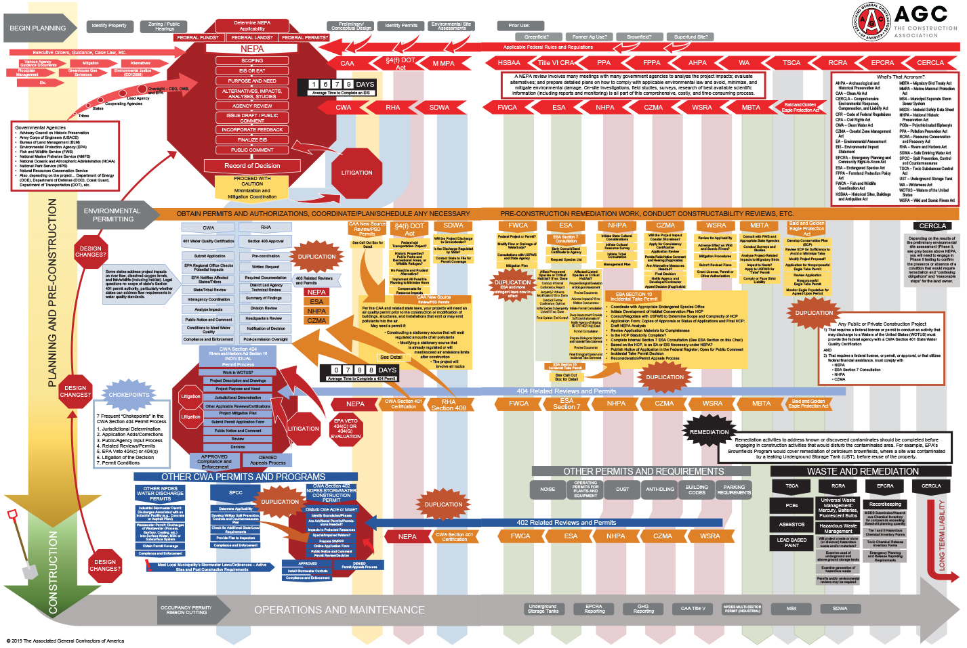
Permitting Process Complexity
Key Finding
Overlapping and duplicative regulatory requirements, inconsistencies across federal and state agencies, and unnecessarily lengthy administrative procedures have created a complex and unpredictable permitting process.
Source: Depiction of a NEPA Permitting Process, The Associated General Contractors of America, 2019.
Notes:
Permitting Process Complexity – Key Points
One of the most significant challenges to infrastructure permitting is the extremely complex set of processes involving multiple agencies at the federal and state level required to obtain approval to build new infrastructure such as a natural gas pipeline.
The process diagram on the slide is intended to illustrate this complexity. It has a lot of timelines, really small print, it is hard to read, and harder to follow It was included in the study to highlight the key finding that overlapping and duplicative regulatory requirements, inconsistencies across multiple federal and state agencies, and unnecessarily lengthy administrative procedures have created a complex and unpredictable permitting process.
Navigating these processes has become a challenging and unpredictable endeavor, making it difficult for companies to properly evaluate and plan these investments.
Overlapping and duplicative regulatory requirements: The regulatory framework for oil and natural gas infrastructure has its roots in the enactment of a series of laws in the 1970s, including the National Environmental Policy Act (NEPA), the Clean Air Act (CAA), the Clean Water Act (CWA), and the Endangered Species Act. These laws, along with at least 15 others, created processes for conducting federal reviews of energy infrastructure projects.
Conflicting federal and state agency policies: In addition to federal regulatory review of infrastructure projects and the state exercise of federally delegated authority, there is a wide variation in state-level environmental statutes and regulations. Generally, states have adopted environmental policy acts that do not align with each other or with federal laws, and it is incumbent on operators to comply with such acts and keep abreast of frequent changes.
Lack of permitting agency staffing: Regulatory agencies remain understaffed at both the federal and state level. Further, state budgets have contracted since the 2008 recession, which have a significant impact on recruitment and retention.
Regulatory bureaucracy: Although originally expected to be concise, NEPA environmental assessments and environmental impact statements (EIS) have grown in length and review time. A 2019 Council of Environmental Quality (CEQ) study analyzed the length of all EISs in a recent 5-year period across all federal agencies. The study found that final EISs averaged 669 pages and final appendices averaged more than 1,000 additional pages.
Unintended Consequences: Permitting challenges can delay and prevent the construction of infrastructure which can lead to high energy and electricity prices, constrained economic development, and lack of power reliability in periods of high demand.
Infrastructure bottlenecks in the Northeast have contributed to New England consumers paying among the highest prices for electricity among the U.S. Lower 48 states.
Pipeline constraints cause increased energy security and economic risks, as illustrated by the Northeast needing to import foreign LNG during the winter of 2017-2018.

Slide 20
Interagency Coordination
Key Recommendation
Significant improvements in coordination between federal, state, and local governments and agencies are needed to reduce permitting process inefficiencies.
State / Local
State / Federal
Federal
Focus SEPA reviews to fulfill state law or delegated federal decisions not required by law.
Industry, state agency organizations, local governments, and interested NGOs, should collaborate to create a model master structure for state permitting and coordination of approvals.
Have a single point of contact for permit coordination in a state.
States should leverage ECOS’ relationships to facilitate common agreement between federal and state jurisdictions when there are conflicts between NEPA and SEPA reviews.
Congress should authorize the lead federal agency to ensure that NEPA analyses encompass those needed for decisions by other federal and state agencies.
The federal government should leverage the FPISC to encourage concurrent review by states during the federal permitting process.
Incentivize states to comply with FAST-41 and OFD in conjunction with the federal NEPA process timeline for federal permits or decisions delegated to the states (CZMA, CWA, CAA).
Coordinate to concurrently conduct the FERC and PHMSA regulatory reviews for the construction of LNG Storage facilities.
CEQ should incorporate elements of the OFD MOU into NEPA regulations to improve interagency coordination to elevate delays and dispute resolution consistently.
CEQ should incorporate a single multiagency permitting timetable with specific concurrence points into the NEPA regulations.
Notes:
Interagency Coordination – Key Points
The involvement of different agencies at the federal, state, and local levels can lead to inefficiencies that may delay infrastructure projects. Coordination at all levels is required to effectively manage the permitting process across the various institutions involved. NPC recommendations address local, state, and federal level interagency coordination challenges:
State/Local Level Coordination Recommendations include:
Some State Environmental Policy Acts (SEPA)s reflect heightened state standards that are more protective than NEPA review. However, most of the state-level NEPA analogs operate at the same level of authority as NEPA with respect to approving or denying interstate natural gas pipeline projects. State SEPA reviews can reach different conclusions from NEPA review and can lead to the denial or delay of federally approved projects. Examples include:
Constitution Pipeline: Greenfield natural gas pipeline from Pennsylvania to New York; state denied water quality permit; further development of this project is no longer supported because of a significantly diminished risk adjusted return.
Jordan Cove LNG: As of March 2020, this proposed LNG terminal and pipeline project in southern Oregon received conditional approval from FERC, but failed to obtain three critical permits from the state of Oregon.
Establishing a model master structure for state permitting and a single point of contact for state level permit coordination would help alleviate confusion and inefficiencies in the current process.
State/Federal Coordination Recommendations include:
States should consider leveraging their Environmental Council of States’ (ECOS’) relationships with state officials and knowledge of the federal process to facilitate a common agreement between state and federal jurisdictions where there are potential conflicts between a NEPA and SEPA review.
Having states conduct concurrent reviews with the federal permitting process and comply with FAST-41 and OFD with respect to permitting timelines.
Federal Level Coordination:
Multiple agencies supervise the construction of LNG facilities. Consideration and approval of plans are rarely done jointly and can result in conflicting requirements, causing delay.
For example, FERC, PHMSA, and the U.S. Coast Guard inspect sites during construction and operations. These inspections overlap in scope and agencies can contradict each other and what was agreed to during permitting.
The One Federal Decision Memorandum of Understanding (OFD MOU) provides a mechanism for resolving disagreements among agencies that requires initial elevation through the chain of command of each relevant agency and encourages resolution of disputes in a consistent manner.
Preparing a single multiagency permitting timetable with specific concurrence points ensures early and continued interagency coordination during the process.

Slide 21
Stakeholder Engagement
Key Finding
Successful infrastructure projects in the US will depend upon early, effective, and continuous stakeholder engagement and collaboration.
Key Stakeholder Concerns
Safety
Climate change
Air and water quality
Noise
Traffic
Wear and tear on roads and bridges
Impacts on wildlife
Environmental justice
Loss of property use
Eminent domain
Historic and cultural preservation
Promotion of local jobs and economic benefit
Treaty rights
Protection of sacred sites
Key Recommendations
Early Engagement
Engage early with relevant organizations to understand and address stakeholder concerns
Stakeholder Input
Incorporate stakeholder input and collaborate on finding solutions; convey reasons where an interest is difficult to accommodate
Education and Awareness
Educate communities and stakeholders to highlight the need for infrastructure and how it can be developed and operated with stakeholder input
Engagement Practices
Implement engagement practices regarding energy, environmental, and related public policies that encourage responsible energy development and transport
Notes:
Stakeholder Engagement – Key Points
Stakeholders include individuals, state and local governments, and organizations that can affect or be affected by infrastructure development and operation. Private citizen stakeholders may include affected landowners, farmers and ranchers, small business owners, and local community leaders and individuals.
The study group held several listening sessions with public interest groups, private citizens, and local government representatives. The study group also reviewed public comments submitted by these groups on infrastructure projects, as well as the experiences related by study group members, including companies, American Indians and Alaska Natives, academia, and public interest groups.
Regulatory processes at all levels of government furnish opportunities for stakeholders to provide input to the permitting process, recognizing the importance of public involvement in and transparency of regulatory decisions. Stakeholder acceptance can influence if a project goes forward or gets delayed.
The key concerns identified through the listening sessions and additional research are outlined in the slide. Addressing these concerns will require working closely with the relevant stakeholders to ensure infrastructure projects can move forward.
Early Engagement: Early engagement is considered key to a project’s likelihood of approval. In addition to identifying and addressing issues that stakeholders might raise as objections later in the design process, gathering public input in the pre-filing process creates an early record that could speed agency approval.
Stakeholder Input: Failure to establish effective stakeholder engagement processes can lead to increased tensions and conflict among stakeholders, as well as hamper industry’s social license to operate. If a company or industry loses this social license, the legal license to operate can be jeopardized as well.
Education and Awareness: Target education and outreach to the needs of diverse audiences: Provide materials/strategies to reach non-English speaking populations, for those who do not use the internet, limited education audiences, etc.
Engagement Practices: Implement existing best practices for early and effective engagement. Work collectively toward more effective engagement practices regarding energy, environmental, and related public policies that encourage responsible energy development and transport.

Slide 22
Permitting and Climate Change Findings
Key Findings
The nation faces the dual challenge of providing affordable energy to support economic growth and human prosperity while addressing the environmental effects including the risks of climate change.
Industry shares the public’s concerns that climate change is a serious issue that must be addressed. Litigation of individual projects to address climate concerns is an ineffective approach.
The permitting and construction of numerous energy infrastructure projects has been challenged, delayed, or stopped as a result of litigation by stakeholders concerned about climate change and the associated policy debate.
National Environmental Policy Act (NEPA)
Council on Environmental Quality (CEQ)
CEQ oversees Federal agency implementation of NEPA
CEQ published a proposed rule to comprehensively update and modernize its regulations for implementing NEPA. Additional details can be found at:
https://www.whitehouse.gov/ceq/
NEPA has become a leading basis for litigation and challenging agency decisions on energy infrastructure. The uncertainty over NEPA interpretation has led to often unnecessarily expanded reviews and delays in permitting.
A 2019 NEPA study found NEPA was the most frequent basis for litigation against natural gas and oil pipelines.
Frequently claimed NEPA errors include:
Insufficient analysis of direct and indirect effects
Insufficient review of upstream and downstream greenhouse gases and cumulative impacts.
Notes:
Permitting and Climate Change Findings – Key Points
One set of stakeholders that have been increasingly active are those that connect the development of oil and natural gas infrastructure with the negative impacts on climate.
The NPC recognizes the dual challenge of providing affordable energy while addressing the risks of climate change. While the NPC shares the concern that climate change is a serious issue requiring action, fighting individual projects in the courts is an ineffective way to achieve change.
NEPA has become a leading basis for litigation and challenging agency decisions on energy infrastructure. The uncertainty over NEPA interpretation has led to expanded reviews and delays in permitting.
Comments filed by citizens in opposition to many infrastructure projects suggest that many who contest new infrastructure, do so out of the belief that the nation will not take other effective measures to achieve GHG emissions reductions.
Federal agencies’ NEPA reviews are typically thorough and generally upheld— agencies have a more than 80% success rate in litigation.
The main NEPA interpretation issue in the litigation is whether FERC, in assessing the environmental impacts of a particular project, must include (1) greenhouse gas emissions upstream of a project, from an increase of production to support an infrastructure project, or (2) emissions downstream of a project, from the use of the fuel transported by the infrastructure.
CEQ has a proposed rulemaking to modernize and improve NEPA regulations to better align with the goals set forth in Executive Order 13807 on infrastructure permitting. The proposed rulemaking includes several recommendations proposed by the NPC such as:
Clarifying the definition of environmental “effects” of a proposed action
Requiring a joint schedule for reaching decisions
Steps to make the process more efficient such as establishing time limits and page limits for the completion of environmental impact statements and environmental assessments.
Strengthening the role of the lead federal agency and requiring timely resolution of disputes
Additional Information
The National Environmental Policy Act (NEPA) (1970), created a government-wide mandate to consider the environmental impacts of major federal actions that significantly affect the quality of the human environment.
NEPA also established the Council on Environmental Quality (CEQ) within the Executive Office of the White House. CEQ is responsible for guiding NEPA activities across federal agencies and issues regulations and guidance to agencies to comply with NEPA.

Slide 23
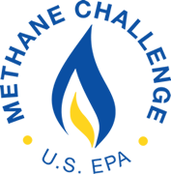
Permitting and Climate Change Recommendations
Key Recommendations
Industry
All infrastructure companies should strive for an outstanding environmental compliance record and to reduce the intensity of GHG emissions from their operations. Emissions reduction programs are a means of demonstrating a company’s efforts to reduce methane emissions.
Government
Congress should clarify that GHG assessments under NEPA, for oil and natural gas infrastructure projects, are confined to emissions that are:
Proximately caused by federal action and,
Reasonably foreseeable
Congress should enact a comprehensive national policy to reduce greenhouse gas emissions and seek to harmonize federal, state, and sectoral policies to enhance efficiency. The policy should be economy wide, applicable to all sources of emissions, market-based, transparent, predictable, technology agnostic, and internationally competitive.
Notes:
Permitting and Climate Change Recommendations – Key Points
Recommendations to address the topic of climate change will require leadership and action from both industry and government. To that end, the NPC recommends:
All oil and gas infrastructure companies should strive for outstanding environmental compliance records and continue to work to reduce GHG emissions from their operations.
The study highlights several programs that illustrate industry’s commitment in this area. Some of these are listed on the slide.
Due to the uncertainty in interpretation, Congress should clarify that GHG assessments under NEPA are confined to emissions that are:
proximately caused (causally related) by the federal action,
reasonably foreseeable
Congressional action adopting a comprehensive policy to reduce economy-wide GHG emissions could help alleviate the issues stemming from the patchwork of local, state, regional, and sector-specific GHG policies AND the concerns of environmentally focused stakeholders, thus minimizing the need for litigation. The NPC recommends:
Congress should enact a comprehensive national policy to reduce GHG emissions and harmonize federal, state, and sectoral policies. The policy should be economy wide, applicable to all sources of emissions, market-based, transparent, predictable, technology agnostic, and internationally competitive.
Transition to Technology Advances & Deployment
Some of the concerns expressed by stakeholders in the infrastructure permitting process are related to the safety and environmental impacts of oil and natural gas infrastructure. Technology combined with robust safety and operations integrity management systems, have already led to significant improvements in these areas and will continue to do so. That is why the last topic addressed by the study team was technology advances and deployment for oil and natural gas infrastructure.

Slide 24
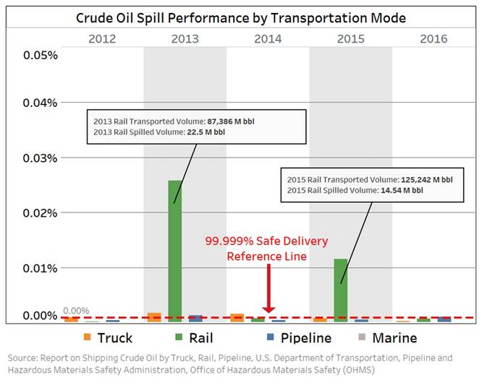
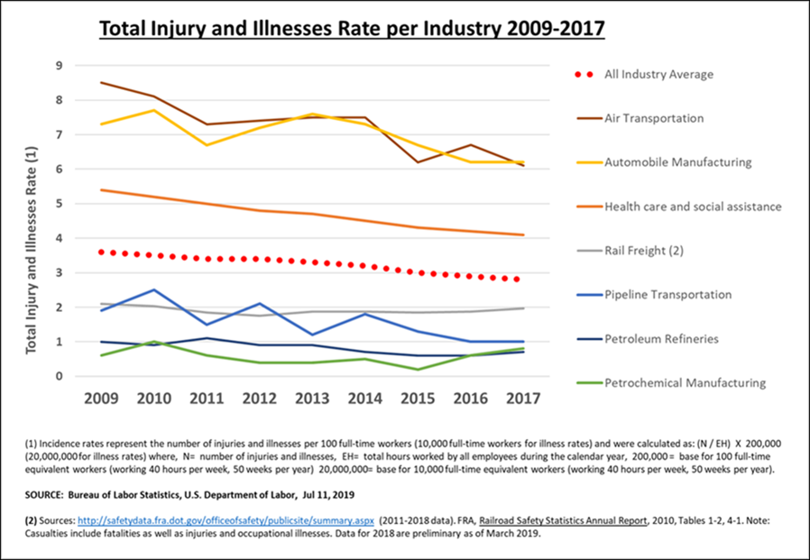
Safety of O&G Transportation Infrastructure Delivery
Key Finding
Crude oil, petroleum products, and natural gas moved by the nation’s infrastructure reach their destinations with a high degree of safety, resiliency, and environmental performance. However, incidents have occurred, and oil and gas companies, the maritime, railroad, and trucking industries are committed to continuous improvement.
.
Safety performance improvements will come from advancements in technology, safety management systems, and a more adaptive performance-based regulatory framework.
Notes:
Safety of Oil and Natural Gas Transportation Infrastructure – Key Points
Through the hard work of the over 100 individuals that contributed to the Technology Advancements & Deployment chapter of the study, we verified what we already knew: that oil and natural gas arrives at its destination with a high degree of safety, reliability, and environmental performance nearly 100 percent of the time. But incidents have happened, and we can do better. The oil and gas infrastructure companies are dedicated to continuous improvement and are working to find a path to zero.
The chart on the left, illustrates key trend data on crude oil spills by transportation mode. In March 2019, the Department of Transportation (DOT) issued a report to Congress on the delivery performance of shipping crude oil transported by truck, rail, marine, and pipeline which showed that over a 10-year period through 2016, crude oil transported by these modes safely reached its destination more than 99.999% of the time.
To put what it means to deliver safely 99.999% of the time into an everyday context, 99.999% is the equivalent to an error rate of 1 in 100,000 or an availability with only 5.26 minutes or less of downtime in an entire year.
Oil and natural gas transportation companies’ focus is now on addressing the remaining 0.001% to eliminate incidents.
Note on spills from crude-by-rail in 2013 and 2015 (high green bars on the chart): Between 2012-2016, crude oil volumes by rail increased significantly from prior years. During 3 of those 5 years, crude oil by rail safely reached its destination 99.999% of the time. During 2 of the years, performance declined due to low probability, but significant events.
According to the Bureau of Labor Statistics, petroleum refining, petrochemical manufacturing, pipeline, and rail transportation continue to provide some of the safest workplaces compared to all other private industries listed and much safer than the private industry average.
Analysis shows that the majority of incidents result in part from human and organizational factors.
Strengthening safety management systems, advancing and deploying technologies, and creating a more adaptive and performance-based regulatory framework could accelerate safety performance improvements.
In the next few slides, we will provide a more detailed overview of the study recommendations for each mode of transport.

Slide 25
Pipeline Technologies
Background
Pipelines have proven to be a safe form of hydrocarbon transport; yet, additional areas exist to improve safety, operational, and environmental performance in the industry.
Recommendations
Safety Management Systems
Pipeline companies should proactively implement safety management systems and strengthen industry-wide safety culture to continuously improve performance.
In-line Inspection/ Leak Detection
Industry, working through research consortiums, should pursue a pilot program as recommended by PHMSA to advance linear monitoring systems (e.g., fiber optics, hydrocarbon detection cables) that could provide additional leak detection capabilities.
Geohazard Management through Data Sharing
DOE and DOT should work with FEMA, NOAA, USGS, or other relevant agencies to organize an information sharing effort to assist with efficient acquisition and management of industry-specific geospatial data.
Coating Systems and Pipeline Materials
DOE, working with PHMSA, industry research organizations, and coating manufacturers, should support R&D on new pipeline and repair coating systems and pipeline materials that are highly durable and damage resistant during construction.
Methane Emissions
DOE should work with industry and technology developers to advance and deploy technologies to better identify, locate, quantify, and mitigate methane emissions.
Notes:
Pipeline Technologies – Key Points
Although pipelines have an impressive safety record, additional areas exist to improve safety, operational, and environmental performance in the industry.
Four categories of causes (i.e., corrosion, excavation damage, natural force damage [e.g., geohazards], and pipe/weld failures) contribute to approximately 75% of all volume released from pipelines.
R&D improvements across safety management systems, in-line inspection tools, geospatial data analysis and sharing, coating systems, and methane emissions may reduce future pipeline incidents.
Safety Management: Improved management systems have been essential to asset integrity performance improvements.
The industry, federal and state regulators, and representatives of the public collaborated to draft and implement API Recommended Practice (RP) 1173, Pipeline Safety Management Systems which provides a comprehensive framework for managing pipelines, including asset integrity.
In-line Inspection/ Leak Detection: Robust and effective leak detection capabilities exist today. Additional detection of the smallest release rates may be improved by validating newer linear monitoring systems and integrating them with other mature technologies.
Geohazard Management through Data Sharing: Desktop research continues as the foundational approach for geohazard management. A portion of the applicable data that is needed is publicly available but is not readily accessible from central repositories for consistent use across industry. An emerging field of leak detection and geohazard monitoring techniques employs the use of remote sensing technologies (RSTs) and geospatial analytics (GSAs).
RST and GA are commercially available technologies that identify, alert, and quantify specific measurements, using noncontact sensors, to detect liquid and gas (methane) leaks, to identify encroachment, and to monitor geohazards..
Coating Systems and Pipeline Materials: Incident statistics from 2014 to 2018 indicate that leading causes of liquids and natural gas pipeline incidents are related to construction and maintenance and involve corrosion, excavation incidents, and pipe material and weld failures. Advancing R&D in new pipeline and repair coating systems could help reduce these incidents.
Methane Emissions: Compressor station fugitive methane emissions could potentially be further reduced through the use of new, innovative technologies for identifying, locating, and quantifying methane emissions.
Natural gas consumption volumes since 1990 have increased more than 40%. In the same timeframe, transmission pipeline and storage sectors have reduced methane emissions by 43%.

Slide 26
Storage Technologies
Key Finding
Advancements in new technologies have been an important contributor to industry’s safety, reliability, and environmental performance. Overcoming challenges and barriers to new technology development and deployment would accelerate these improvements.
Recommendations: Underground Storage
Casing and Cement:
DOE should lead a collaborative effort with PHMSA and industry trade associations to determine the most effective measures of casing and cement integrity and explore opportunities for casing and cement logging improvements.
Well Inspection Technology:
DOE should pursue additional R&D on well inspection technologies that can improve integrity logging, and reduce the frequency of tubing removals, which would reduce risk to personnel and the environment.
Recommendation: Aboveground Storage
Tank Integrity Monitoring:
Industry and PHMSA should consider additional research and validation on tank integrity monitoring technologies to measure floating roof stability and integrity, including:
camera technologies and associated pattern recognition software,
wireless sensors, and
unmanned aerial systems (drones)
Notes:
Storage Technologies – Key Points
The underground storage of natural gas is a critical component of the natural gas supply system in the United States. Gas storage facilities store the natural gas when demand is low and supply the natural gas when demand increases.
Natural gas storage also reduces overall energy costs as it is stored when demand and prices are low and is delivered when needed.
Approximately 400 natural gas storage facilities, comprising almost 18,000 storage wells, provide service today.
Addressing well design and inspection technologies is critical to reducing safety incidents in underground natural gas storage facilities.
Well design and integrity are a critical aspect of managing underground storage reservoirs.
Industry deploys a variety of technologies to manage wells, including well logging to verify cement bonds at different sections of the well and to determine integrity of well casings.
Safety incident case study: While industry has had an excellent safety record overall with underground gas storage, incidents have occurred. One notable incident was the Aliso Canyon SS-25 well gas leak, which lasted from October 2015 until February 2016. During the incident approximately 6 billion cubic feet of natural gas escaped to the atmosphere. The leak was a result of external microbial corrosion (MIC) of the 7” casing. The MIC caused approximately 80% wall loss which resulted in bulging, thinning, and ultimately a failure of the well casing.
In aboveground storage facilities, recent technology advancements with floating roof integrity monitoring offer promising opportunities to reduce risk of mechanical roof failures.
Aboveground floating roof storage tanks consist of an open-top cylindrical steel shell with a roof that floats on the surface of the stored liquid. It is the preferred method for controlling product evaporation loss and preventing tank fires. These tanks are used both as break out tanks for pipeline operation and long-term storage.
The U.S. EIA reports that over the past decade the fast growth in domestic crude oil production has strained storage capacity and demand for new infrastructure has been acute with the U.S. crude oil storage capacity increasing by 60% since March 2011 to 590 million barrels in 2019.
Industry research and incident investigations have concluded that a sizable portion of floating roof incidents could have been prevented through earlier recognition of specific roof behavior patterns. Technologies have been developed to detect threats in real time, the threat that a floating roof may sink, but widespread field adoption is limited.

Slide 27
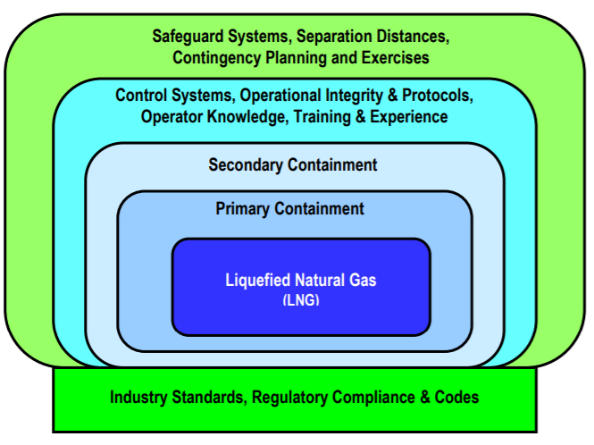
LNG Storage
Overview
The LNG industry has advanced significantly since inception in both safety and technology and has an exemplary safety record.
After being an importer of LNG for many years, in 2016, the United States began exporting LNG and is set to become a major player in the world export stage.
Illustration of Layers of Protection for Onshore LNG Storage and Containment Systems
Finding
Current Title 49 CFR Part 193 regulations do not recognize the latest design codes and standards in use for LNG production & export facilities.
Recommendations
Updating regulations to reflect latest standards and practices
Pursuant to EO 13868, PHMSA should work with the LNG industry to update Title 49 CFR Part 193 for design, construction, and operation of LNG facilities to align with global best practices, advances in design codes, and to reflect risk-based standards.
Industry, through its trade associations, should work with PHMSA to develop an inspection protocol specifically for LNG storage tanks that are built to API 625 and ACI 376, and their failure mechanisms unique to LNG storage.
Notes:
LNG Storage Technologies – Key Points
The LNG industry has advanced significantly since inception in both safety and technology, resulting in global liquefaction facilities that are designed and constructed for safe, reliable and efficient operations.
The industry has an exemplary safety record that has been built up over its first half century: as reported by the International Group of Liquefied Natural Gas Importers, some 97,000 LNG cargoes have been delivered without any major accident attributable to the cargo.
Overall, from an industry perspective, LNG storage tanks and related safety systems have been based on proven technology and sound engineering. Design and operational practices are governed by several layers of protection supported by industry standards, regulatory requirements and design codes, as illustrated by the image on the slide.
After being an importer of LNG for many years, as of February 2016, the United States began exporting LNG from the U.S. Lower 48 states and is poised to become a major player in the world export stage.
The expected growth in LNG infrastructure in the United States further underscores the need to ensure that regulations reflect the latest standards and best practices with respect to building and operating these facilities.
Current DOT Part 193 regulations do not recognize updated design codes and standards used today for LNG production and export facilities. These requirements do not recognize relevant risk-based standards that are used internationally for LNG export projects, which can impair the cost competitiveness for U.S. LNG operators. The NPC recommends that:
PHMSA, working with the LNG industry, should jointly review and update 49 CFR Part 193 for design, construction, and operation of LNG facilities to ensure they align with world-wide best practices, advances in design codes and reflect risk-based standards.
Industry, through its trade associations, should work with PHMSA to develop an inspection regime/protocol specifically for LNG tanks that are built to API 625 and ACI 376, and their failure mechanisms unique to LNG storage. This initiative could take the form of a standard similar to API 653 that is applicable to API 650 tanks.

Slide 28
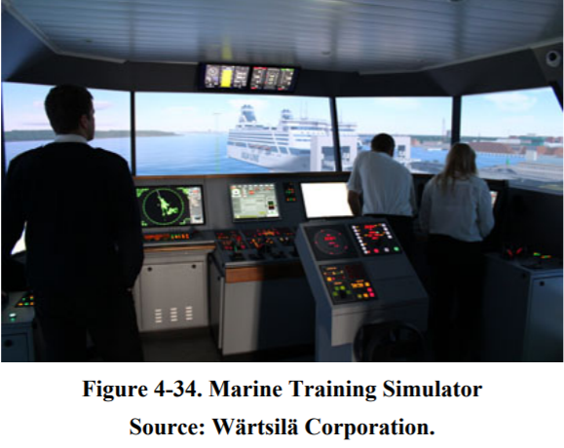
Marine Technologies
Finding
Marine vessel safety has improved in the past few decades, but opportunities exist to improve operations. Additional advancements in navigation technologies and training systems offer the best opportunities to mitigate marine vessel accidents.
Recommendations
Navigational Technologies
The U.S. Coast Guard (USCG) should:
Fully implement NTSB recommendations that could improve Vessel Traffic Service (VTS) system ability to reduce the risk of allisions, collisions, and groundings within VTS areas.
Implement additional traffic separation schemes and traffic rules to reduce marine traffic risk of allision, collision, and grounding.
Training and development to reduce accidents caused by human factors:
U.S. Coast Guard should extend requirements for vessels to be outfitted with Automatic Identification System (AIS) to all commercial towing vessels with accurate tow-dimension input. Operator training should be required on model-specific AIS technology in use.
Local port authorities should adopt National Ocean Service (NOS) real-time oceanographic data and other navigation products.
U.S. Coast Guard should require that all vessels required to carry AIS “Type A” be fitted with an electronic chart system.
Marine Training Simulator
Source: Wärtsilä Corporation
Notes:
Marine Technologies – Key Points
The marine industry has been a leader in advancing safety and environmental performance since 1990, largely from the implementation of the Oil Pollution Act of 1990 and an industry commitment for vessel operators to implement and improve safety management systems. Unintentional vessel impacts by collision, allisions, and material failures are the leading accident types.
Total oil spill volume from tankers and barges in the U.S. navigable waters over the past decade through 2017 was 77% less than was spilled in the year 1990. More than 50% of the oil spill volume between 2007-2017 was caused by 3 collision events.
Additional advancements in navigation technologies and training systems offer the best opportunities to mitigate marine vessel accidents.
Navigation Technologies: An effective way to expand capacity of ports would be to apply navigational technologies that support reliable two-way channel traffic. Advancements in both route planning and integrated navigational system technologies offer potential for maximizing channel capacity. The NPC recommends that the U.S. Coast Guard:
Improve Vessel Traffic Service (VTS): This shore-based surveillance and communication system is comprised of a network of 12 centers around the country with the authority to ensure the safe, efficient movement of marine traffic in hazardous and/or congested waterways. The systems mission is to reduce the risk of allisions, collisions, and groundings.
Implement additional traffic separation schemes and traffic rules to reduce marine traffic risk of allision, collision, and grounding: Traffic rules that may be implemented include speed limits, one way, and tethered escort tugs.
Training and development to reduce accidents caused by human factors: Safe navigation of marine vessels requires skilled, competent mariners working in bridge teams to safely direct vessel movement. Investigations of navigational incidents find human factors to cause a high percentage of these type of accidents.
U.S. Coast Guard should extend requirements for vessels to be outfitted with Automatic Identification System (AIS) to all commercial towing vessels with accurate tow-dimension input. Operator training should be required on model-specific AIS technology in use.
Local port authorities should adopt National Ocean Service (NOS) real-time oceanographic data and other navigation products (e.g., PORTS) to promote safe navigation. The deployment of PORTS at Corpus Christi demonstrates how the LNG shipping industry has worked with NOAA to implement a system that meets the needs of all stakeholders toward improving navigation safety.
U.S. Coast Guard should require that all vessels required to carry AIS "type A" under 33 CFR 164 should also be required to be fitted with electronic chart systems. Additionally, the U.S. Coast Guard should require that chart system training is specific the technology model being used.

Slide 29
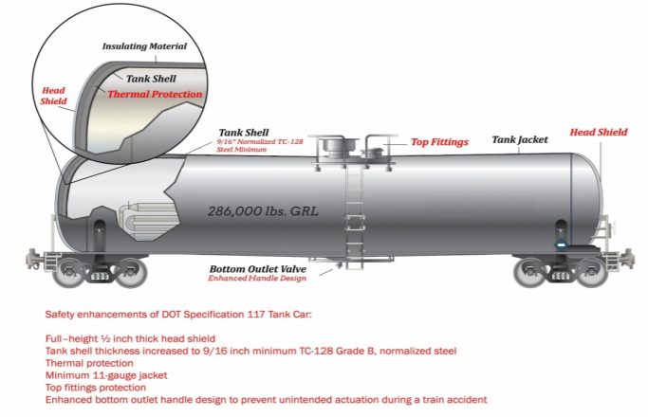
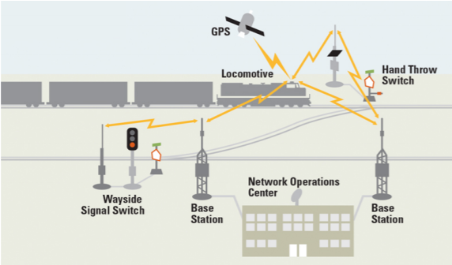
Rail Technologies
Findings
The railroad industry has implemented additional standards, processes, and new technologies to address leading causes of accidents: track, equipment, and human error.
Recommendations
Example of DOT-117 Tank Car
Source: U.S. Department of Transportation
Track:
Track safety can be improved by aggressively implementing defect detection technologies, which can improve flaw detection through the use of various ultrasonic, laser, optical, and infrared technologies grounding.
Equipment:
Equipment-related improvements will be supported by enhanced tank car standards promulgated by PHMSA in 2015. These updated standards require new and retrofitted tank cars.
Human Error:
Improvements to reduce incidents caused by human error include deployment of technologies such as positive train control, locomotive cab technologies, and route modeling.
Positive Train Control
Source: BNSF
Notes:
Rail Technologies – Key Points
Railcars transporting petroleum-based commodities safely reach their destinations with high reliability. Infrequent accidents do occur.
FRA safety statistics demonstrate the rail industry’s commitment to safety and show a 37% decrease in train accidents since 2000.
The railroad industry has implemented additional standards, processes, and new technologies to address the causal factors related to these accidents which include the track structures, the equipment that powers the trains, and the people involved with operating the trains.
The percentage of total incidents caused by these factors in 2018 was: track (29%), equipment (14%), and human error (37%). The remaining 20% were miscellaneous causes.
Track and equipment-related safety can be improved by aggressively implementing defect detection technologies. These state-of-the-art systems can improve flaw detection through the use of various ultrasonic, laser, optical, and infrared technologies.
Equipment-related improvements will be supported by enhanced tank car standards promulgated by the Pipeline and Hazardous Materials Safety Administration (PHMSA) in 2015. These updated standards require new and retrofitted tank cars to meet strict design specifications, which will translate into a 50% to 70% lower probability of release in the event of a train accident.
Tank cars built after October 1, 2015, used to transport flammable liquids, including crude oil and ethanol, in High-Hazard Flammable Trains (HHFT) must meet the following provisions:
New tank cars constructed after October 1, 2015, are required to meet enhanced DOT Specification 117 design or performance criteria for use in an HHFT.
Existing tank cars must be retrofitted in accordance with the DOT-prescribed retrofit design or performance standards and must be completed based on a schedule.
HHFTs: Trains with either a continuous block of 20 or more tank cars loaded with a flammable liquid or at least 35 tank cars loaded with a flammable liquid dispersed throughout the train.
Incidents resulting from human error can be significantly improved by the implementation of various technologies. A good example is positive train control shown in the diagram on the bottom right:
Positive Train Control (PTC): Designed to automatically stop a train before incidents occur like train-to-train collisions, derailments caused by excessive speed, and the movement of a train on the wrong track due to a track switch left in the wrong position.
The Rail Safety Improvement Act of 2008 mandated implementation of positive train control (PTC) technology. Implementation is underway and is expected to be complete in 2020.

Slide 30
Trucking Technologies
Background
Sensors and computers available for trucks today can detect hazards, analyze more information, and respond to events much faster than any human being. These technologies can help reduce accidents and eliminate thousands of deaths and injuries.
Recommendations
Information Sharing:
National Highway Transportation Safety Administration (NHTSA), and other appropriate federal agencies, should sponsor a research study to confidentially gather performance data of safety technologies.
Incentivizing Technology Deployment:
DOT should consider sponsoring incentive mechanisms for the trucking industry and equipment manufacturers to accelerate deployment of safety technologies
Infrastructure Improvements:
DOT should ensure funds are provided to maintain proper road markings which enable safety technologies to work properly (e.g. LDWS)
Supporting Research:
NHTSA should support research to identify technologies that improve LDWS ability to work on snow-covered or improperly marked roads.
FMCSA and NHTSA should support research to advance fatigue and distraction detection technologies.
Trucking Safety Technologies
Forward Collision Warning and Avoidance Systems
Lane Departure Warning and Corrective Steering (LDWS)
Fatigue and Distracted Behavior Recognition
Vehicle Camera Systems
Notes:
Trucking Technologies – Key Points
Sensors and computers available for trucks today can detect hazards, analyze more information, and respond to events much faster than any human to reduce safety incidents.
Some of the safety technologies in this industry are listed on the slide on the right.
However, there are challenges with deploying these technologies. The industry is very fragmented; there are not a lot of mechanisms to share information and data about expected benefits, the initial costs to implement are high; implementing appropriate rules and regulations to govern their use; and driver resistance are some of the most notable challenges.
Recommendations related to trucking technologies cover four key topics as follows:
Information Sharing: The National Highway Transportation Safety Administration (NHTSA), and any other appropriate federal agency, should sponsor a research study to confidentially gather performance data from current users of various advanced safety technologies.
Data sharing across industry and government stakeholders may support collision-avoidance investments, thus accelerating deployment and implementation.
Incentivizing technology deployment: DOT should consider incentive mechanisms for commercial industry and equipment manufacturers to accelerate the adoption and deployment of safety technologies. Incentives may include:
Government/industry consortiums to invest in technology advancements
Phased tax credit incentives
Insurance
Regulatory requirement
Note: Petroleum company customers should consider requiring their trucking carriers to use driver-assist safety technologies by contract.
Infrastructure improvements: DOT should ensure adequate funds are provided for infrastructure improvements to ensure that roads maintain the proper markings to allow these Lane Departure Warning Systems (LDWS) to operate properly. If road markings are nonexistent or obscured, then the system will not work properly.
Supporting research to advance promising technologies:
To identify new technologies that improve LDWS ability to work properly on snow-covered roads or roads without proper markings. (NHTSA)
Advance fatigue and distraction detection technologies (FMCSA and NHTSA)

Slide 31
Regulatory Barriers to Technology Deployment
Regulatory challenges can be overcome with collaboration between government and industry, and a regulatory framework encouraging the use of new technologies to improve safety, reliability, efficiency, and environmental performance.
Current State
Recommendations
Field Testing
More efficient pathways for field testing new technologies could reduce deployment time and accelerate quality and reliability improvements.
Agile Pathway
DOT should lead, while working with DOE, EPA, and U.S. Coast Guard, the creation of an agile pathway for evaluation and regulatory acceptance of new technologies to shorten the research, deployment, and adoption cycle time.
Prescriptive Regulations
Prescriptive, rules-based regulations, which can lock in old technology solutions and be slow to adopt more effective and often less costly practices, can stifle innovation.
Pilot Programs and Performance-based Rules
Congress should authorize DOT to lead a collaborative effort, with support from industry, to develop pilot programs that can accelerate pipeline, storage, and LNG technology adoption based on performance-based rules to enhance public safety.
Limited Research Funding
Research investments by individual operating companies, research consortiums, or suppliers can be limited by competing priorities that more directly impact their business model.
Cost Recovery
FERC and state regulatory agencies should work with DOT, DOE, and others to promote laws, regulations, and public-private partnerships that support cost recovery for oil and natural gas pipeline safety and environmental R&D.
Notes:
Regulatory Barriers to Technology Deployment – Key Points
Companies face challenges with respect to research, development, commercialization, and adoption of new technologies. The inherent challenges to deploying new technologies include time and cost to develop and deploy, adequate acceptance testing, and regulatory impediments.
These challenges translate into higher risks, costs, and uncertainty in the benefit-cost evaluation of new technology investments. These challenges can be overcome with the proper level of collaboration among government and industry organizations and from a regulatory framework that promotes the use of advanced technologies to help enable continued improvements in safety and environmental performance.
Field Testing: Certain prescriptive requirements within existing PHMSA regulations discourage field testing of new inspection technologies where the performance, accuracy, and repeatability of a technology is not yet proven. Addressing regulatory requirements associated with conducting trial runs can add significant costs and slow adoption of new technology.
To address this, the NPC recommends that DOT should lead, while working with DOE, EPA, and U.S. Coast Guard, creation of an agile pathway for evaluation and regulatory acceptance of new technologies that can improve transportation safety and shorten the research, deployment, and adoption cycle time.
Prescriptive regulations that specify which methods and techniques to apply hinder the use of new alternative technologies that have the potential to achieve improved outcomes. Over time, regulations should adapt to accommodate to changes in the market such as new technologies and improved standards and practices, but the rulemaking process is lengthy and takes years before a change is adopted.
Congress should authorize DOT to lead a collaborative effort, with support from industry, to develop and prioritize pilot programs that can accelerate pipeline, storage, and LNG technology adoption based on performance-based rules with a goal of enhancing public safety. Upon successful completion of pilot programs, regulators should promptly update their regulations to allow use of new technology.
Limited research funding: Industry, in cooperation with federal agencies, is advancing promising new technologies to prevent high-impact events. Adoption of new technology can be impeded by high early-adopter costs and limited research funding.
To address this, the NPC recommends that federal agencies should work with each other to promote laws, regulations, and public-private partnerships that support funding protocols and/or cost recovery for natural gas and oil pipeline safety research.

Slide 32
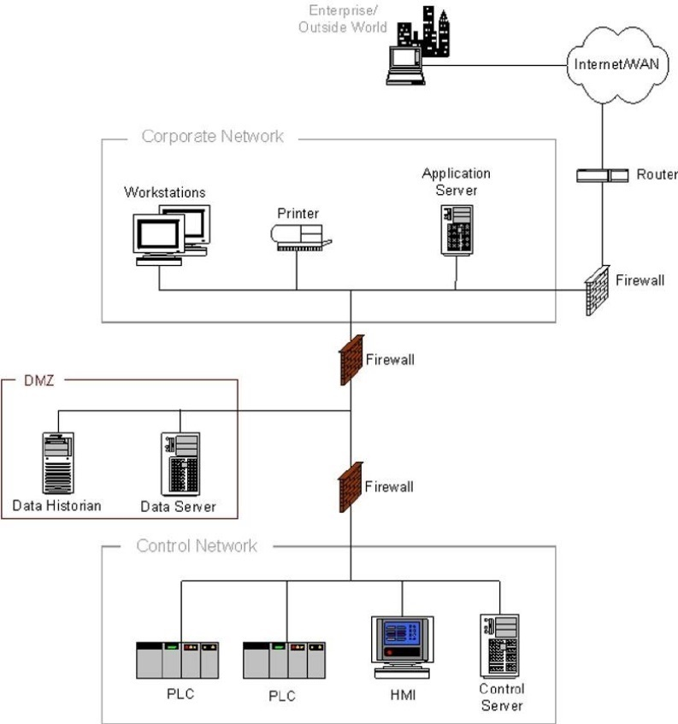
Cybersecurity Challenges
Cyber threats to energy infrastructure control systems are increasing, and security protections are being challenged due to increasing connectivity and growing malicious cyber activity.
Challenges
Convergence of Information Technology (IT) networks with Operational Technology (OT) Industrial Control System (ICS) networks has introduced greater cyber challenges to the oil and natural gas industry.
Targeted ICS attacks have increased in frequency and sophistication, furthering the risk of economic impact, operational shutdowns, damaged equipment, environmental, and safety consequences.
NIST 800-2. Firewall between Corporate Network and Control Network.
Notes:
Cybersecurity Challenges – Key Points
Cyber threats to control systems are increasing due to greater reliance on control technology to manage risk and optimize assets, additional connectivity to business systems, and increasing instances of cyber activity targeting Industrial Control Systems (ICS).
The growth in Internet access and the growth of Internet-enabled devices and systems have enabled data access and availability to improve performance and make informed decisions across all major industries.
Connectivity between Information Technology (IT) networks with Operational Technology (OT) provides a pathway for cyber threats. Over time, connections to IT networks protected by firewalls or similar controls have been added, as shown in the image on the slide.
Additional Information
This report does not address the cybersecurity threats relating to business information systems. Business/Information Technology (IT) systems and Operational Technology (OT) systems have very different goals and risk profiles.
Business systems focus on financial or other informational aspects and enable broad connectivity
OT systems are dedicated to maintaining safe and reliable operation of industrial systems and typically have less connectivity and fewer access points.

Slide 33
Cybersecurity Recommendations
Stakeholder support of efforts to improve digital security through technological innovation and adoption of improved operational and policy frameworks will strengthen cybersecurity defenses.
Key Recommendations
Adopt and maintain performance-based cybersecurity management standards
Increased government support to carry out cybersecurity assessments and audits on critical infrastructure.
The public and private sectors should assist sector Information Sharing and Analysis Center (ISAC’s) and regional groups to promote information sharing including learnings from investigations.
R&D activities to address:
current and anticipated threats;
transportation types with the highest risk of cyber Operational Technology (OT) threats; and
funding, partnering, or incentive opportunities to reduce cyber OT risks.
Notes:
Cybersecurity Recommendations – Key Points
NPC recommendations to address increased cyber threats to energy infrastructure include:
Industry, in collaboration with trade associations and federal government agencies should adopt and maintain up-to-date performance-based cyber security management standards. These standards should be continuously updated to keep pace with corresponding digital technology advancement and changes to the cyber threat landscape.
DHS and DOE should increase capabilities and resources to support independent and secure cybersecurity assessments prioritized on critical infrastructure.
Assessments should be conducted by authorized entities, including but not limited to, government-sanctioned entities. Cybersecurity assessments should be informed by current threat intelligence information sharing and lessons learned from cyber incidents.
DHS and other regulatory agencies should update the assessment mechanisms to address any ongoing recommendations, including those relating to the potential limitations of a voluntary framework.
DHS, working with DOE, other federal agencies, and the oil and natural gas industry, should assist sector Information Sharing and Analysis Centers (ISACs) and regional groups to promote information sharing, including learnings from investigations.
DHS should encourage increasing ISAC membership across industry sectors. DHS and other federal agencies should quickly share actionable information with ISACs and operators.
Collaboration to share cyber threats is increasing between industry, trade associations, and federal governmental agencies. OT cyber threat sharing often lacks the necessary transparency among and within companies that is necessary to improve effective cyber management practices. Current practices can result in findings that are overly sanitized and are inconsistently shared.
ISAC: Nonprofit organization that provides a central resource for gathering information on cyber threats to critical infrastructure and providing two-way sharing of information between the private and public sector.
DOE, working with industry, and the other relevant agencies should establish a collaborative process to identify and prioritize research and development aimed at sector-wide protection against nation-state and advanced persistent threat actors.
The process should include current and anticipated threats; transportation types with the highest risk of cyber Operational Technology (OT) threats; and funding, partnering, or incentive opportunities to reduce cyber OT risks.

Slide 34
Discussion – Questions
Report is available at:
dynamicdelivery.npc.org
Notes:
Introduction – Key Points
Introduction to the presentation should be tailored to the audience and include:
Introduction of the presenters
The purpose of the presentation which is to provide an overview of the National Petroleum Council (NPC) report on Dynamic Delivery: America’s Evolving Oil and Natural Gas Infrastructure
How the study might be of interest to the audience and their organization’s mission
Comments regarding COVID-19 and current environment
The COVID-19 pandemic has introduced a heightened degree of uncertainty in the institutions that make up our country’s energy production and delivery system. Over the past two months, most of the world’s industrialized countries have essentially shut down their economies. As a result, demand for motor gasoline, jet fuel, and other refined products has seen an unprecedented reduction. In response, North American refineries have scaled back their operations by 30%-40% or shut down entirely, according to the energy trade press. Simultaneously, this broad impact is being felt upstream and downstream in energy economies throughout the world. An ill-timed global oil market price collapse has compounded this dramatic impact, aggravating the sense of unpredictability in the oil and gas marketplace.
The NPC study was completed and reported out to the Secretary of Energy on December 12, 2019. Many of the outlooks in the Supply & Demand section were prepared in 2018-2019 and do not reflect current oil and gas market conditions. However, as the United States and the world emerge from the pandemic, demand for petroleum products will rebound to drive economic recovery. Even though the timing and path to economic recovery are uncertain, the oil and gas industry will undoubtedly play a central role in propelling the recovery forward. As we think of what will be needed for the oil and gas sector to thrive beyond this time of disruption and uncertainty, the findings and recommendations from this study provide insights for policy makers and business leaders to consider and act upon to support the return of prosperity.

