Slide 1
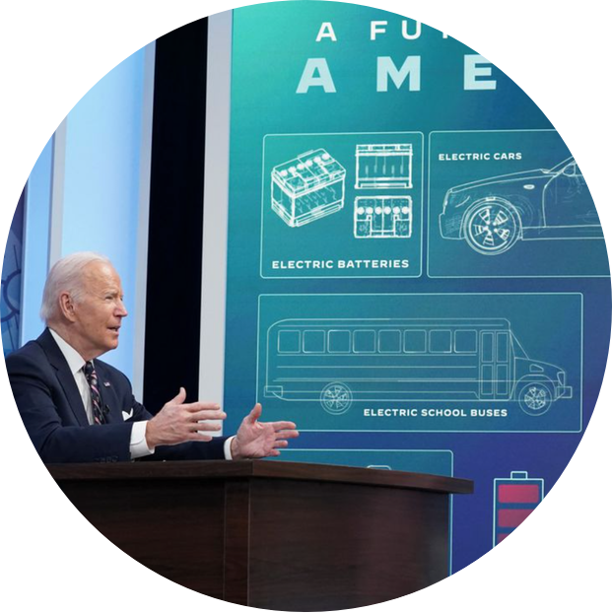
Waking Up to Mineral Supply Chain Insecurity
“We can’t build a future that’s made in America if we ourselves are dependent on China for the materials that power the products of today and tomorrow.” ~ President Biden, Securing Critical Minerals for a Future Made in America Event

Slide 2
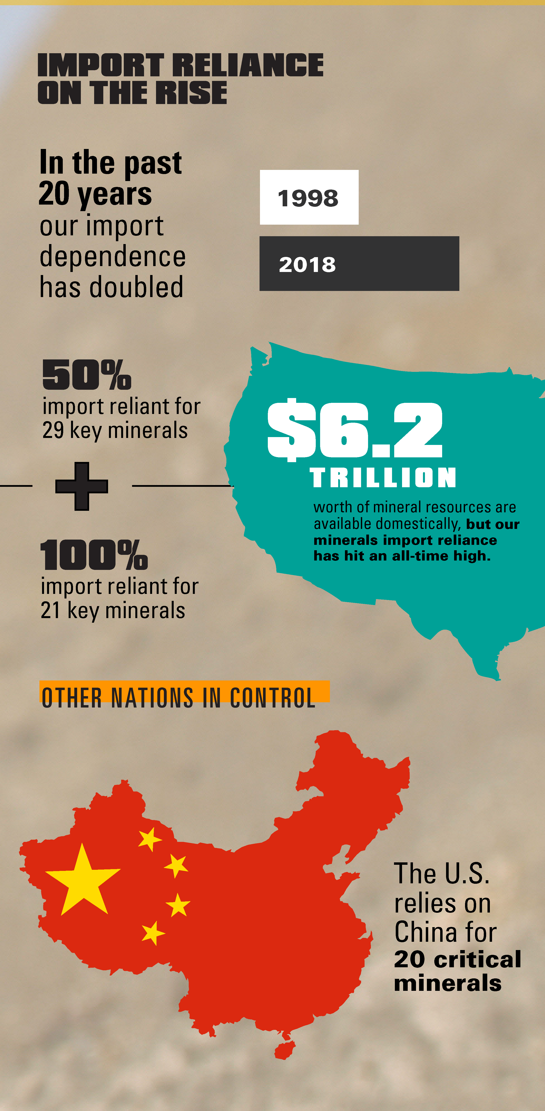
The Backdrop
Increased Reliance on Foreign Sources – over 250 % since 1954
Decreased Investment in US projects – down 50 % since 1993
Supply Chain Security Events – China’s Market Control, COVID, Russia-Ukraine
The US is a Mineral Rich Country – $6.2 Trillion Worth
Average Timeframe for US Mining Project Approvals – 7 to 10 Years

Slide 3
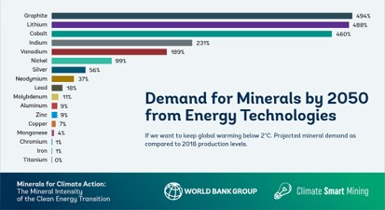
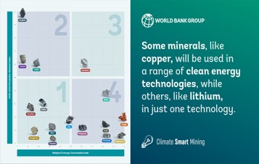
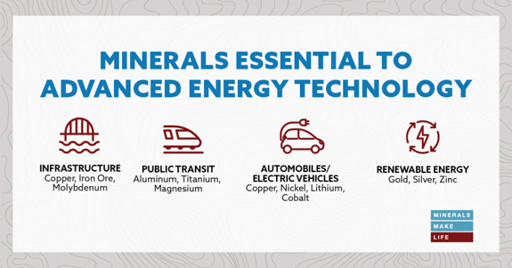
The Energy Future Requires A Dramatic Increase In Minerals

Slide 4
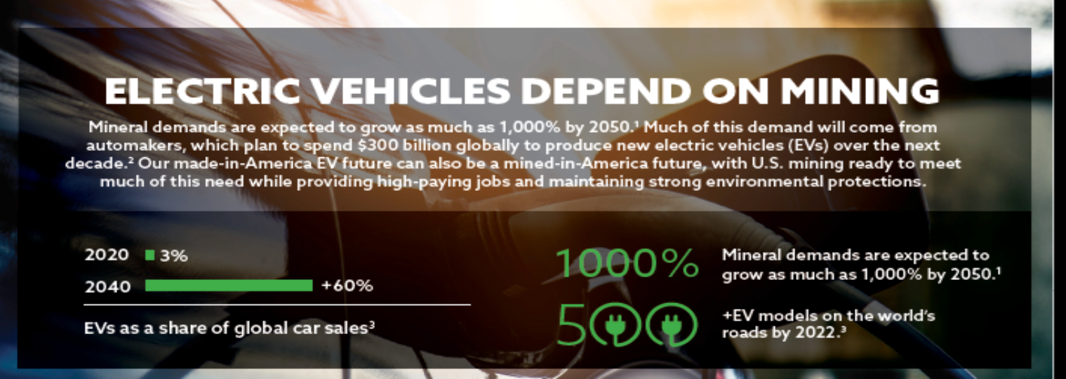
Electric Vehicles – Key Driver
Beyond Battery Metals
“Battery” Metals

Slide 5
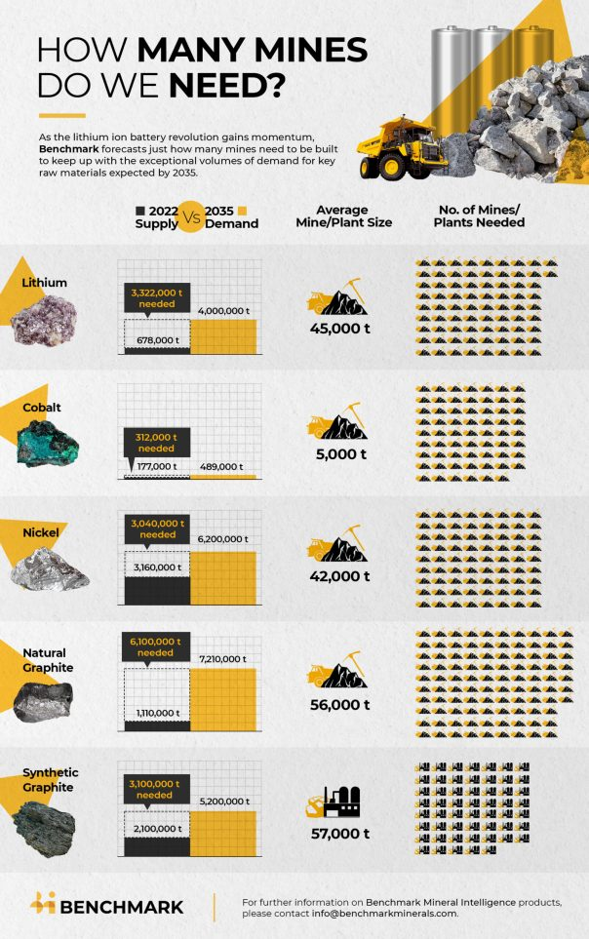
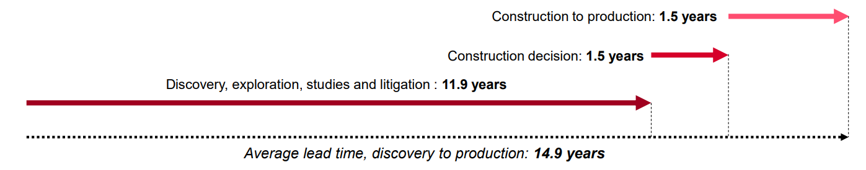
Behind the Curve in Meeting Demand
Nearly 400 Mines Needed
Timeframe Predictions
  S&P Global data on 127 mines across the world that began production between 2002 and 2023 shows that a major new resource discovery today would not become a productive mine until 2040 or later.
  Furthermore, this is on average: large and complex projects in politically sensitive areas can take longer. 4

Slide 6
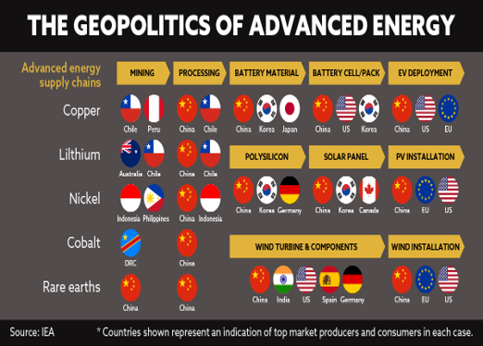
It’s Not Just Mining

