Slide 1
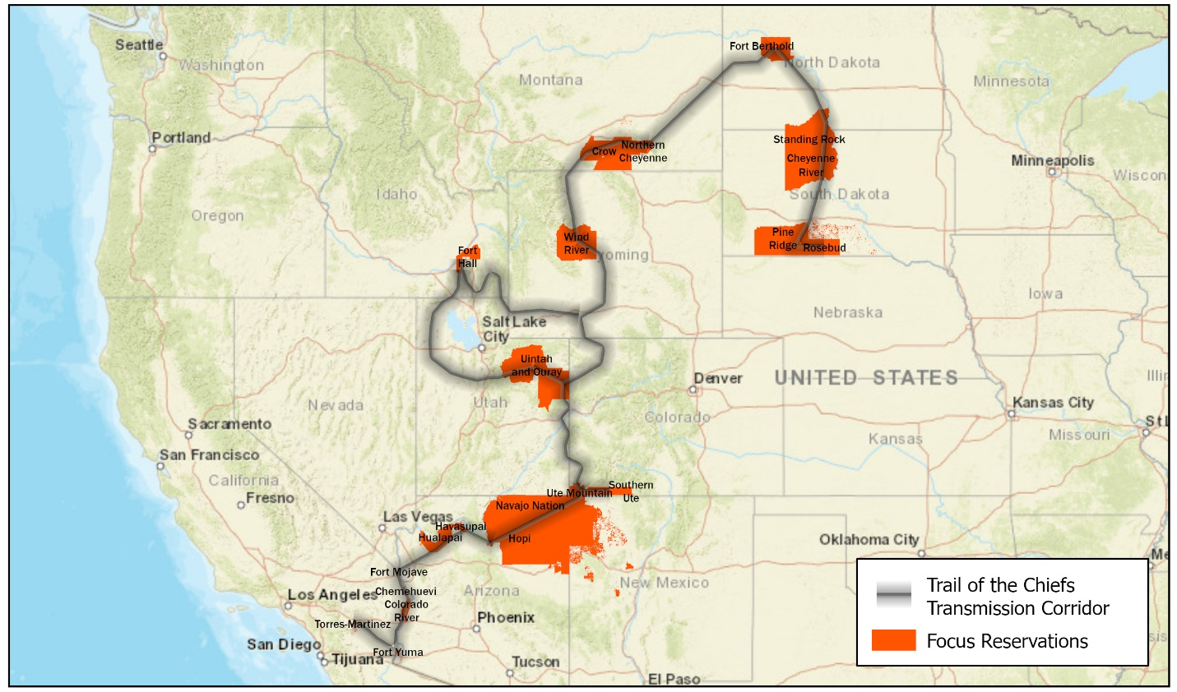
Trail of the Chiefs Corridor Consortium
November 07, 2024

Slide 2
The presentation outlines the formation and objectives of the Trail of the Chiefs Corridor Consortium, a project aimed at integrating a wide range of energy technologies and infrastructure across the Western United States, specifically connecting Indian Country to the larger energy “grid”.

Slide 3
Introduction:
The Trail of the Chiefs Corridor Consortium (TCCC) aims to address energy transition challenges across 10 states and 21 Tribal Nations, spanning 2,604 miles. The consortium aims to integrate various energy technologies into existing infrastructure, fostering economic growth while respecting cultural and environmental sensitivities.

Slide 4
Rationale:
The Trail of the Chiefs Corridor supports critical mineral extraction, carbon management, power generation, hydrogen development, water development, and transmission line upgrades. It is driven by tribal organizations and seeks explicit support from tribal nations. The consortium aims to address technical, economic, financial, social, and environmental complexities.

Slide 5
Potential Partnerships:
The consortium aims to include Tribes, Tribal Organizations, Tribal Communities, the Federal Government, National Laboratories, Academic Institutions, Private Industry, Non-Profit Organizations, and State Governments.

Slide 6
Objectives:
The Trail of the Chiefs Corridor Consortium aims to establish a 2,604-mile geographical energy corridor, evaluating technical aspects and conducting comprehensive GIS mapping. It involves a multi-disciplinary team to assess feasibility, stakeholder engagement, and economic benefits.

Slide 7
Approach:
We will conduct a phased approach of the consortium for developing the Trail of the Chiefs Corridor.
Formation of a multi-disciplinary team involving Tribes, Federal Agencies, National Labs, Academic Institutions, and private companies to assess technical, economic, environmental, and social aspects.
Rigorous evaluation of each component of the corridor, including transmission lines, pipelines, water infrastructure, mining, and critical mineral transportation.
Utilization of advanced GIS mapping techniques to establish a feasible route considering physical geography, tribal lands, existing federal energy corridors, rights of way, land ownership, and environmental and cultural sites.
Extensive community outreach and collaboration with impacted communities, tribal nations, and stakeholders to shape corridor development.
Techno-economic analysis to quantify economic benefits, potential job creation, financial investments, tax collections, revenue streams, and required stakeholder contributions for the corridor.

Slide 8
Tribal Initiative and Importance:
The Trail of the Chiefs Corridor Consortium will involve 21 Tribal Nations or more, including their respective on and off reservation communities in the Western US. Indigenous rights, perspectives, worldviews, and needs are of the upmost importance, will be our number one priority, and will be respected.

Slide 9
Impact and Expected Outcome:
The Trail of the Chiefs Corridor Consortium aims to enhance critical US infrastructure for the energy transition, prioritizing technical rigor, interdisciplinary collaboration, and stakeholder engagement. The consortium will manage energy and resource management across the western US, ensuring sustainable development and inclusivity.

Slide 10
If interested in joining or for more information, please contact:
Daniel Cardenas
CoFounder
Trail of the Chiefs Corridor Consortium
dcardenas@trailofthechiefs.org
(307) 220-4848

