Slide 1
A Journey into Defensible Architecture:
A Defenders’ Guide
Cybersecurity and Digitalization:
Supply Chain Risks in the Electricity Sector

Slide 2

Markus Mueller
Principle Industrial Consultant
Dragos
LinkedIn: www.linkedin.com/in/markusmuellerics
Email: mmueller@dragos.com
Website: www.dragos.com

Slide 3
Brian Foster
Senior OT Cybersecurity Architect
Southern California Edison

Slide 4
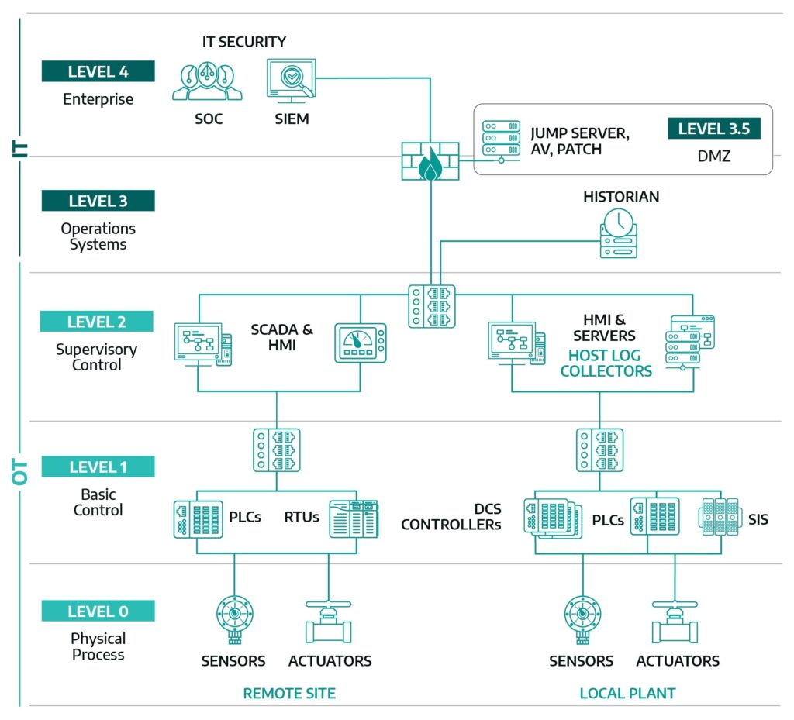
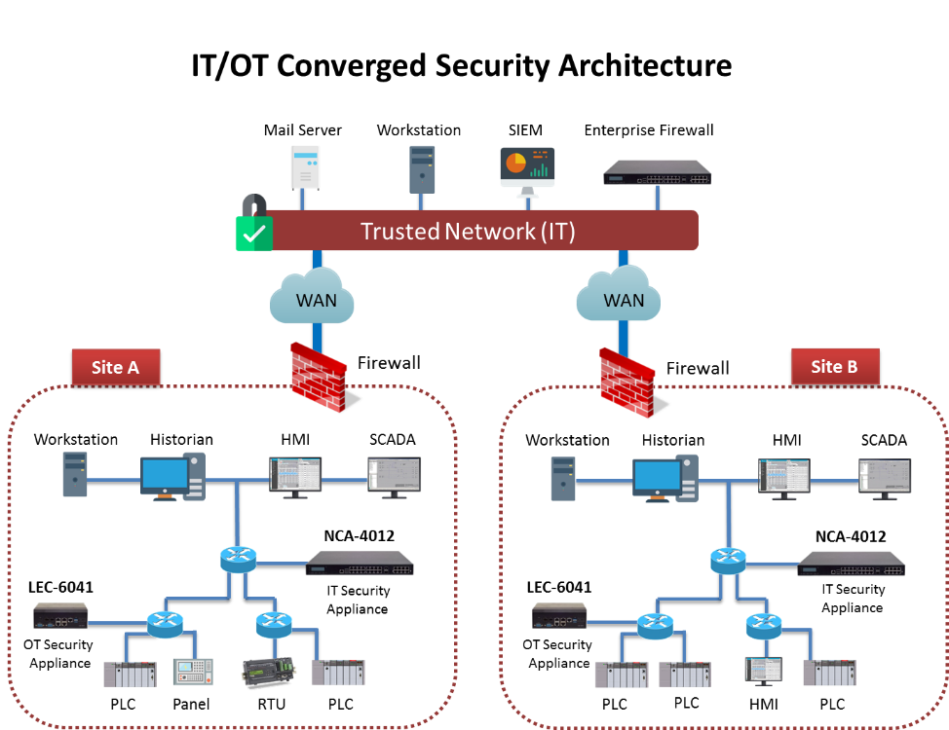
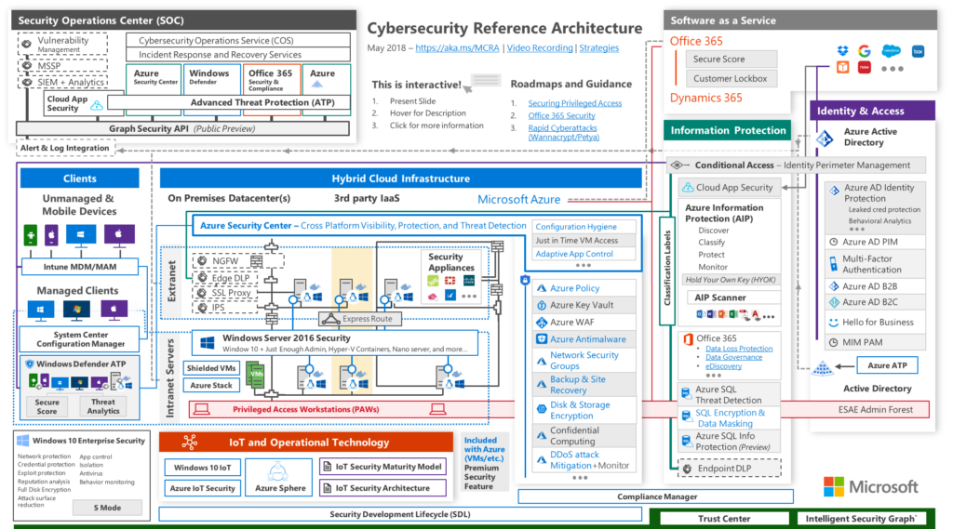
Reference Architectures
Best Practices May Not Be The Best Approach
Define and segment the layers
Defense at each layer
Traffic inspection and filtering between layers
Encrypt critical data
Deploy security solutions on the network and endpoints
Zero Trust

Slide 5
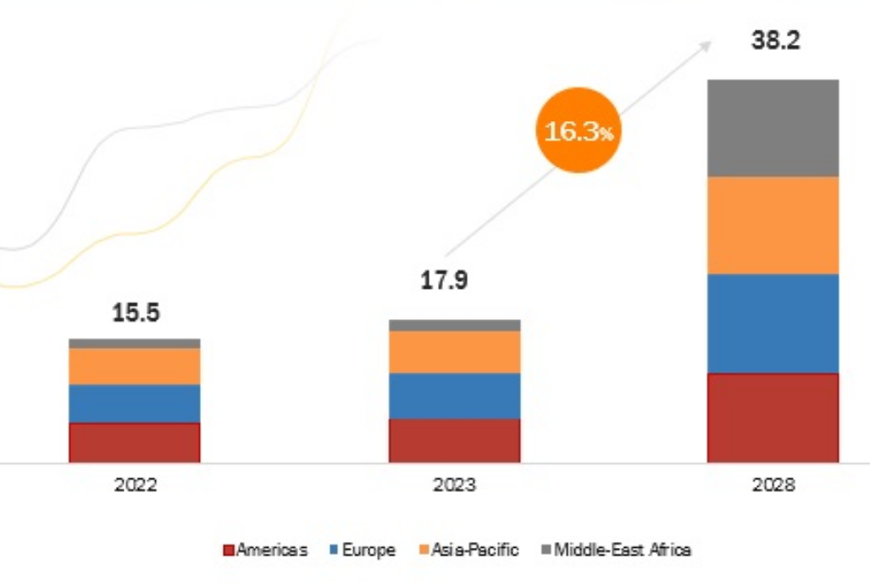
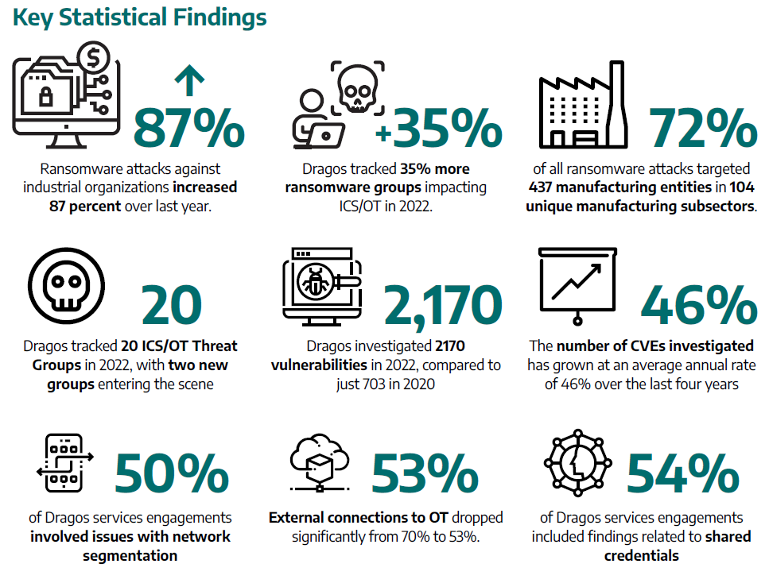
Reference Architectures
Failure To Understand The Why Can Result In Failure

Slide 6
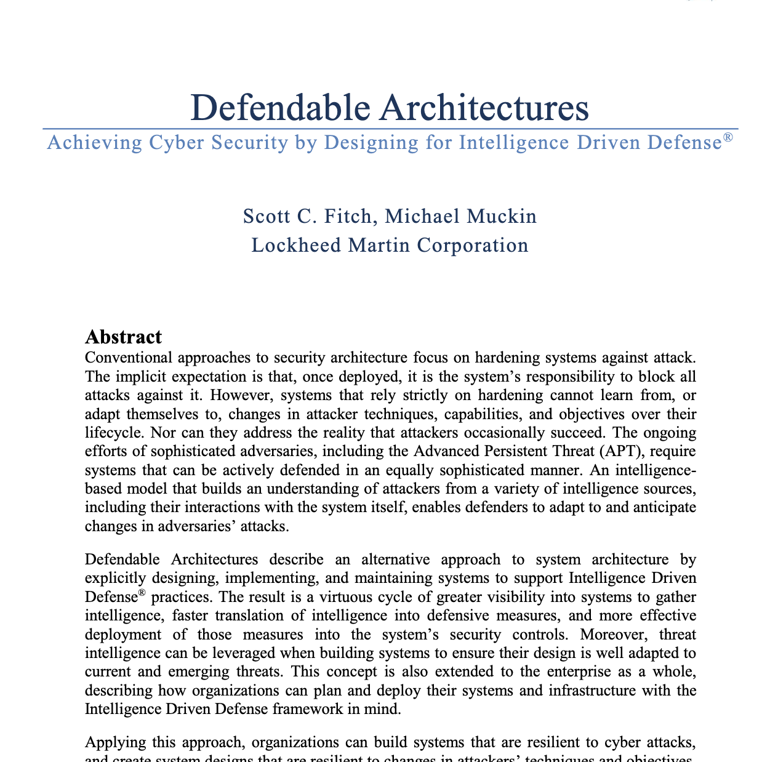
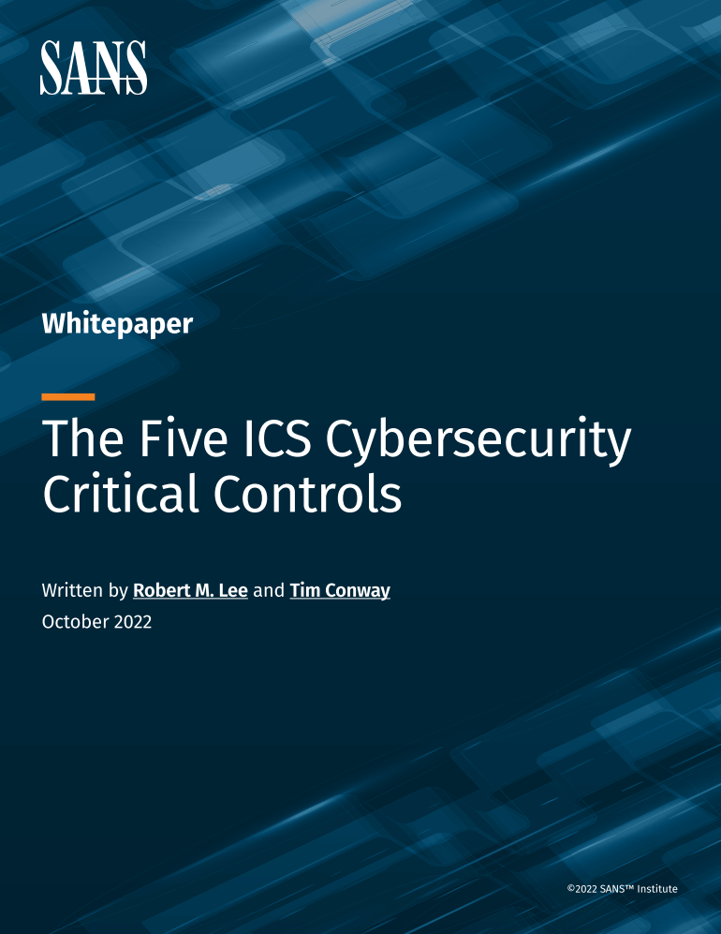
Defensible Architecture
A More Intelligent Approach
“Defendable Architecture: Achieving Cyber Security by Designing for Intelligence Driven Defense®”
– Fitch & Mukin, Lockheed Martin Corp
  Explicitly design, implement, & maintain systems to support intelligence driven defense processes
Control #2 of SANS Five Critical Controls:
  Architectures that supports visibility, log collection, asset identification, segmentation, industrial DMZs, process-communication enforcement meets the definition.

Slide 7
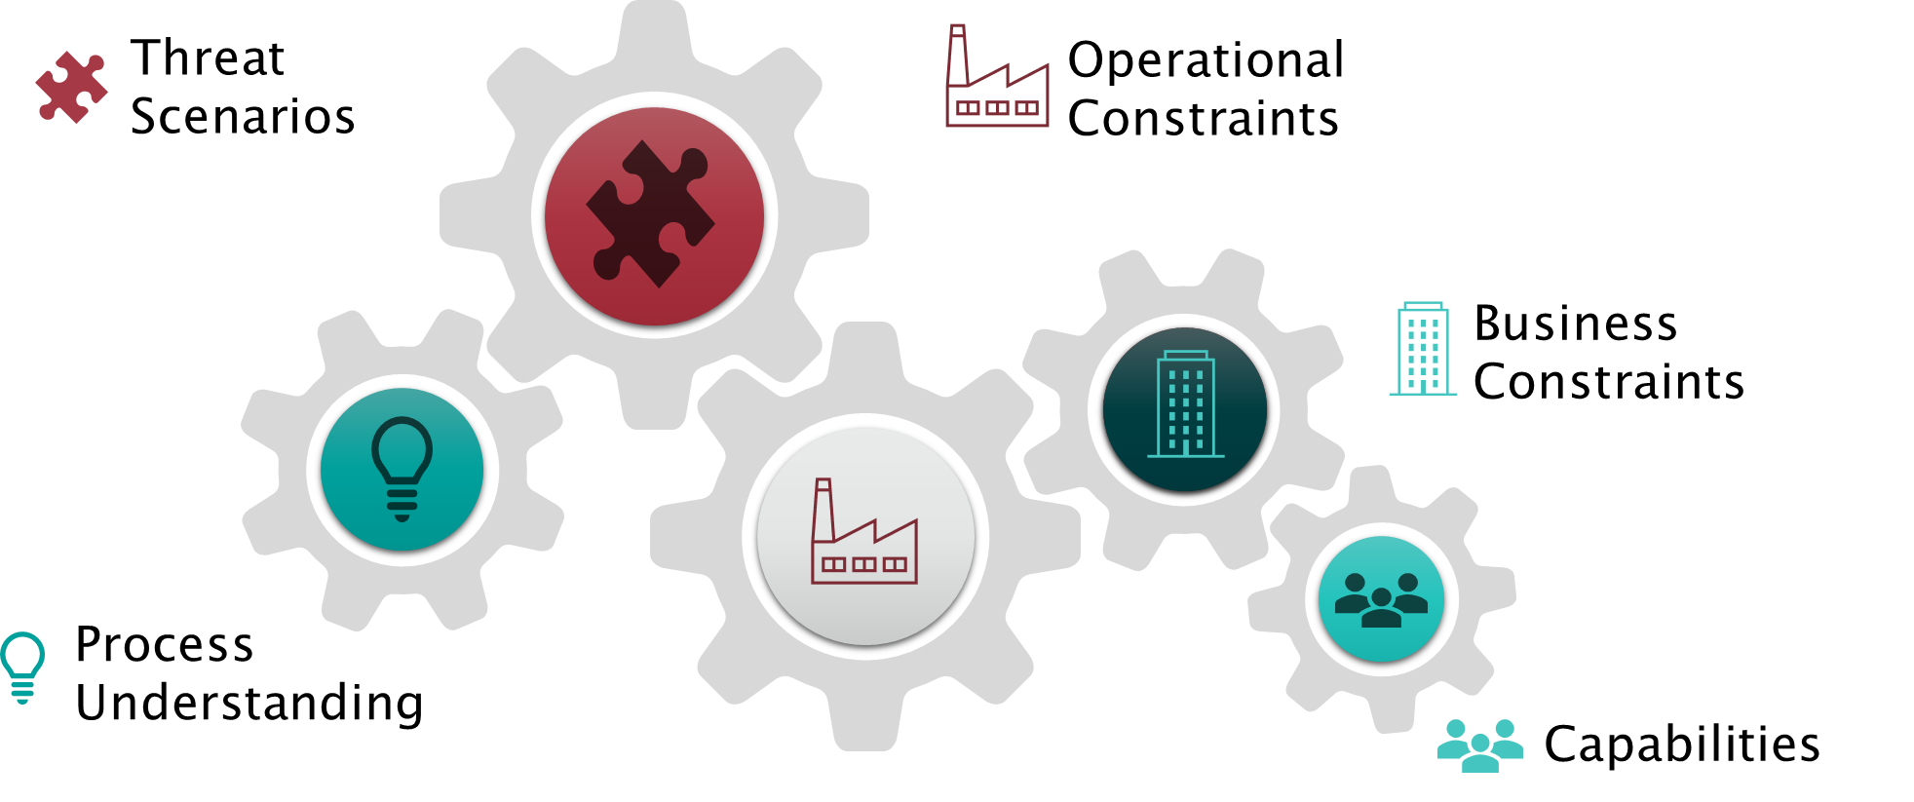
Intelligence Driven Defensible Architecture

Slide 8



Implementing These Principles
A small Utility

Slide 9
ACME - Small
The Start of the Journey
Sector: Utility
Subsector: Water\Wastewater
Employees: 76
Customers: 6000
Forecasted Growth: 150% YoY
Infrastructure
  7 Wells
  2 Large Water Tanks
  4 Small Water Tanks
  1 Treatment Plant
  2 Lift Stations
Technology Stack:
Business Systems
  O365
  Cloud Customer Information System (CIS)
OT Systems
  Rockwell PLCs
  Ignition Plant SCADA
  Badger Meter System - Automatic meter reading (AMR)

Slide 10








ACME - Small
The Catalyst
A business user clicked a link on a phishing email which resulted in:
  Downloaded Malware
  Infected and encryption of ~20 computers
  Impacted 2 operations systems
    Meter System
    Engineering Station

Slide 11


ACME - Small
Steps Taken
Crown Jewels Analysis
  Well 1 & Tank 1
  Treatment Plant
Threat Scenario Approach
  Opportunistic Ransomware
Identify Constraints
  Limited Budget
  Limited Staff
  Infrequent Production Outages

Slide 12
ACME - Small
Network Segmentation
Shared Infrastructure
IT/OT Separation

Slide 13



ACME - Small
Security Controls
System Hardening
  Password Vault
  Role Based Levels (Servers, Applications, PLCs)
    Admin
    Operator
    Read Only
FactoryTalk AssetCentre
  Secure Project Files
  Config Management
  Config Backup
MFA OT Remote and Admin
Backup Solution for OT
  Local NAS
  Offline Removable Disk

Slide 14
ACME - Small
Making it Defensible
Intel Feeds
  WISAC
  OT-Cert
Monitoring
  CMF
  SIEM
  Security Use Case
Workforce
  Training
  OT/OPS
  Cross Training
Playbooks
  IT/OT Disconnect
  OT Restoration
  Ransomware
Respond
  IR Tabletop Exercise
  Test Restore

Slide 15


Implementing These Principles
A Medium Utility

Slide 16
ACME - Medium
The Mid Point in the Journey
Sector: Utility
Subsector: Water\Wastewater & Electric
Employees: 254
Customers: ~9000
Forecasted Growth: 25% YoY
Infrastructure
  11 Wells\ 7 Tanks
  2 Treatment Plant
  3 Lift Stations
  4 Distribution Substations
  70 kV System
  12/21 kV System
Technology Stack:
Business Systems
  O365
  Cloud CIS\CRM\OMS
OT Systems
  Water SCADA
  Electric DMS
  Meter Systems
Communication
  Wireless
  Fiber
  Leased Cellular (Private APN)
  Leased Line

Slide 17
ACME - Medium
Steps Taken
Crown Jewels Analysis
  Water SCADA
  Electric SCADA
Threat Scenario Approach
  Opportunistic and Targeted Ransomware
  Hacktivism
Identify Constraints
  Limited Budget
  Limited Staff
  Infrequent Production Outages

Slide 18
ACME - Medium
Network Segmentation
Dedicated OT Infrastructure
One Up\Down Data Model
Internal Segmentation

Slide 19
ACME - Medium
Field Network

Slide 20
ACME - Medium
Identity Management

Slide 21
ACME - Medium
Security Controls
System Hardening
  Application Allowlisting
EDR
Privileged Access Management (PAM)
Backup Solution for OT
  Local\Site-to-Site Replication
  Offline to Tape

Slide 22
ACME - Medium
Making it Defensible
Intel Feeds
  EISAC
Monitoring
  ICS Network Visibility
  Hunts
Workforce
  SOC (MSSP)
Playbooks
  Compromised Credentials
  Compromised System
  Forensic Triage
Respond
  OT Tabletop Exercise
  Site Recovery Drill

Slide 23


Implementing These Principles
A Large(ish) Utility

Slide 24
ACME - Large
The Last Part of the Journey
Sector: Utility
Subsector: Water\Wastewater & Electric & Generation
Employees: 500
Customers: ~27,000
Forecasted Growth: 25% YoY
Infrastructure
  11 Wells\ 7 Tanks
  2 Treatment Plant
  3 Lift Stations
  6 Distribution Substations
  40 MW Solar & Wind Farm
  20 MWh BESS
  Distributed Solar\BESS
Technology Stack:
Business Systems
  Cloud CIS\CRM
  OMS
  GIS
OT Systems
  Water SCADA
  Electric ADMS
  AMI Meter Systems
Communication
  Wireless
  Fiber
  Private Cellular
  Leased MPLS

Slide 25
ACME - Large
Steps Taken
Crown Jewels Analysis
  ADMS
  Water SCADA
Threat Scenario Approach
  Ransomware
  APT
Identify Constraints
  Limited Budget
  Limited Staff
  Infrequent Production Outages
  Regulatory Oversight

Slide 26
ACME - Large
Network Segmentation
Micro Segmentation
Site Resilience
Path Resilience

Slide 27
ACME - Large
Field Network

Slide 28
ACME - Large
Identity Management

Slide 29
ACME - Large
Security Controls
Asset Management
Change Management
Baseline Tracking
Risk Based Vulnerability Management Program
Port Security
Hunt and Forensic Program
Backup Solution for OT
  Local\Cloud Replication
  Immutable Cloud Storage
  Standby Systems

Slide 30
ACME - Large
Making it Defensible
Intel Feeds
  Information Sharing Groups
Monitoring
  Expanded ICS Network Visibility
  OT System Logging
  ICS Device Logging
Workforce
  SOC IT/OT (L2+)
  Responders
Playbooks
  Insider Threat
  Defensible Cyber Stance
Respond
  Executive Tabletop Exercise
  System Recovery Drill

Slide 31
Summary

Slide 32
Defensible Architecture
Summary

Slide 33



Intelligence Driven Defensible Architecture
Easy Right?
Understand how operations and business functions
Use an intel-driven design that fits the operation environment
Deploy technology and processes that support the ability to detect and respond to events
Develop resilience and response capabilities
Enabling and supporting defenders

Slide 34
Thank You

