Slide 1
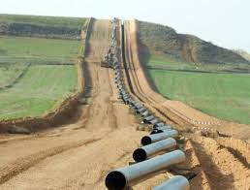
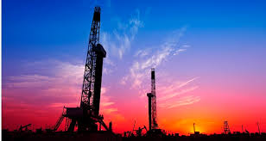


Transforming our Nation’s Energy Future —
North Dakota’s Carbon Management Solutions
United States Energy Association Briefing
Bill Sawyer – ALLETE Clean Energy
John Harju – University of North Dakota Energy & Environmental Research Center
January 25, 2017

Slide 2

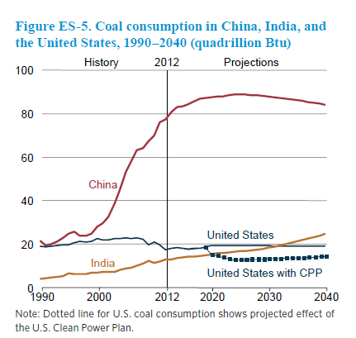
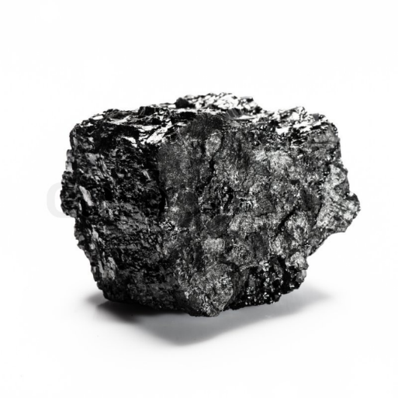
Coal is …
#1 fuel for electric generation in the World.
#1 fuel for electric generation in the United States…..

Slide 3
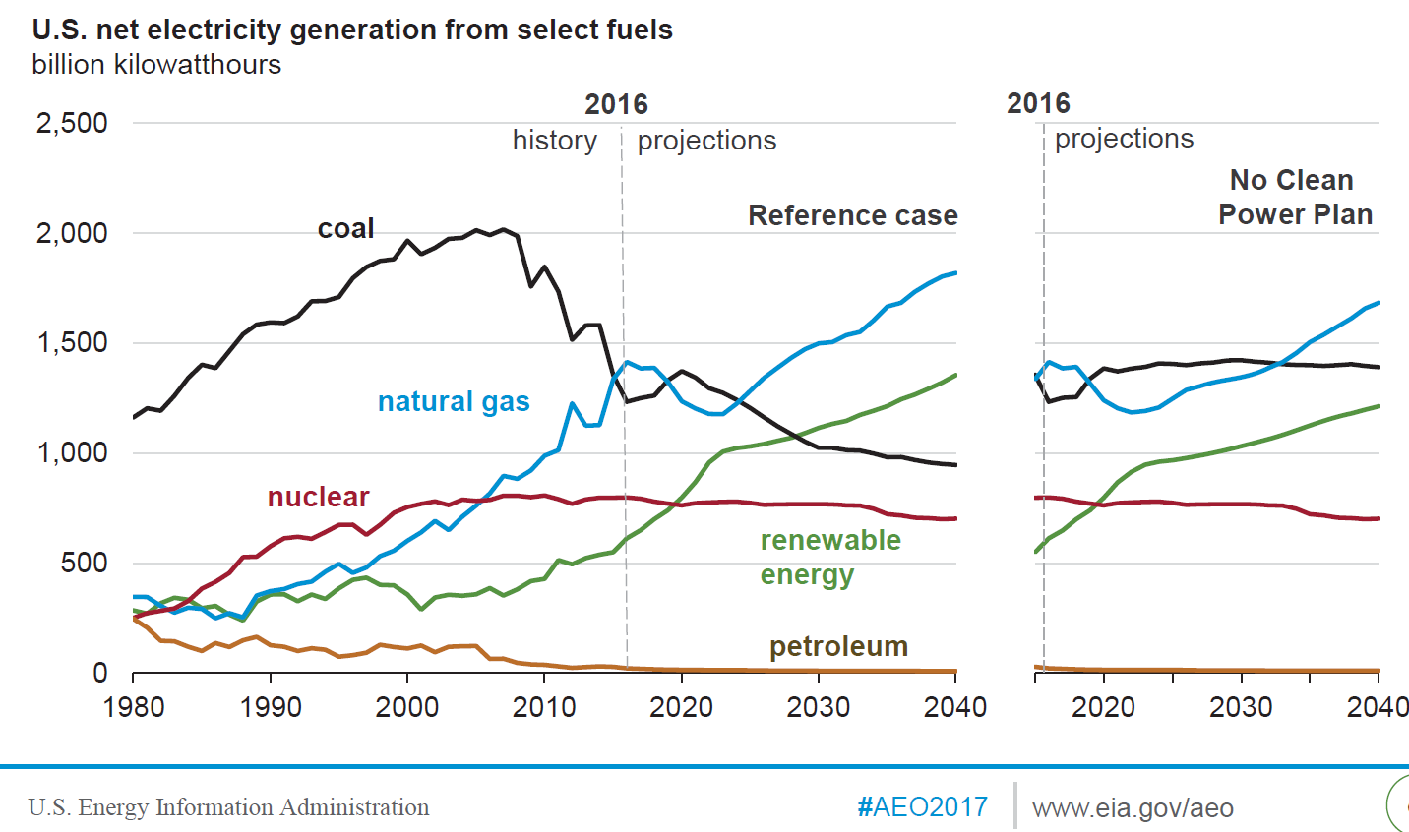
Until….it is Not

Slide 4

Energy Industry Challenges –
Why are we Here?
Low-cost, reliable, coal-fired generation is challenged in today’s regulatory environment.
Natural gas use for generation is growing, but has variability in pricing and is also challenged under long-term environmental regulations.
Renewable generation options are expanding, but intermittency is challenging.
http://ekahicenter.com

Slide 5
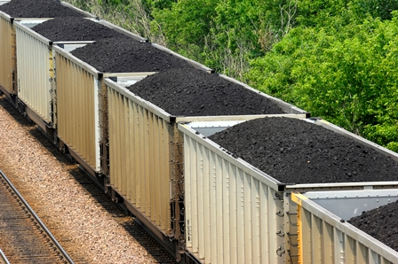
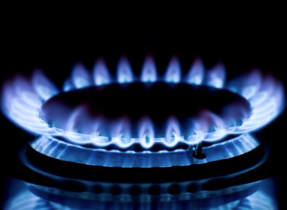
Energy Industry Challenges –
Why are we Here?
According to recent EIA data, there is a long-lasting supply of coal and gas in the U.S.:
Based on U.S. coal production in 2015, the U.S. estimated recoverable coal reserves would last about 280 years.
Based on U.S. natural gas usage in 2014, the U.S. estimated recoverable gas reserves would last about 90 years.
www.energynd.com
Source: www.eia.gov
www.egeneration.org

Slide 6
Energy Industry Challenges –
Why are we Here?
We need an all-of-the-above strategy that offers a platform for meeting the nation’s energy needs while providing a solution to our carbon challenge.
Our Vision:
An integrated energy and carbon solution that allows the utility industry to continue to use our nation’s most abundant fuel, while providing the foundation for the beneficial use of the CO₂ produced at these facilities.

Slide 7
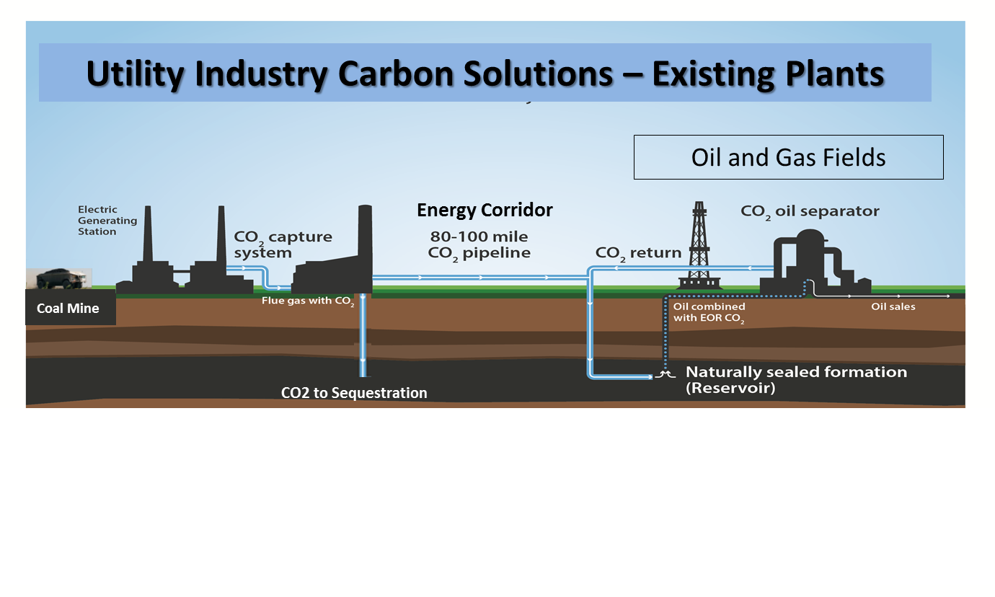
An Integrated Solution: How it Looks
1
2
3
Coal-fired power plant with carbon capture technology providing beneficial CO₂ for enhanced oil recovery or to be stored in geologic sequestration.

Slide 8

An Integrated Solution: How it Works
This type of integrated solution requires four key components:
  The technology to enable the CO₂ capture.
  The infrastructure to transport the CO₂.
  The oil reserves and sequestration sites to utilize and store the CO₂.
  Dedicated utility partners with strong State and Federal support.

Slide 9
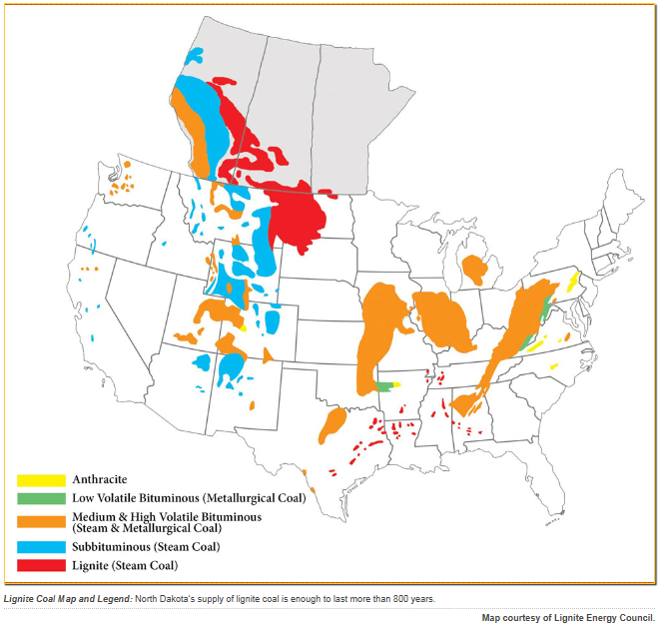
An Integrated Solution: How it Works
North Dakota is rich in the key components to build this integrated platform, and we are developing this integrated energy and carbon solution right now!
25 billion tons of recoverable lignite coal
8 Lignite-fired power plants
Numerous potential locations for CO₂ storage (EOR and deep saline)
>250 MMBBI oil from conventional fields
~4000 MMBBI potential from the Bakken Petroleum System

Slide 10
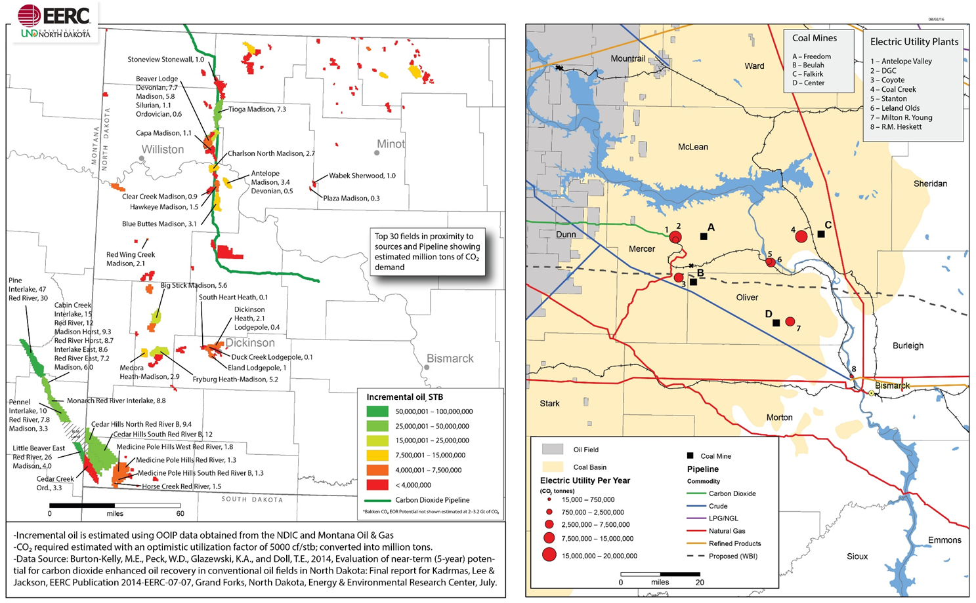
North Dakota – A State of Opportunity
Oil Fields
Coal Plants

Slide 11
An Integrated Solution: How it Looks
1
2
3

Slide 12
Key Components: Technology
A solution for the entire industry is needed. This requires technology applications for:
  The existing coal fleet.
  Coal plant replacements or new additions.
  Our carbon solutions initiative is developing projects on both pathways:
    Existing Fleet – Project Tundra
    New Units – Allam Cycle

Slide 13
Existing Fleet Technology Solution
Project Tundra:
  Carbon capture retrofit to the Young Station in Center, North Dakota.
  Amine/Solvent based technology already demonstrated at a large scale.
  Project enhancements from previous deployments to improve efficiency and reduce cost of capture.
  Strong partnership between ALLETE, Minnkota Power Cooperative, State of North Dakota, U.S. DOE, EERC, and Mitsubishi.

Slide 14
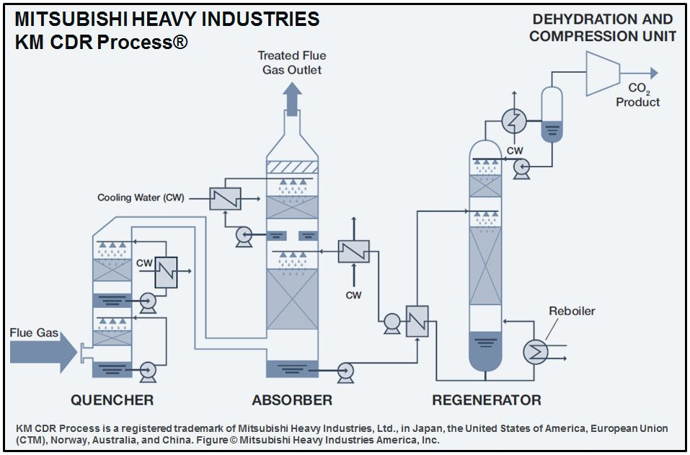
Existing Fleet Technology Solution

Slide 15
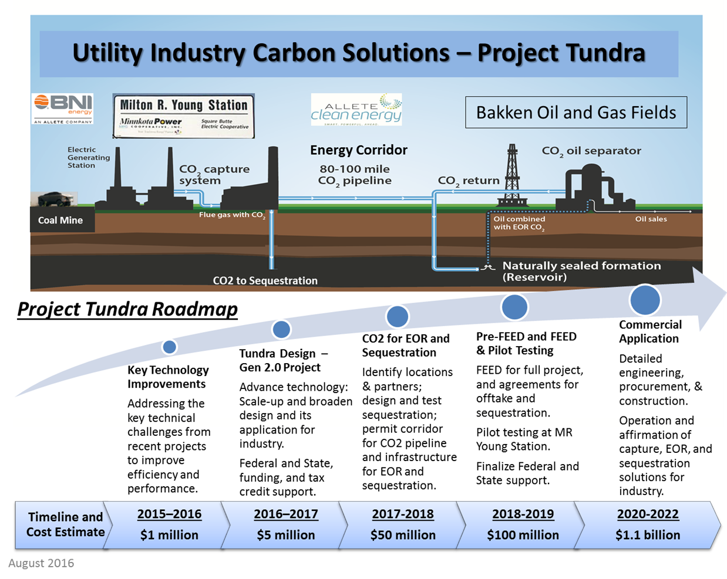
Existing Fleet Technology Solution

Slide 16

New/Replacement Technology Solution
Allam Cycle:
  Transformational technology platform.
  Supercritical CO₂ power cycle.
  Strong partnership between ALLETE, Basin Electric Power Cooperative, State of North Dakota, U.S. DOE, EERC, and 8 Rivers Capital.
Moving
Technology
Forward

Slide 17
Technology Summary: Allam Cycle
Patented, oxy-fuel, high-pressure, supercritical CO₂ cycle invented and developed by 8 Rivers Capital – the Allam Cycle is next generation technology.
Major performance, cost, and environmental benefits vs. existing systems and other new energy system designs.
The turbine is driven by supercritical CO₂.
Near-zero emissions - 100% of the CO₂ available for utilization at pipeline pressures.
Efficiency estimates nearing 50% - 1.4x higher than the U.S. coal fleet average.
Economic Power Generation
  $0.04-$0.05 /kWh with sale of CO₂
  $0.06-$0.07 /kWh without the sale of CO₂
Smaller Footprint - 20% of a traditional coal-based plant.
A new opportunity for truly clean, low-cost, coal power.
Confidential to recipient. Contains the intellectual property of 8 Rivers Capital, LLC and Net Power, LLC

Slide 18
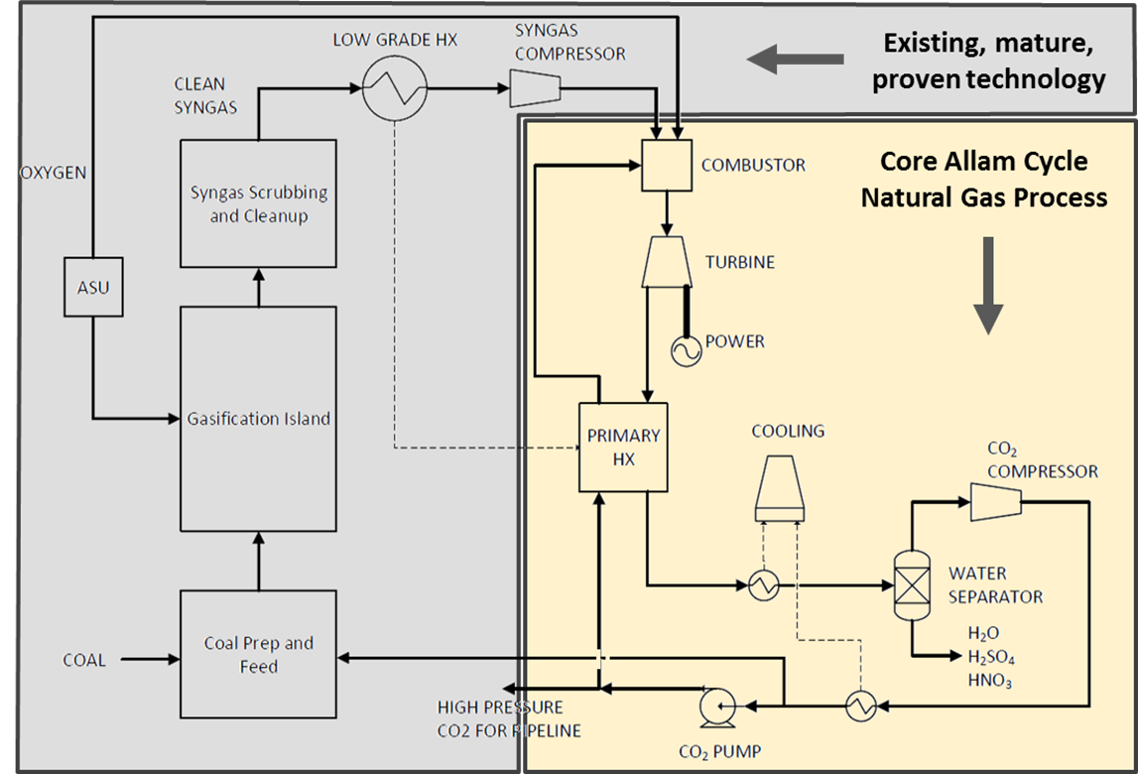
Allam Cycle Process Diagram
Core Power Block (in yellow)
Coal Gasification System (in gray)

Slide 19
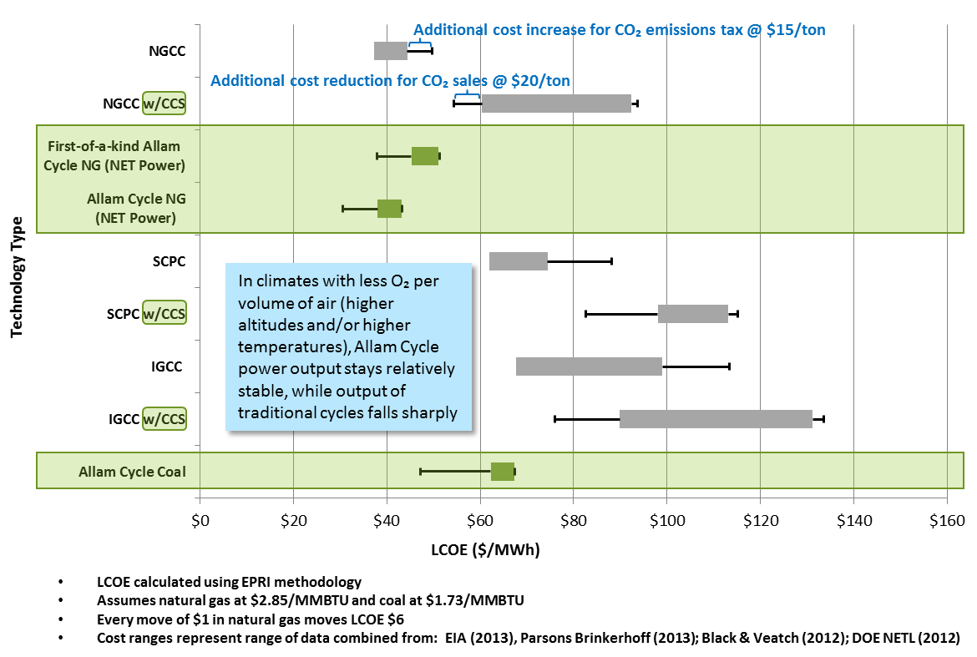
Allam Cycle is Competitive with Traditional Technologies that Don’t Have Carbon Capture
$140 million natural gas Allam Cycle demonstration program underway by NET Power, 8 Rivers, CB&I and Exelon
Confidential to recipient. Contains the intellectual property of 8 Rivers Capital, LLC and Net Power, LLC

Slide 20
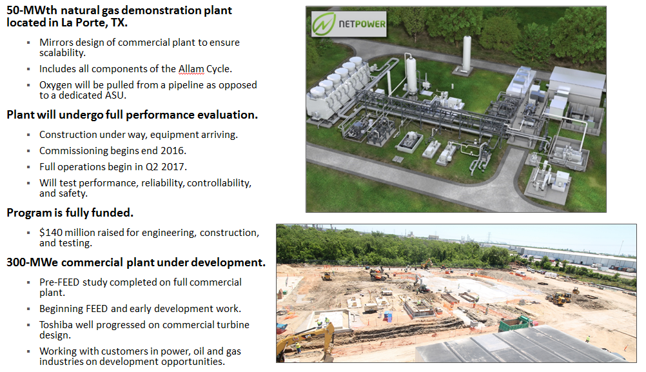
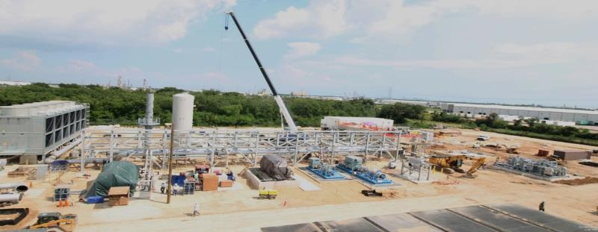
Initial Demonstration Underway
Core natural gas Allam Cycle is being demonstrated by Net Power
Confidential to recipient. Contains the intellectual property of 8 Rivers Capital, LLC and Net Power, LLC

Slide 21
Strong Support for Preserving the Coal Option
Research and development on key challenges has been successfully conducted.
A 25 MWe natural gas-fired demonstration plant is currently being constructed in Texas.
Further development creates a path forward for continued utilization of coal.
Substantial investment already committed from federal, state, industry, and international partners.
  ~ $15 million of coal design, research, and testing work through 2017.
  ~ $140 million of core cycle design, testing, and demonstration.
World-class research and development leaders at the University of North Dakota, Energy & Environmental Research Center.

Slide 22
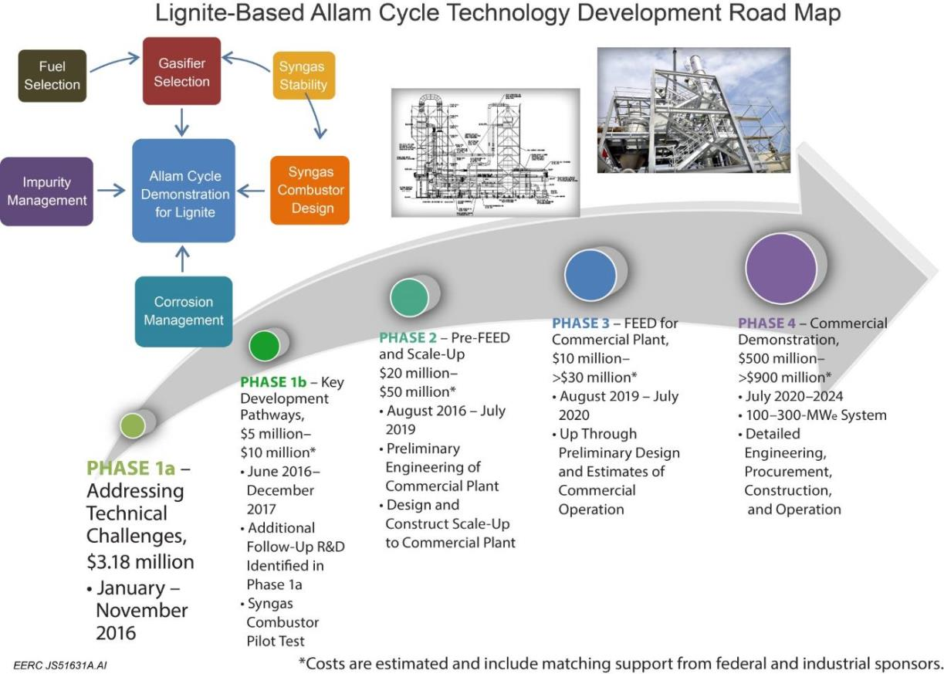
Our Path Forward

Slide 23
Our Integrated Solution
– A Broad Vision –
Demonstrate the existing plant and new technology solutions in North Dakota using local lignite.
Transport CO₂ from electric plants to the Bakken for Enhanced Oil Recovery and storage (in conventional oil fields).
Develop a solution for utilization of the CO₂ in the Bakken Petroleum System (tight oil fields).
A sustainable solution for coal coupled with a sustainable solution for additional oil recovery and CO₂ storage.

Slide 24
Our Integrated Solution
– A Broad Vision –

Slide 25

Carbon Utilization: Much Promise in North Dakota
Through the Plains CO₂ Reduction Partnership
  Extensive investigation into associated storage of CO₂ in the Bell Creek oil field of SE Montana.
    Successful integration of research efforts with an active CO₂ EOR project
    Modeling, dynamic simulation, MVA, 4-D seismic, reservoir saturation logging
    Accurately predicting the movement of CO₂
    Accurately documenting the storage of the CO₂
    Experience readily transferred to other states!
  Regional characterization efforts examined multiple saline formation options for CO₂ storage
    Gigatonnes of storage potential in western North Dakota
      Broom Creek, Deadwood, Inyan Kara, Madison Formations
    Prime formations underlay the lignite-fired power generation facilities

Slide 26
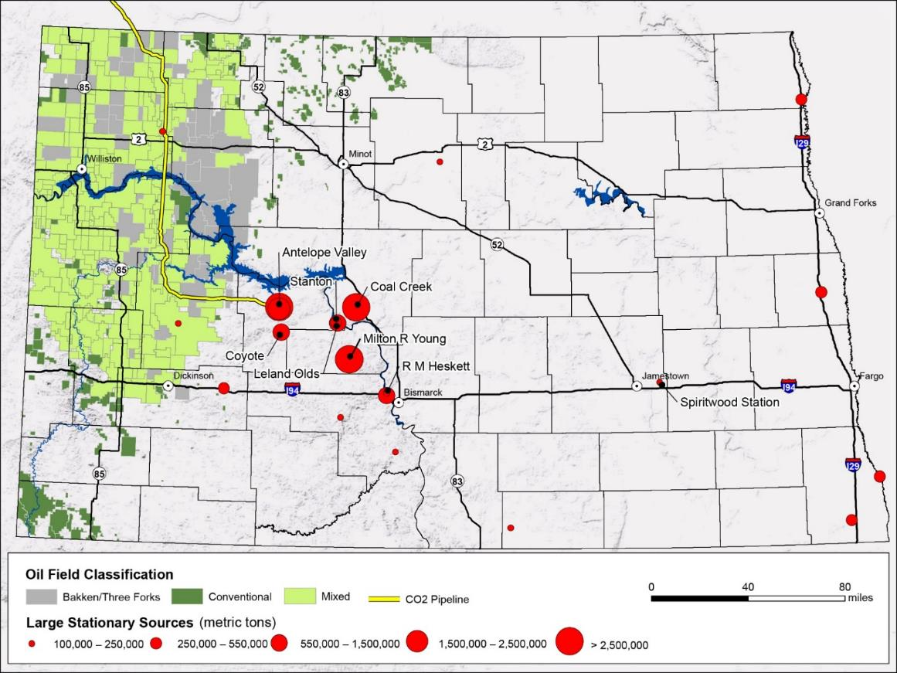
North Dakota Oil Fields

Slide 27
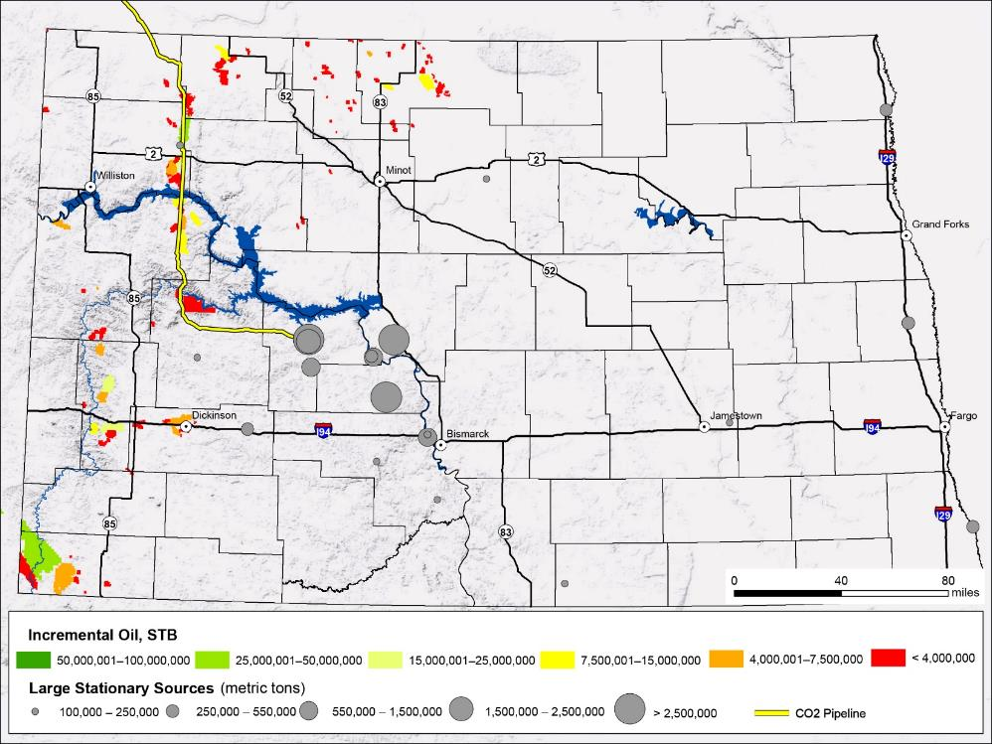
Top Conventional Oil Fields for CO₂ EOR
KLJ (2014) report lists:
  In 86 North Dakota conventional oil fields:
    47 to 283 million metric tons of CO₂ storage.
    280 to 631 million barrels of oil recovered.
Potential to store a decade of North Dakota’s coal-fired CO₂ emissions.

Slide 28
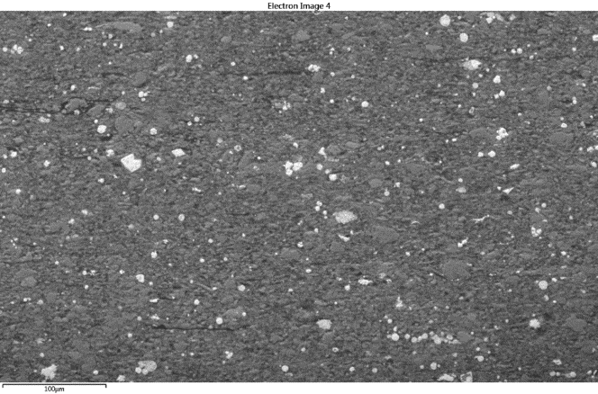
Conventional Sandstone Reservoir vs. Bakken
Muddy Fm Sandstone
(250x)
Middle Bakken Siltstone (250x)
Lower Bakken Shale
(250x)
Black in the images represents pore spaces.
28

Slide 29
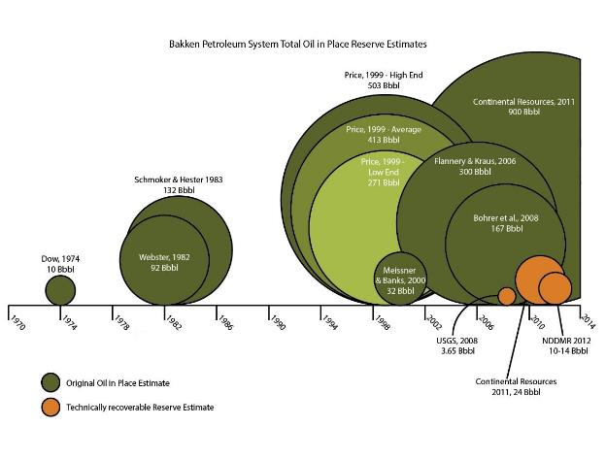
How Do We Get More Out of the Bakken?
The more we understand about the Bakken petroleum system, the more oil we recognize is in it.
Currently, only a 3%–10% recovery factor.
Small improvements in recovery could yield over a billion barrels of oil.
Can carbon dioxide be a game changer in the Bakken?

Slide 30
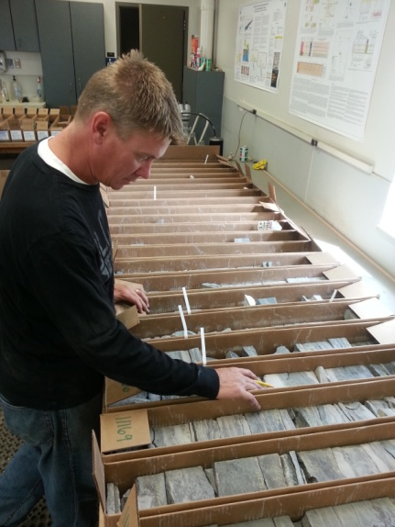
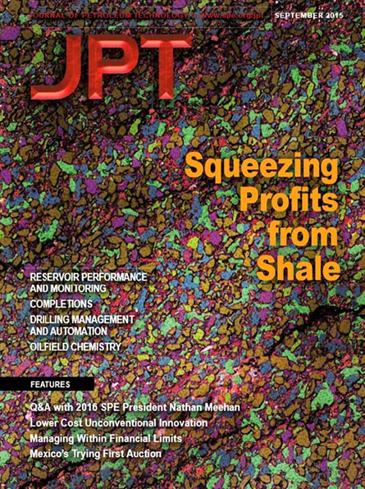
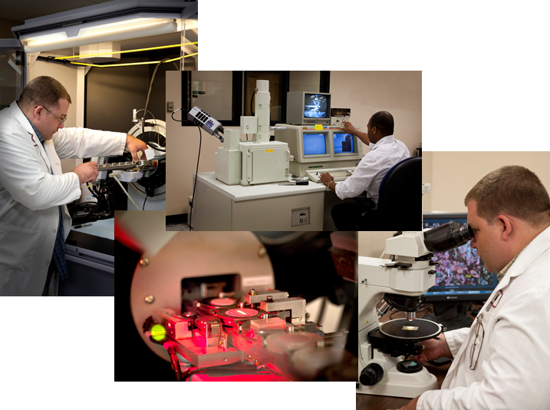
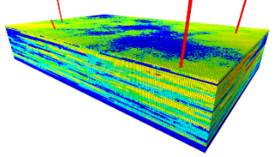
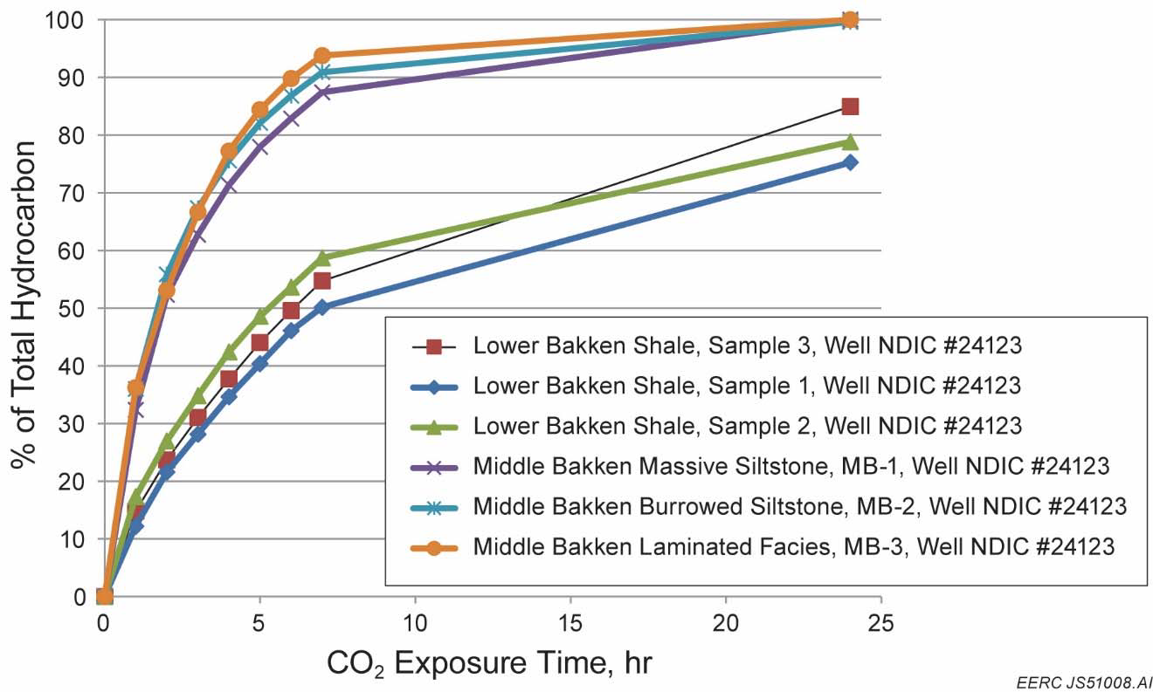
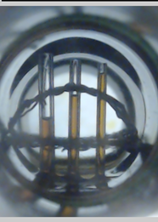
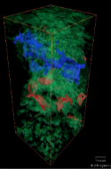
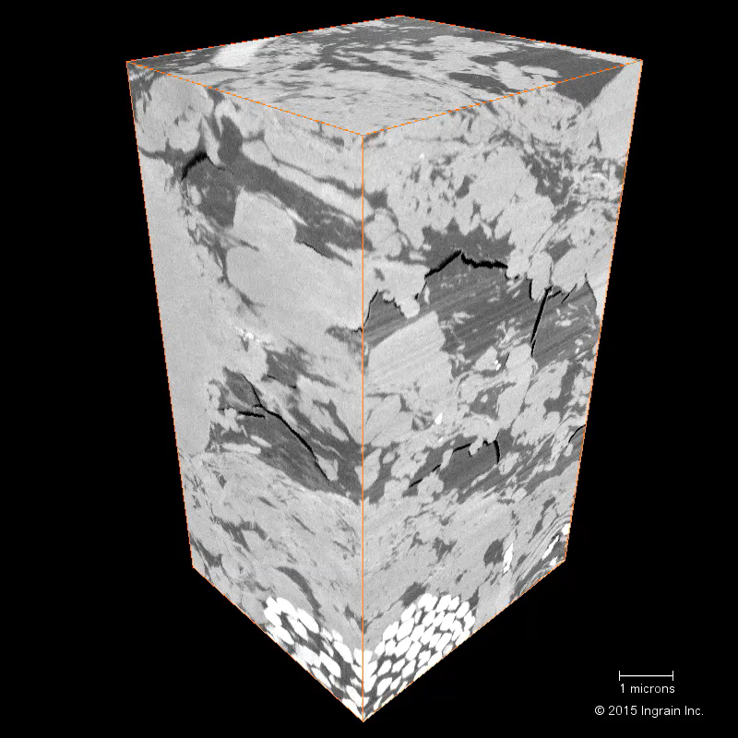

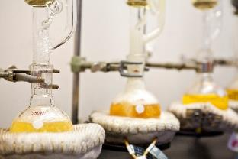
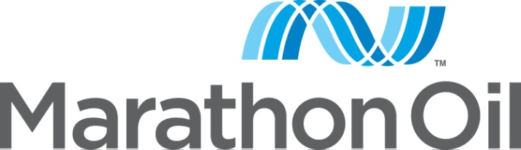
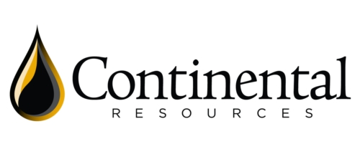




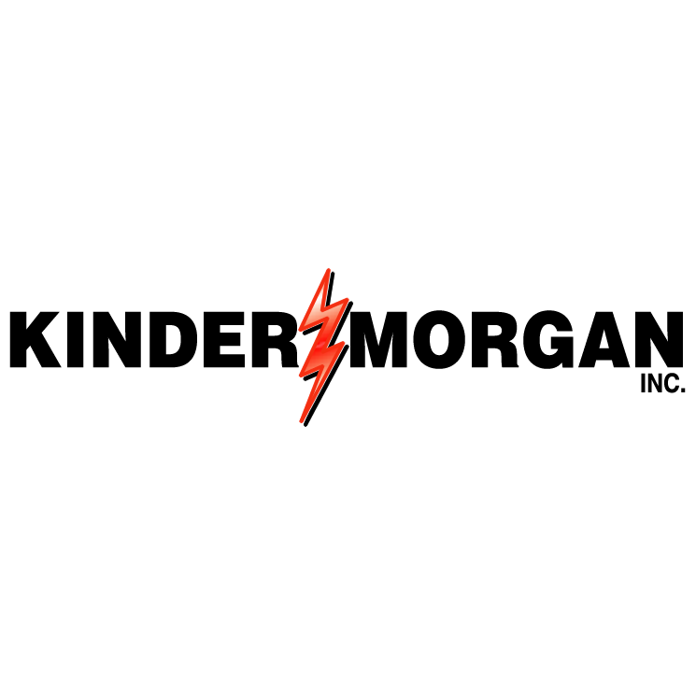

EERC Efforts to Address Bakken EOR Challenges

Slide 31
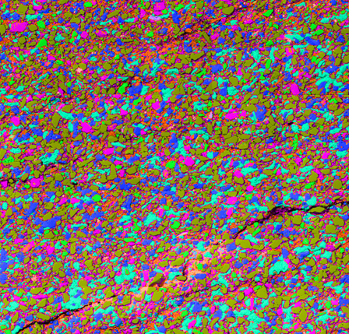
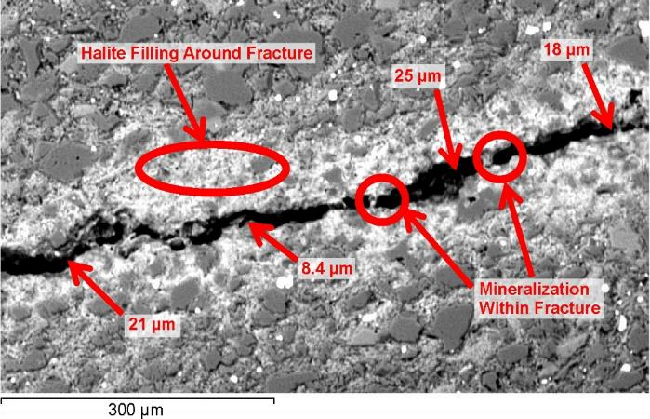
Reservoir Characterization
Key Lessons Learned
Movement of fluids (CO₂ in and oil out) relies on fractures.
Microfractures account for most of the porosity in the productive Bakken zones.
Integration of natural fracture data into modeling are essential to develop effective EOR strategies.
Scanning Electron Microscopy (SEM) Mineral Map of a Middle Bakken Sample (colors represent minerals; black represents porosity)
Microfractures

Slide 32

Bakken CO₂ Demand in North Dakota –
A 30,000-ft View
Based on the following:
  Traditional evaluation techniques
  North Dakota Industrial Commission OOIP (original oil in place) estimates
  4% incremental recovery
  Net utilization of 5000 and 8000 ft³/bbl
2 to 3.2 billion tons of CO₂ needed.
Could represent 50 to 100 years of North Dakota’s current CO₂ emissions from coal-fired power!

Slide 33
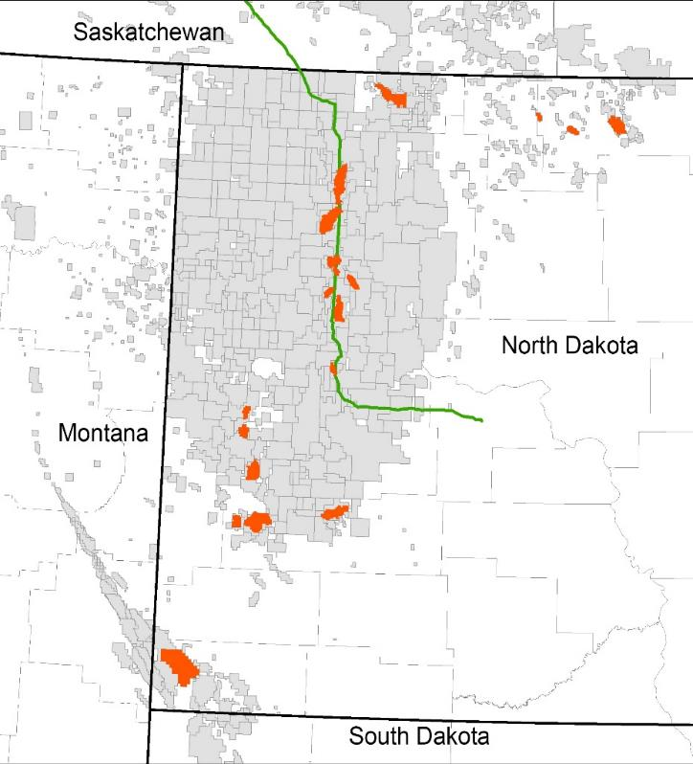
Carbon Utilization: Infrastructure and Needs
One CO₂ pipeline in the region.
  Delivers CO2 to Weyburn-Midale field in Saskatchewan
  Well planned route
  Limited additional capacity
  Souring of the CO₂
Top conventional fields for CO₂ EOR

Slide 34
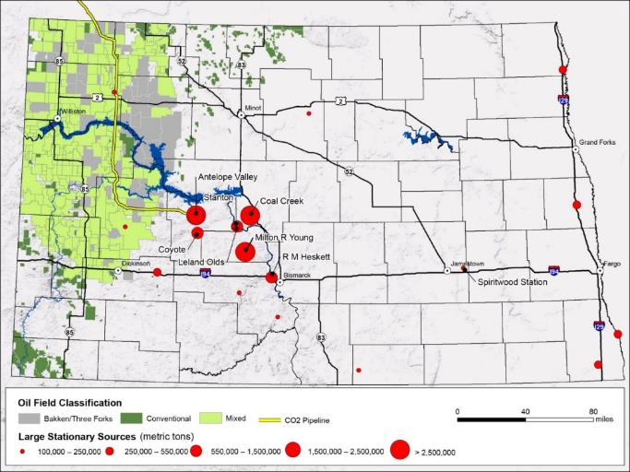
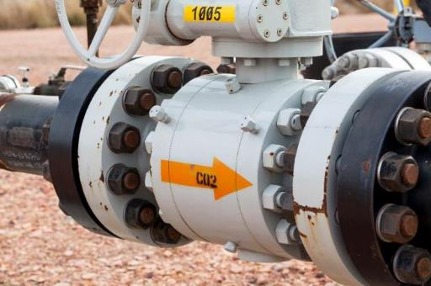
North Dakota – Ideally Suited
North Dakota has an ideal situation for CO₂ management.
  CO₂ emission sources are in close proximity to CO₂ storage targets.
  Between 23 and 78 Gt of storage available within the state between saline formations and oil reservoirs.

Slide 35
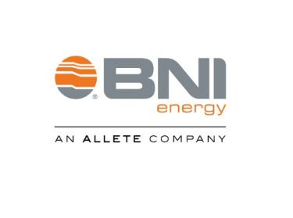
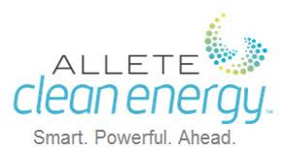

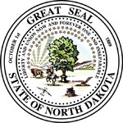







Our Partnerships –
Working Together to Create a Pathway for Carbon Solutions
Energy Industry
Government & Research
Solutions
Technology Industry

Slide 36
Thank You!
Questions?

Slide 37
Contact Information
William Sawyer
Manager, Clean Energy Solutions
ALLETE Clean Energy
John Harju
Vice President for Strategic Partnerships
University of North Dakota Energy & Environmental Research Center

