Slide 1
Welcome!
Bridging Waters: A Model for Enhancing Grid Reliability and River Restoration during the Energy Transition

Slide 2
Mark W. Menezes
USEA President and CEO

Slide 3
Malcolm Woolf
NHA President and CEO

Slide 4
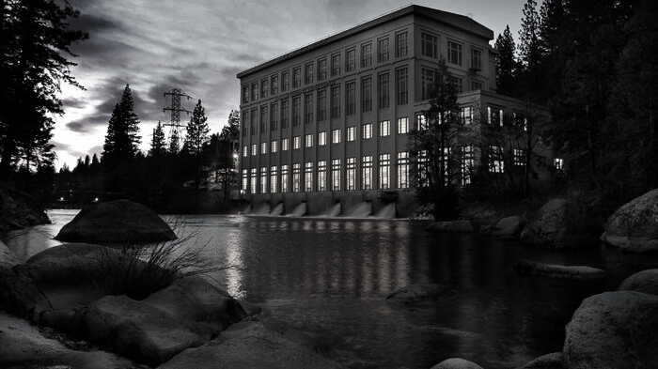
Intro to Hydropower
Provides power to roughly 30 million+ Americans
About 30% of U.S. renewable energy
96% of current U.S. electricity storage capacity
80 GW of hydropower capacity
22 GW of pumped storage hydropower capacity
Globally produces more electricity than all other forms of renewables combined

Slide 5
Reason #1 to Fall in Love With Hydro Again:
It Keeps the Lights On
As demand for electricity grows, hydropower and Pumped Storage provide 100 GWs of dispatchable, baseload generation.

Slide 6
Reason #2 to Fall in Love
With Hydro Again: Grid Reliability

Slide 7
Reason #3 to Fall in Love With Hydro Again:
Carbon Mitigation

Slide 8
Growth Opportunities Using Existing Infrastructure
As of 2023, the U.S. hydropower development pipeline included:
96 PSH projects with a combined power storage capacity of 91 GW
117 new facilities with a combined capacity of 1.2 GW
23 active upgrade projects, which would increase the capacity of the existing feet by 254 MW

Slide 9
Current Challenges
Lack of federal tax parity for existing hydropower (S.2994, H.R. 6653)
Antiquated licensing process (S.1521,
H.R. 4045)
Market design
failures

Slide 10
Potential Wave of Retirements
Licenses for 459 hydropower facilities, representing 17GWs, are set to expire by 2035.
Relicensing takes, on average, 7.6 years to complete, but often much longer.
Relicensing requires millions of dollars of paperwork and potentially hundreds of millions in project upgrades.
Survey: 36.4% of hydropower industry asset owners said that they were “actively considering” decommissioning a facility.

Slide 11
Not Your Grandfather’s Hydropower

Slide 12
Thank you!
Click here for more info on NHA’s digital ad campaign.

Slide 13
Bridging Waters: A Model for Enhancing Grid Reliability and River Restoration during the Energy Transition
Matthew Grosso, Acting Director
Water Power Technologies Office, U.S. Department of Energy
July 18, 2024

Slide 14
WPTO and the Uncommon Dialogue
WPTO and National Lab staff serve as observers to the Uncommon Dialogue work
Support specific research questions

Slide 15
“Stakeholder Insight Into Hydropower R&D Issues” Funding Opportunity Announcement
Spring 2023: American Rivers selected to develop tools and documents that provide insights and recommendations on
Dam Safety
Inclusive Workforce
Licensing
Fleet Modernization
Reservoir Emissions
Aims to deepen relationships and trust between hydropower and river stakeholders to better integrate community priorities into hydropower R&D activities.

Slide 16
Hydropower Vision and Roadmap
Hydropower Vision:
Released in 2016
Hydropower’s role in a clean energy future and a roadmap to get there by 2050
Roadmap:
Reimagined in 2023
Offers a holistic view of hydropower and its community’s needs
WPTO’s Hydropower Program strategy identifies R&D activities that are appropriate for DOE to support over the next decade and aligned with the opportunities identified in the Vision and objectives of the Roadmap.

Slide 17
NPD HYDRO
Developed to analyze the feasibility of retrofitting existing non-powered dams (NPDs) with generation and energy storage technologies.
Goals
Identify retrofit opportunities
Prioritize opportunities
Increase hydropower’s role in the clean energy grid

Slide 18
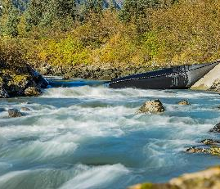
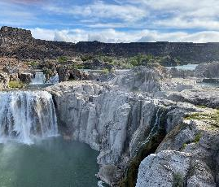
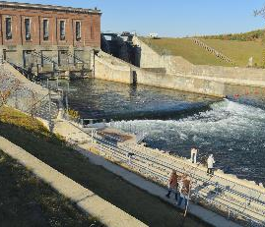
Hydropower Testing Network (HyTN)
Phase 1
Phase 2
Phase 3
Testing Facility Solicitation:
Interested facilities should submit applications by
August 8, 2024.
Technology Developer Selection and
Matchmaking:
Expected to open in fall 2024.
Project Execution:
Developers will determine the scope of work and
begin contract.

Slide 19
Pumped Storage Hydropower (PSH) – Project Successes
Pumped Storage Hydropower Valuation Tool (PSHVT)
Provides step-by-step valuation guidance for PSH developers, plant owners or operators, and other stakeholders to assess the value of existing or potential new PSH plants and their services.
Grand River Dam Authority Technical Assistance
Assistance from Argonne and Idaho National Labs
Evaluates batteries and modern technological upgrades and determine grid benefits and return on investment
Quidnet Geomechanical Pumped Storage System
Involves pumping water between rock layers to be kept under pressure until released through a hydroelectric turbine.

Slide 20
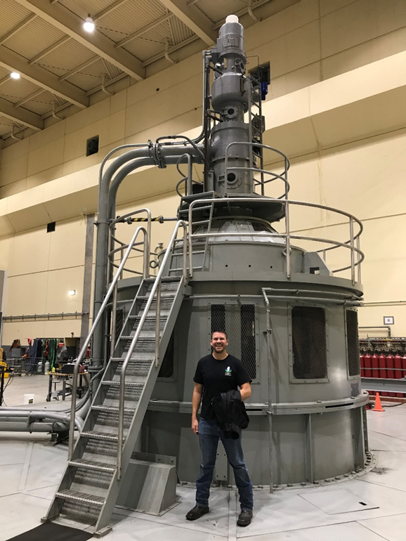
HydroWIRES: Future Work and New Priorities
Technology Gaps
Work with Fleet Modernization to identify new technologies where funding could develop the conventional fleet.
Unit Flexibility Enhancement
Leverage insights from FOA to determine what conventional plant technologies need further focus and funding.
Plant Flexibility Enhancement
Demonstrate hybrids, which is a significant opportunity for industry impact.
New PSH Approaches
Continue to provide opportunities for innovation and ingenuity in new PSH.

Slide 21
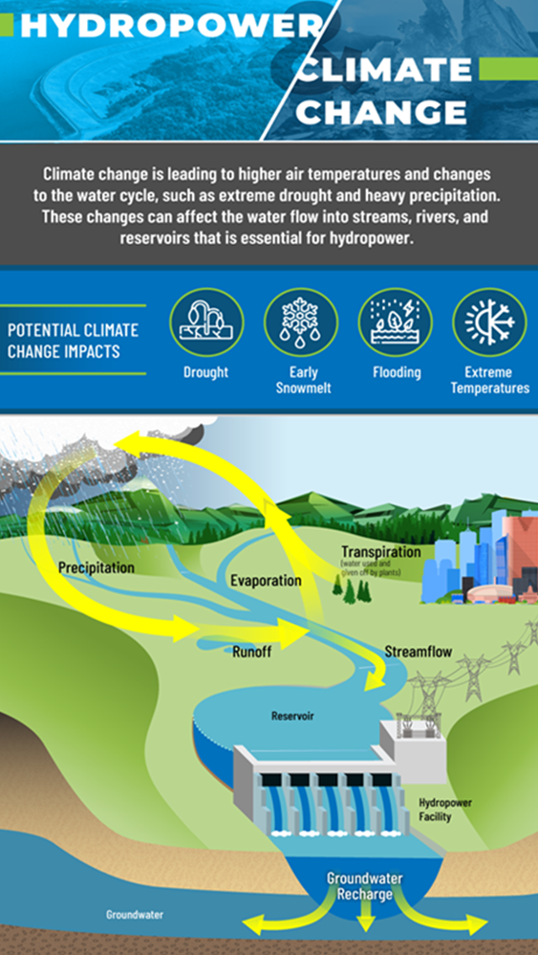
Carbon Sequestration and Emissions from Reservoirs
WPTO Funded Research - Oak Ridge National Laboratory (ORNL) staff identified several limitations in the current accounting practices and recommended improvements for future evaluations.
Fixing these problems is essential for strengthening and maintaining a clean electric grid.
Recommendations involve contextualizing reservoirs and emissions, broadening datasets, incorporating time scale factors, and evaluating hydropower's advantages in the electricity portfolio against potential emission impacts.
Greenhouse Gas emissions can occur naturally, it is important to distinguish what fraction of GHG releases can be attributed to hydropower reservoirs.

Slide 22
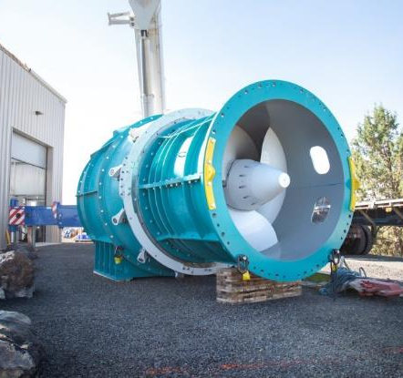
Fish Passage Infrastructure Success
R&D to Improve Environmental Performance Improving understanding of fish movement, habitat use, and survival through the development of advanced monitoring technologies, relevant metrics, and other impact assessment tools.
Natel Energy - Developed a solution validated by Pacific Northwest National Laboratory
Goal: make it easier for fish to navigate through hydropower facilities
Natel Energy's Restoration Hydro Turbine (RHT)
Image from Natel Energy.

Slide 23
Fish Tracking and Monitoring
Fish Tags and Sensors
Evaluate how fish move near hydroelectric dams, injuries, responses to changes in water pressure, temperature, etc.
Environmental DNA and RNA
Comparing genetic signatures of fish found in water samples to visual counts of fish at fish passage viewing windows, allows teams to identify species and estimate the number of fish moving through a fish passage with 98% accuracy.
Collecting and sampling eDNA and eRNA from waterways both outside hydropower facilities and within fish passages offers a reliable, cost-saving method of fulfilling legal requirements and safeguarding aquatic species.

Slide 24
energy.gov/water
Scan the QR code to sign up for our newsletters!

Slide 25
Environmental Perspective on Hydropower Development and Community Engagement
Kelly Catlett, J.D.
Director, Hydropower Reform

Slide 26
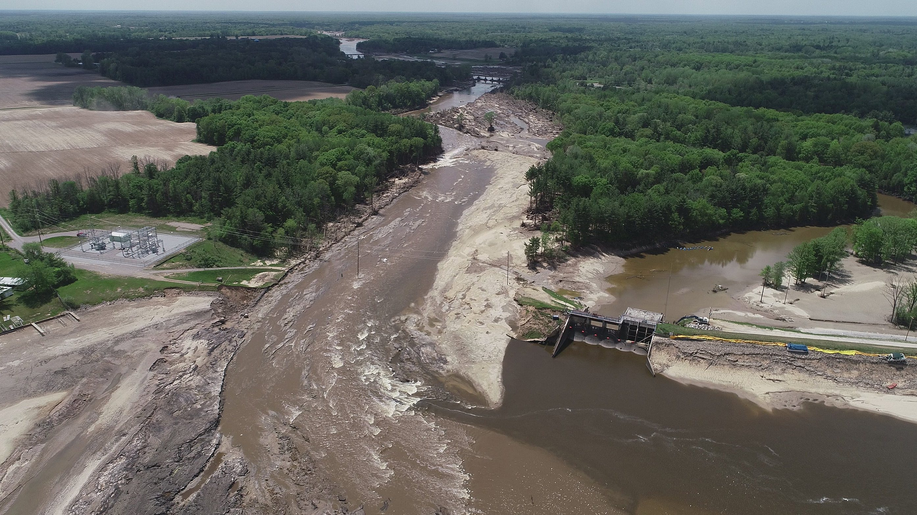
Climate Challenge
1980-2023 US averaged 8.5 climate/weather disaster events.
Most recent 5-year average (2019-2023) US experienced 20.4 events.
Placing strain on aging dams and creating public safety concerns for communities nearby.

Slide 27
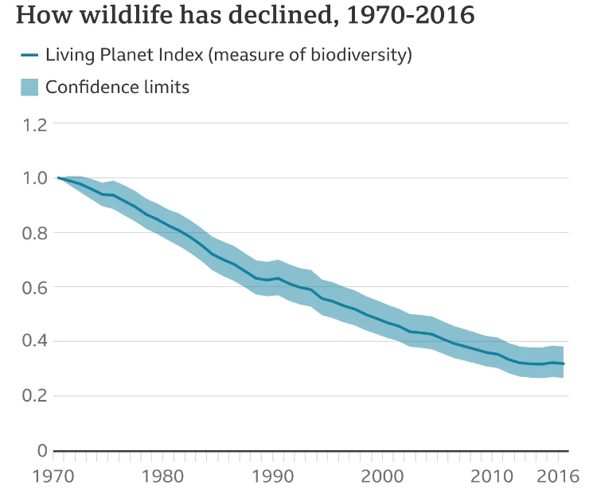
Biodiversity Challenge
Since 1970, there has been an 84% decline in the populations of freshwater species.
Freshwater ecosystems are declining twice as fast as their terrestrial and ocean counterparts.
When dams are improperly sited or lack functional fish passage, they can contribute to the factors causing biodiversity loss.

Slide 28
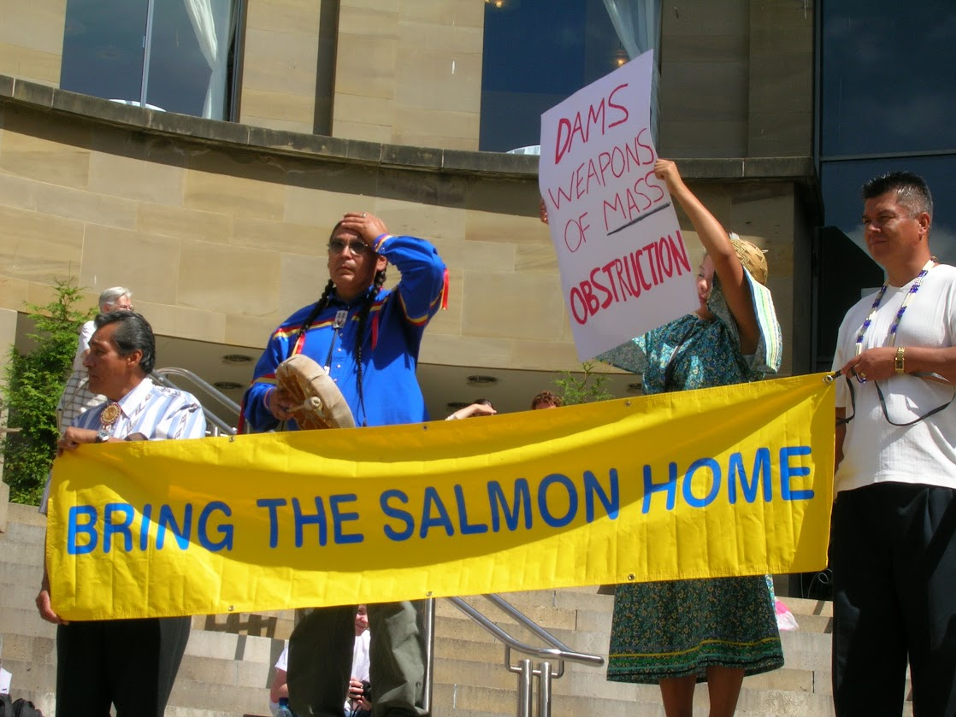
Racial Justice Challenge
Infrastructure development in the 20th C. had profound impacts on rural and indigenous communities.
Hydropower development and licensing ignored tribal treaty rights, overlooked tribal interests and perspectives, and damaged indigenous lifeways.
Many Tribes impacted by hydropower development do not receive any benefit (electricity, jobs, etc.) from the projects in their communities.

Slide 29
The Future of Hydropower Development
Era of building lots of new dams on rivers is over.
Need storage and additional generation from existing dams.
Design to avoid impacts to aquatic ecosystems and communities.
Do not repeat the development mistakes of the past.
But how?

Slide 30
Community Engagement!
Outreach and engagement is essential.
Without it, opposition can kill a project.
Broad support and Bipartisanship is the only way to get policy change through a closely divided Congress.

Slide 31
Uncommon Dialogue
Hydro Industry, Environmental NGOs, some Tribal participants.
Conversation built understanding, open communication, and trust.
Found common ground.
Working together to encourage environmental mitigation, strengthen dam safety rules, and repair and retrofit dams with more generation.

Slide 32
Lessons Learned
Listen- don’t use community engagement to convince others that you are right.
Do more than the minimum- don’t just check a box.
Build engagement into your timeline.

Slide 34
Mary Pavel
Partner, Sonosky, Chambers, Sachse, Enderson & Perry LLP

Slide 35
Questions?

