Slide 1
CREATING TOMORROW`S SOLUTIONS
WACKER:
WORLD’S LEADING SEMICONDUCTOR AND SOLAR POLYSILICON MANUFACTURER
Greg Brabec
Head of Government Affairs, WACKER Polysilicon North America
February 2024

Slide 2
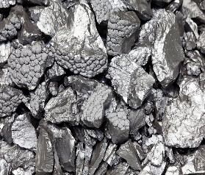


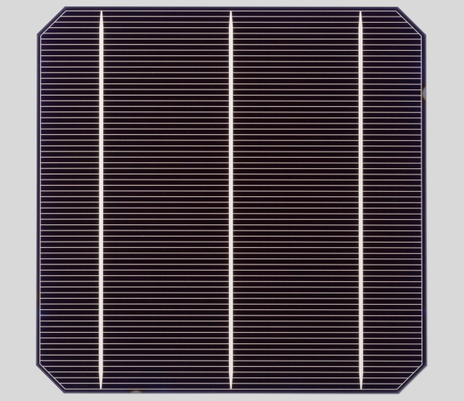
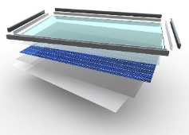

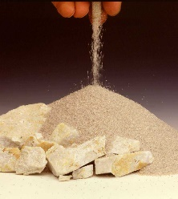
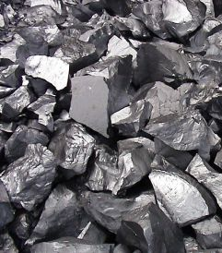
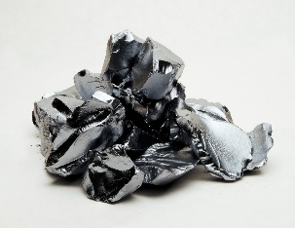
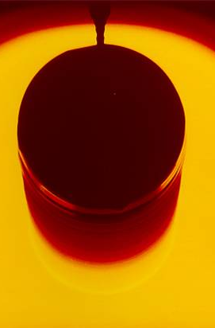

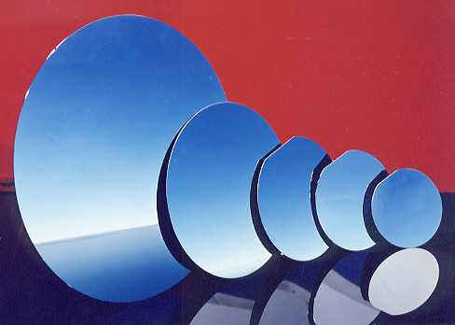
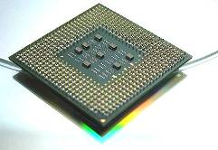

Polysilicon – The Essential Base Material for Semiconductors and Solar Panels
PV value chain
Polysilicon purity: 99,9999999% (9N+)
Polysilicon
Wafer
Ingot / Wafer
Cells
Module
System
Si-Metall
(99%)
Wafer
Quartz
(SiO₂)
Polysilicon
Ingot/Wafer
Chip
End-user
devices
Semiconductor value chain
Polysilicon purity: 99,999999999% (11N+)

Slide 3
POLYSILICON Is Represented Globally with 3 Production Sites
80KT =
Western Leader
All Non-China Manufacturing: ~180KT total
Office Locations, Sites and Nameplate Capacities*
40KT
WACKER is:
* World’s Largest Semiconductor Polysilicon Manufacturer
* World’s Largest Solar Polysilicon Manufacturer (outside China)
20KT
20KT
Nünchritz
Burghausen
Charleston
Production site and head office
Production site
* in metric tons per year

Slide 4
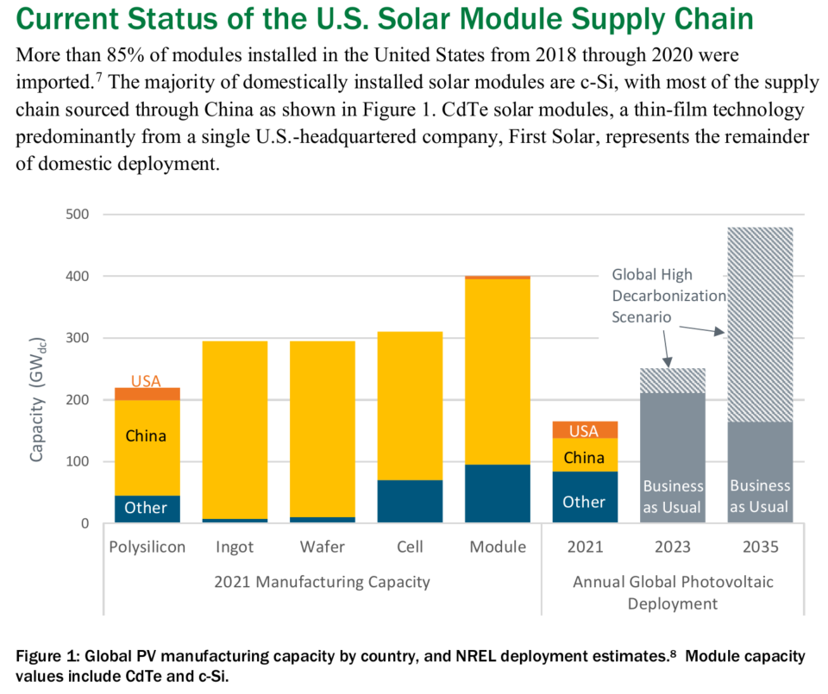
DOE Office of Energy Efficiency & Renewable Energy:
Building a Bridge to a More Robust and Secure Solar Energy Supply Chain

Slide 5
Tipping Point in 2022 – New Era of Solar Growth Expected Globally
Opportunity: Huge Growth Market
  Market Dynamics
  Solar lowest cost electricity source
  Urgent need to decarbonize our societies
  Substitution of fossil-based electricity generation
  Electrification of heating / transport / industry
  Global spread of Photovoltaics
Solar Market Development (GW)
~10200*
~8500*
~7400*
~6300*
~950*
Source: GB-P analysis; *) cumulated PV capacity

Slide 6
Relevant Topics
Solar only presently represents ~5% of overall US energy consumption
Solar is the cheapest form of energy, global deployment expected to increase significantly
Polysilicon as an Energy User → And key foundational component of Utility Solar Panels
COVID / UFLPA / Political Actions Impacts on Supply Chain Risk and Energy Independence

Slide 7
Backup / Questions

